Slide 1


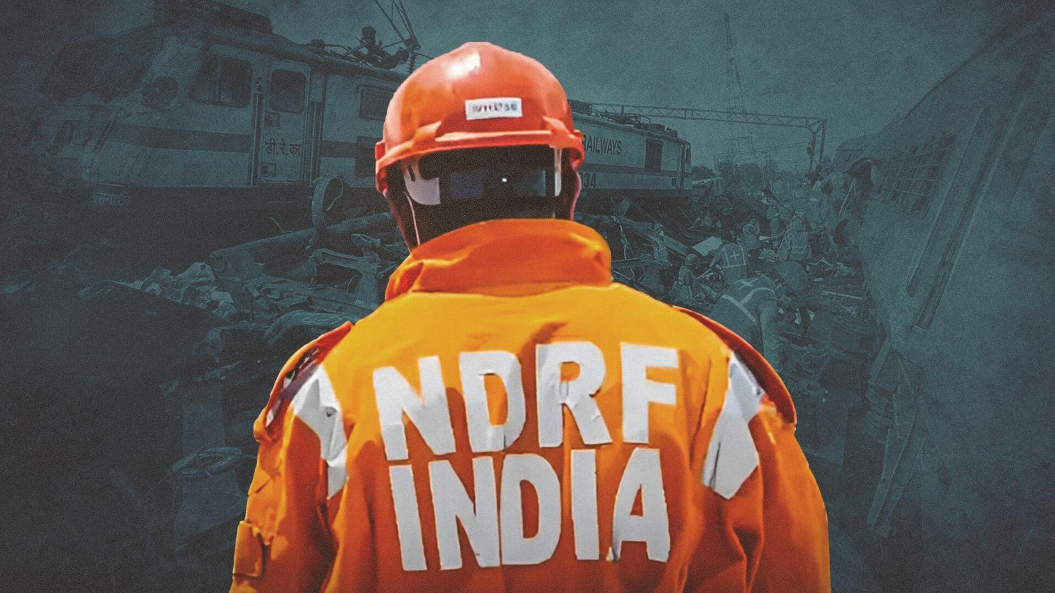


CADRE
Lesson 9
WATER EMERGENCIES

Slide 2



OBJECTIVES
List at least 5 common water emergencies
Demonstrate 6 knots used for joining and securing
Demonstrate the 2 types of extension assist taught in the CADRE course.
Demonstrate how to wade through moving (shallow) water.
1
Upon completion of this lesson, you will be able to :-
2
3
4

Slide 3


Drowning may happen in a large water source, such as a lake, river or swimming pool.
…But drowning may also occur in different water sources, from the biggest ocean to the smallest puddle.
WATER EMERGENCIES

Slide 4
Drowning
Diving in shallow water
Man overboard
Hypothermia
Electrocution
Animal Bites
Soft tissue injuries
COMMON WATER EMERGENCIES

Slide 5
Heavy rains – caused by seasonal or environmental factors
Dam failure
Strong current
Accident
Boat accidents or capsized boat
Live electric outlet in homes
CAUSES

Slide 6
Low head dam/hydraulics
Strainers
Floating debris
Foot entrapment
Stationary objects
WATER HAZARDS

Slide 7
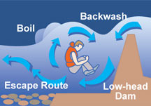
LOW HEAD DAMS

Slide 8
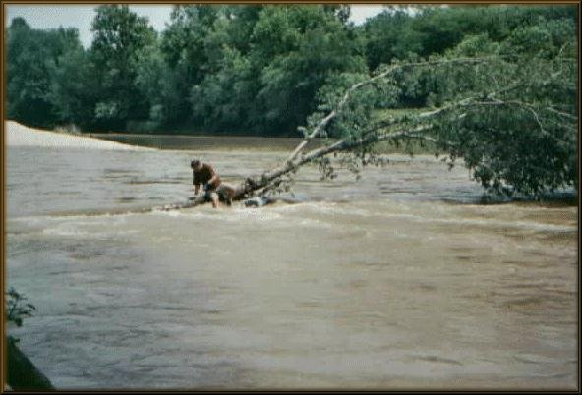
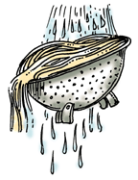
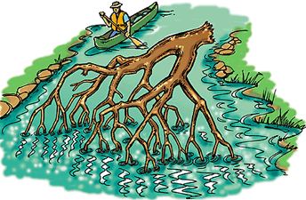
Strainer

Slide 9
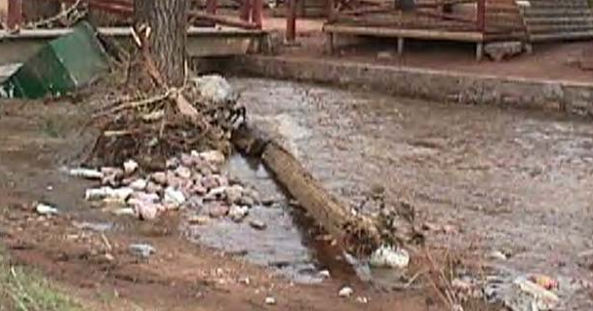
Floating Debris

Slide 10
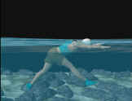
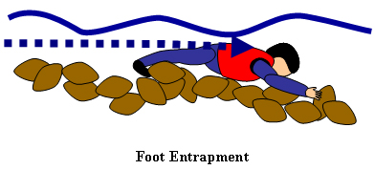
Foot Entrapment

Slide 11
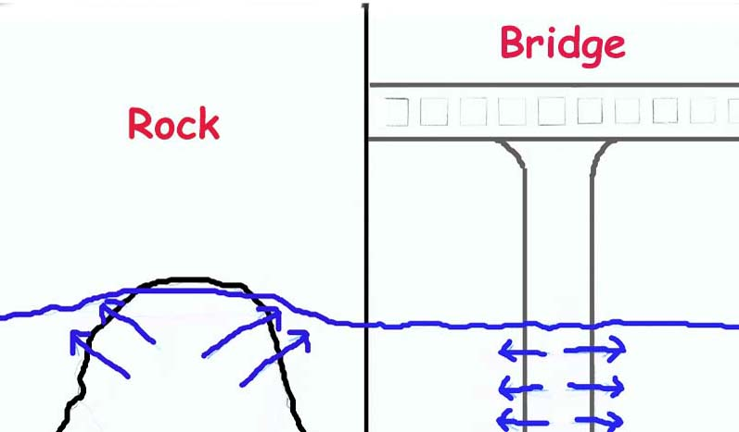
Stationary Objects

Slide 12
Panicked swimmers
Contaminated water
Hypothermia
Dehydration
WATER HAZARDS

Slide 13
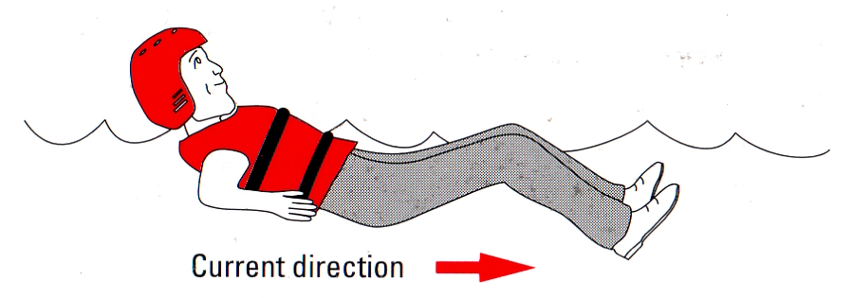
Floating
Open water
Swift water
Flood water
Safe/Defensive Swimming Position
Survival

Slide 14
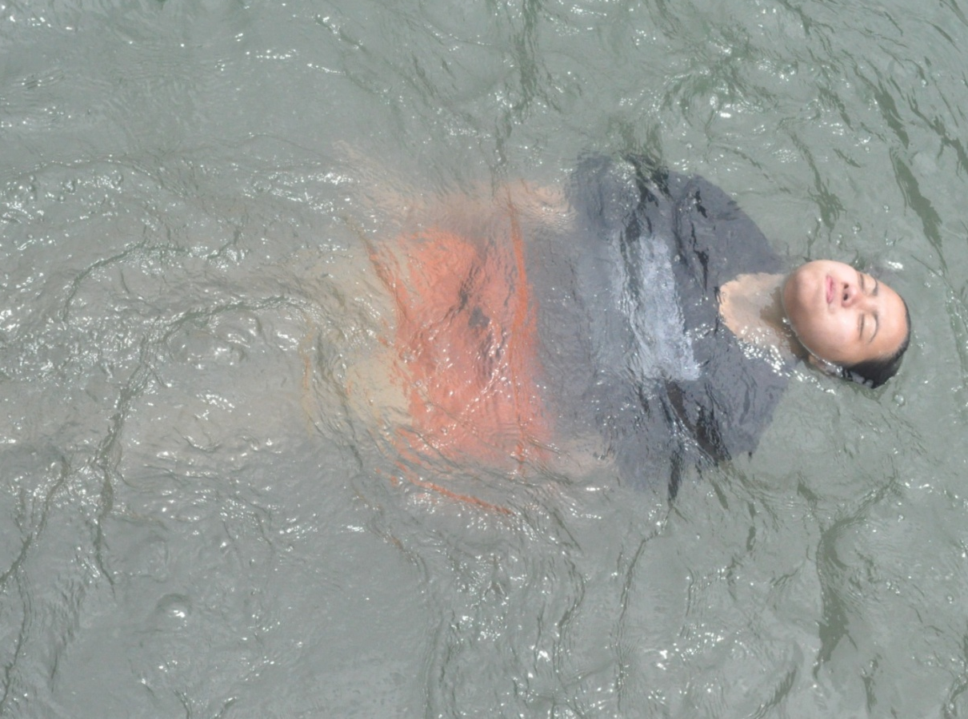
BACK FLOAT

Slide 15
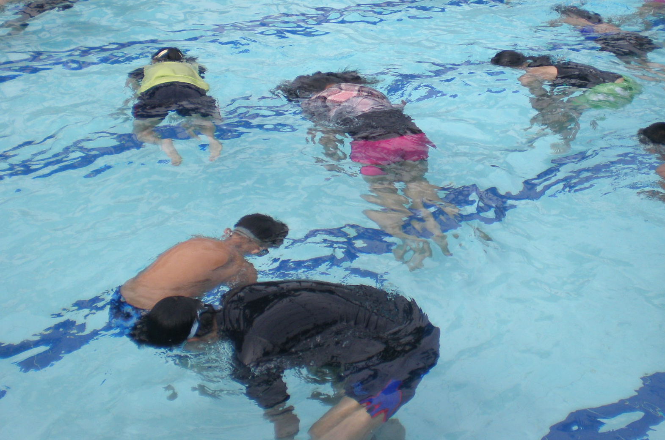
JELLYFISH FLOAT

Slide 16
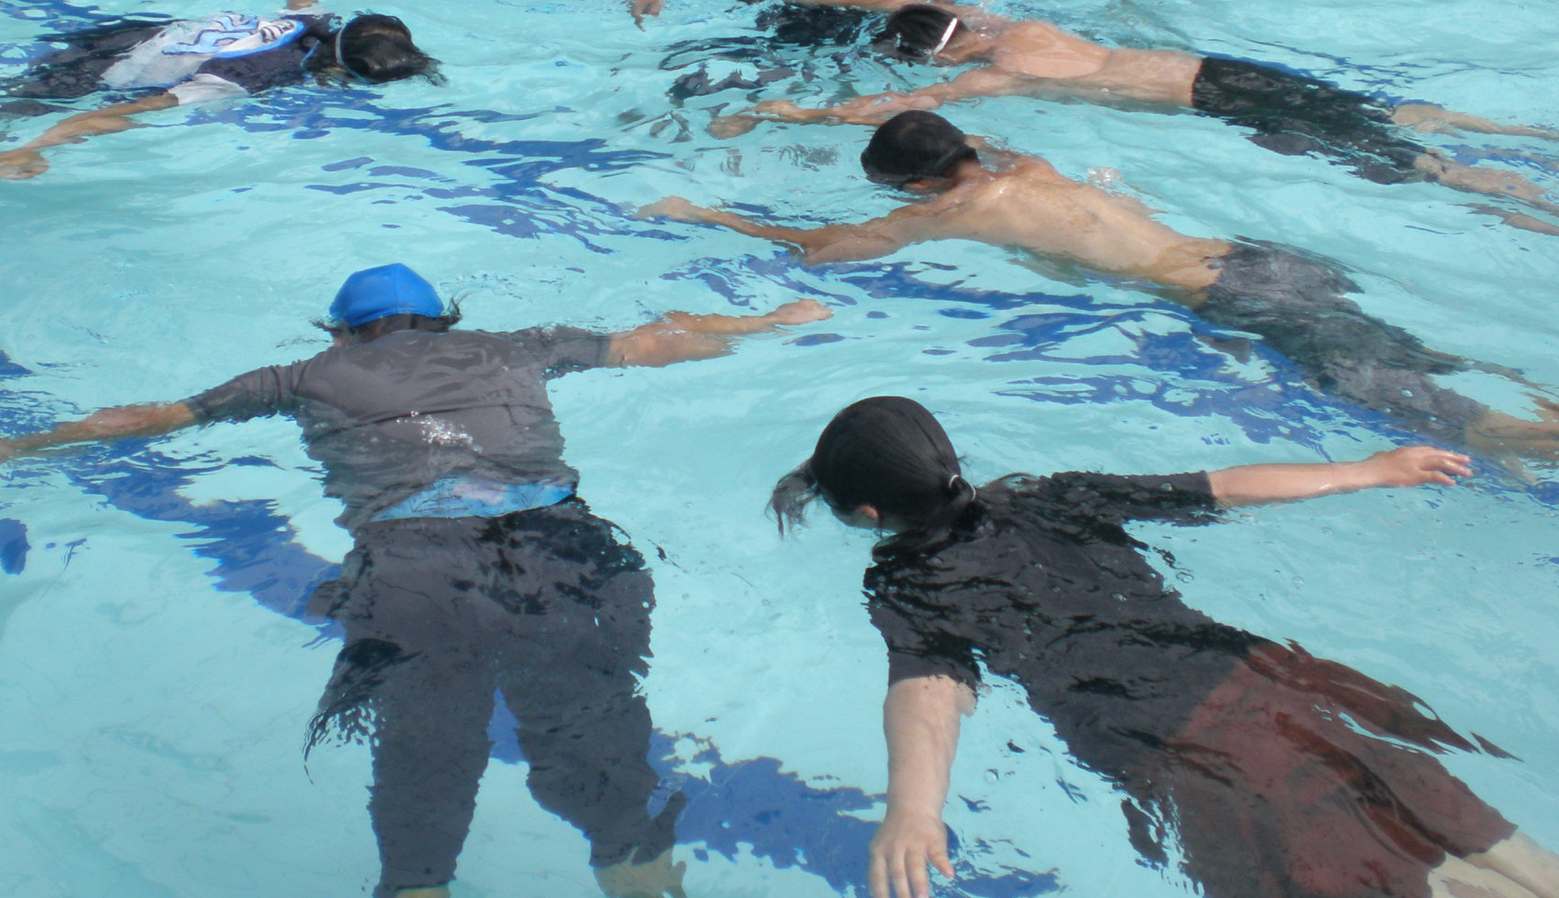
PRONE/DEAD MAN FLOAT

Slide 17
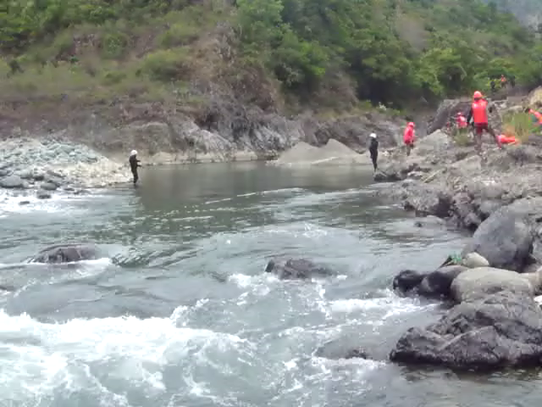
Defensive Swimming Position

Slide 18
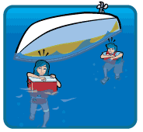
Life Vest / Personal Floatation Device
Ring buoy
Water container
Tire Interior Tube
Styropore /Styrofoam box
Surfboard
Floating wood / lumber?
PFD & IMPROVISED FLOATATION DEVICE

Slide 19
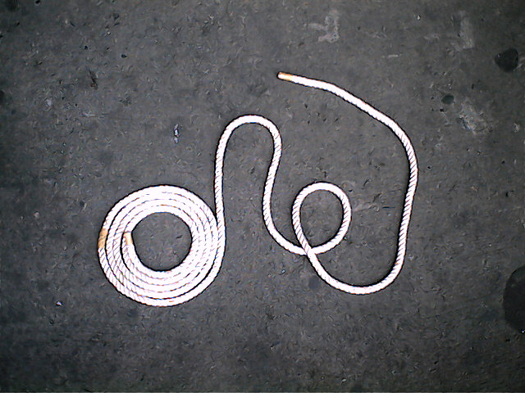
Bight
Bight
Working end
Working end
PARTS OF THE ROPE
Standing part
Standing end
Loop
Loop
Coil
Coil

Slide 20
Square knot / Reef knot
Figure of eight bend
Sheet Bend
Clove hitch
Bowline
Body Bowline/Double Bowline
BASIC KNOTS

Slide 21
Use the fastest and most direct route to get to a distressed swimmer.
Have available and use floatation device.
Have rescue equipment, keep it handy, and know how to use it.
Steps of a Water Based Rescue

Slide 22
DO: Reach to assist or throw a rope.
DON’T: Whatever you do, don't become the next victim when trying to help a drowning person.
DO & DON’T

Slide 23
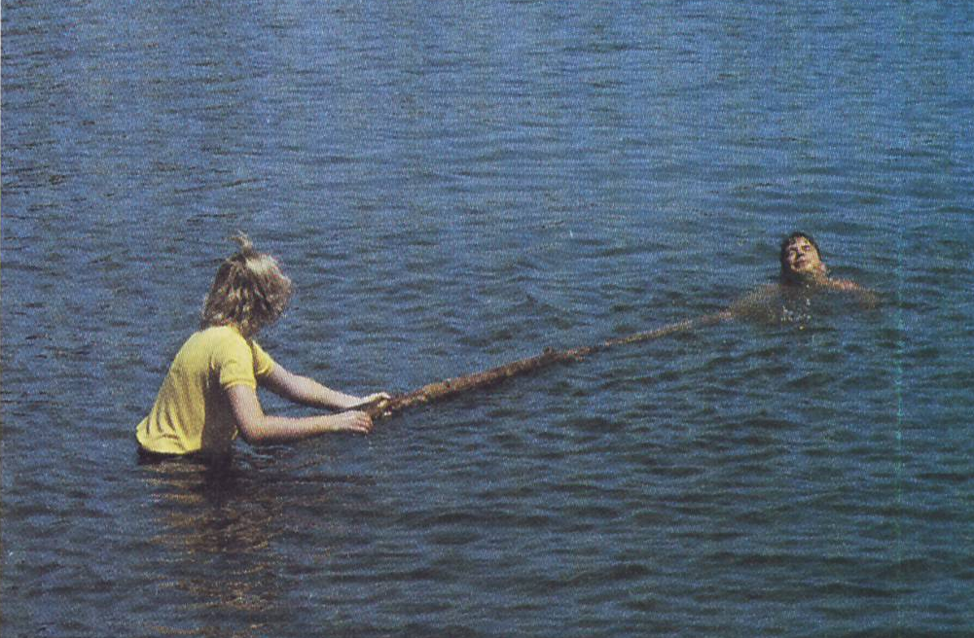
REACH – The easiest and most desirable form of rescue is to reach out or extend an object to the person in trouble.
EXTENSION ASSIST

Slide 24
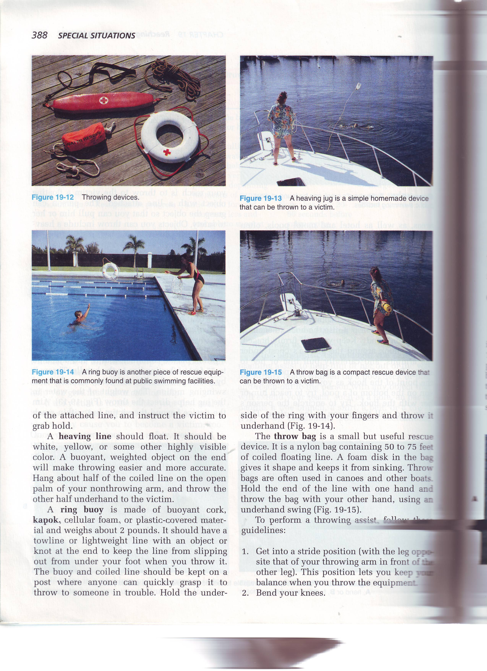
2. THROW and TOW – if the victim is too far away to reach with anything, you may be able to use this rescue technique to provide assistance.
EXTENSION ASSIST

Slide 25


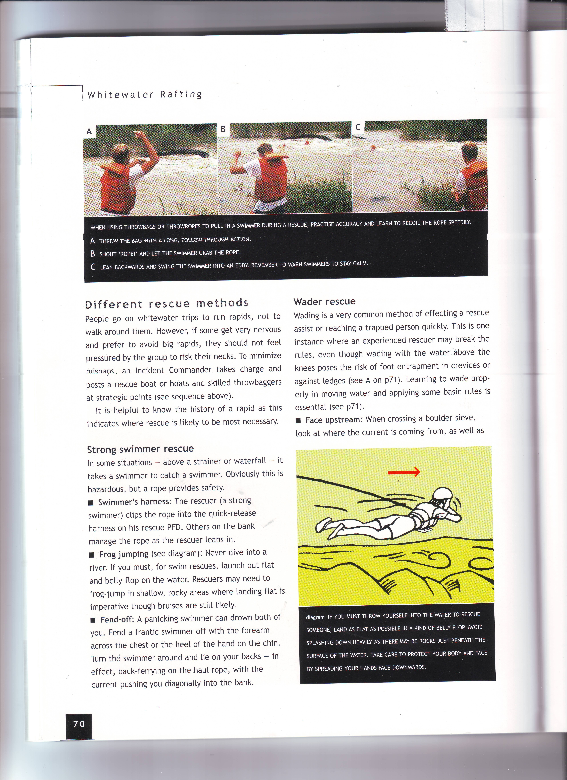

Slide 26
Remember always: REACH, THROW, but only GO with training and equipment.

Slide 27
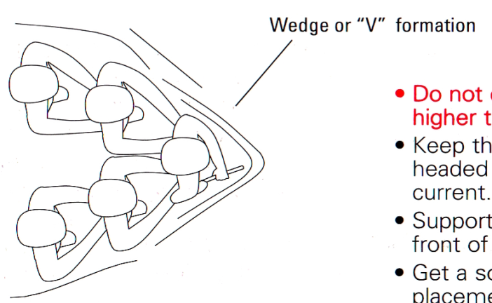
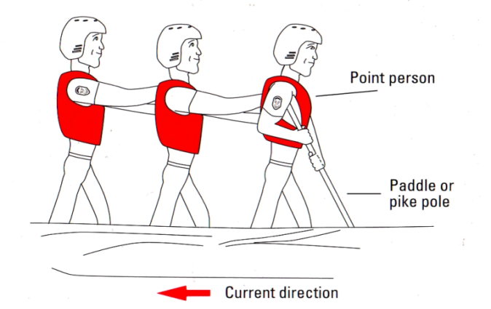
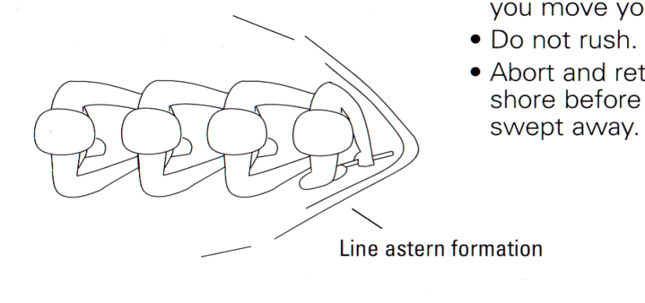
SHALLOW WATER CROSSING

Slide 28
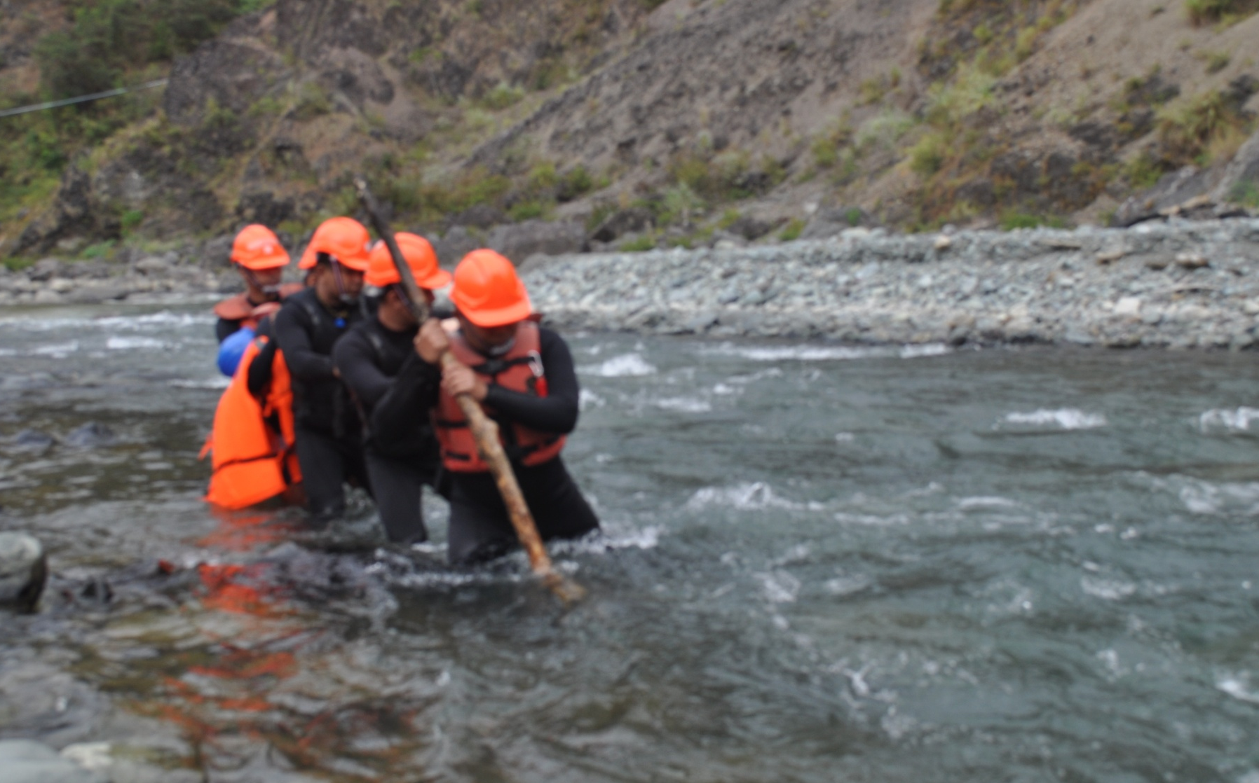
SHALLOW WATER CROSSING

Slide 29
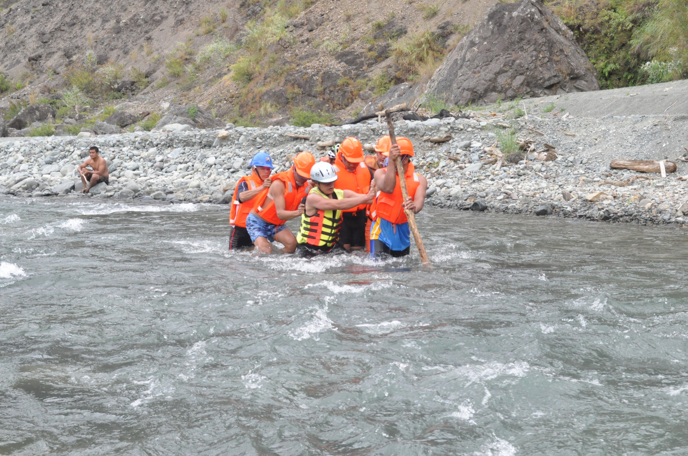
SHALLOW WATER CROSSING

Slide 30
REVIEW
List at least 5 common water emergencies
Demonstrate 6 knots used for joining and securing
Demonstrate the 2 types of extension assist taught in the CADRE course.
Demonstrate how to wade through moving (shallow) water.
1
2
Now you will be able to :-
3
4

Slide 31

THANK YOU

