Slide 1


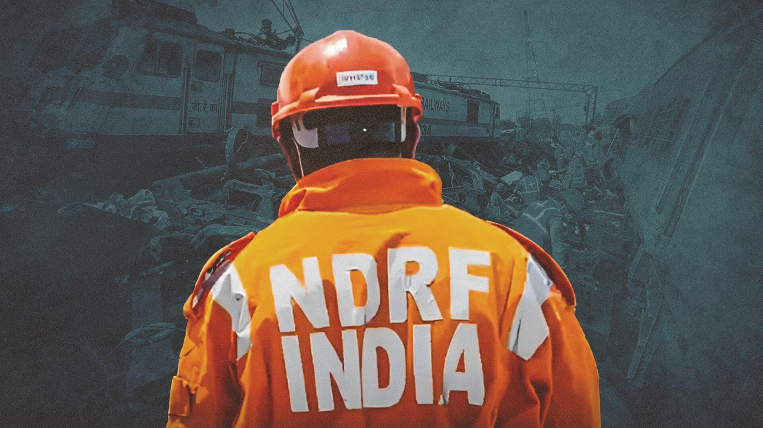


CADRE
Lesson 10
Other Emergencies

Slide 2



OBJECTIVES
List the signs & symptoms of bites and stings, and steps for pre-hospital treatment.
List the signs & symptoms of poisoning, and steps for pre-hospital treatment.
Identify three signs & symptoms of heat cramps, heat exhaustion, and heat stroke; describe pre-hospital treatment for each.
Identify three signs & symptoms of Acute Mountain Sickness (AMS) and methods of treatment.
1
Upon completion of this lesson, you will be able to :-
2
3
4

Slide 3


Treat all snake bites as poisonous.
Signs & Symptoms
Anxiety, rapid breathing
Numbness/tingling, dizziness
Vasovagal shock → fainting, collapse, slow pulse
Irrational behavior, misleading symptoms
Improper first aid may worsen condition (tourniquet → swelling, necrosis).
Fang marks
Local pain (severe in cobra/viper bites)
Swelling, bruising, local bleeding
Blisters, necrosis, abscess formation
Lymph node enlargement
Bites and Stings
Snake Bites

Slide 4
Pre-hospital Treatment:
Ensure scene safety.
Perform primary assessment (Airway, Breathing, Circulation).
Clean bite site with soap and water.
Immobilize affected limb, keep below heart level.
Apply pressure bandage as per protocol.
Provide supplemental oxygen, monitor vital signs.
Treat for shock.
What NOT to do:
Do not kill/handle snake.
Do not suck venom, cut wound, or apply herbs/chemicals.
Avoid arterial tourniquets.
Bites and Stings
Snake Bites

Slide 5
Considered puncture wounds → risk of infection.
Dangerous due to rabies, venom, or allergic reactions.
Animal Bites (Dog, Cat, etc.):
Do not try to catch the animal.
Do not suck the wound.
Clean, bandage, and send patient to hospital immediately.
Bee Sting:
Remove stinger by scraping (not pulling).
Apply ice pack or cold compress.
Clean and bandage.
If difficulty in breathing, swelling, or rashes → hospital immediately.
Bites and Stings
Animal and Insect Bites

Slide 6
Definition: Any substance that impairs or destroys cell function.
Routes of Entry:
Ingestion
Inhalation
Absorption
Injection
Reasons:
Suicidal attempt
Accidental poisoning (contaminated food, water, chemicals)
Signs & Symptoms:
Nausea, vomiting, abdominal pain
Headache, dizziness, seizures
Altered mental state, coma
Breathing difficulty
Skin discoloration, burns, injection marks
Diarrhea, abnormal pulse/BP
Poisoning

Slide 7
Pre-hospital Treatment:
Ensure scene safety (use protective gear).
Assess airway, breathing, circulation.
Administer oxygen per protocol.
Remove or deactivate poison (brush off powders, wash skin, move patient).
Call poison control center / shift to hospital.Provide supportive care, monitor vital signs.
Poisoning

Slide 8
1. Heat Cramps
Symptoms: Severe cramps (legs/abdomen), nausea, fatigue, fainting.
Treatment: Move to cool area, give water, rest.
2. Heat Exhaustion
Symptoms: Rapid shallow breathing, weak pulse, pale/cold skin, dizziness, fainting.
Treatment: Move to cool place, loosen clothing, elevate legs, oxygen if available, give water.
3. Heat Stroke (Life-threatening)
Symptoms: Dry, hot, red skin; rapid pulse; dilated pupils; unconsciousness; seizures.
Treatment:
Cool patient immediately (wet sheets, cold packs, immersion if possible).
Administer oxygen, monitor vitals.
Immediate hospital transfer.
Heat Emergencies

Slide 9
Headache,throbbing, often worse for bending over and lying down, and relieved by mild painkillers
Dizziness, light headedness
Nausea and/or vomiting
Loss of appetite
Tiredness, fatigue
Irritability
Disturbed sleep
Signs & Symptoms of Acute Mountain Sickness (AMS)

Slide 10
Keep an eye on the victim and check him/her regularly especially at night.
Rest (avoid exertion) at the same (or lower) altitude until the symptoms clear (this usually takes one to three days)
Ensure adequate liquid intake Keep the urine pale and plentiful
Give oxygen at 1 L/minute, especially at night
Place the victim in a pressure bag (Gamow Bag), if available, for two to four hours, or until the symptoms clear
Examine the victim for severe AMS (HAPE and HACE) regularly If symptoms worsen after resting at the same altitude, or do not improve, or signs of severe AMS appear, descend immediately.
Methods of treatment.

Slide 11
Safety Precautions:
“When thunder roars, go indoors.”
Avoid trees, metal objects, water bodies.
Stay away from windows, concrete floors/walls.
Avoid using electronics, telephones, plumbing.
Pre-hospital Treatment for Lightning Injury:
Check breathing → provide rescue breathing if needed.
Check heartbeat → CPR if required.
Look for burns, nervous system injury, fractures.
Treat for shock, transport immediately.
NDMA Guidelines:
Install lightning arrestors & grounding in buildings.
Follow 30/30 Rule (indoors if thunder follows lightning within 30s, stay inside for 30 mins after last thunder).
Unplug electrical items, secure outdoor objects.
Lightning Emergencies

Slide 12
OBJECTIVES
List the signs & symptoms of bites and stings, and steps for pre-hospital treatment.
List the signs & symptoms of poisoning, and steps for pre-hospital treatment.
Identify three signs & symptoms of heat cramps, heat exhaustion, and heat stroke; describe pre-hospital treatment for each.
Identify three signs & symptoms of Acute Mountain Sickness (AMS) and methods of treatment.
1
Now you are able to:-
2
3
4

Slide 13

THANK YOU

