Slide 1




MEDICAL FIRST RESPONDER
LESSON 17
Seizures,
Diabetic Emergencies and Cerebral Vascular Accidents
CAPF | MFR | INDIA
-

Slide 2
OBJECTIVES
Upon completing this lesson, you will be able to:
1
  Define seizures.
  List four steps for the pre-hospital treatment for seizures when arriving while the patient is still having a seizure.
2

Slide 3
OBJECTIVES
Upon completing this lesson, you will be able to:
3
  List five additional steps for
  the pre-hospital treatment for seizures to take after the seizure is over.
  List seven signs and symptoms for hyperglycemia and list three steps
  for pre-hospital treatment.
4

Slide 4
OBJECTIVES
Upon completing this lesson, you will be able to:
5
  List nine signs and symptoms hypoglycemia and describe
  pre-hospital treatment.
  List nine signs and symptoms for a cerebral vascular accident (CVA).
6

Slide 5
Seizure
A sudden and temporary change in mental status cause by massive electrical discharge in the brain.

Slide 6
Causes of Seizures
Brain Tumors
Head Trauma
Epilepsy
Hypoxia
CVA
Poisoning
Seizures
Fever (Children)
Hypoglycemia
Chronic medical conditions
Infection
Eclampsia

Slide 7
Seizures
Aura phase:
The patient becomes aware that
the seizure is coming on, usually described as an unusual smell or flash of light, usually lasting only a second.
PPT 17 -

Slide 8
Seizures
Cont.
Tonic phase:
Patient becomes unresponsive and collapses. All the muscles of the body contract.
The body becomes rigid and the patient may stop breathing. May become incontinent.
PPT 17 -

Slide 9
Seizures
Cont.
Clonic phase:
The patient convulses violently.
May foam at the mouth or drool, and may become cyanotic.
PPT 17 -

Slide 10
Seizures
Cont.
Postictal phase:
Begins when convulsions stop.
Patient gradually regains consciousness. Headache is common.
PPT 17 -

Slide 11
Use universal precautions & secure the scene
If you arrive while the patient is still having a seizure, begin at step one:
Place the patient gently on the floor & move any objects that patient might strike
Stay calm & wait. Don’t force any thing into the patient’s mouth. Seizure should be over in a few minutes
Loosen restrictive clothes. Don’t restrain patient
Place the patient on his/her side to prevent aspiration
Prehospital treatment
PPT 17 -

Slide 12
Assess & monitor airway & breathing
Treat any injuries the patient may have sustained during convulsions
Place the patient in recovery (if you don’t suspect spinal injury)
Administer oxygen as per local protocol
Comfort & reassure the patient
For febrile seizures in children, lower the patient’s temperature with tepid water with a bath sponge or wash cloth.
Transport the patient to the hospital
Prehospital treatment
PPT 17 -

Slide 13
Hyperglycemia
Signs and symptoms
Gradual onset
Sweet, fruity breath
Flushed, dry skin
Hunger or thirst

Slide 14
Hyperglycemia
Signs and symptoms
Cont.
Rapid weak pulse
Frequent urination
Intoxicated appearance, staggering, slurred speech

Slide 15
Use universal precautions & secure the scene & alert local EMS. Never give patients who cannot control their airways anything to eat/ drink
Perform initial assessment & obtain patient history
Administer glucose as per local protocol. When in doubt, give sugar
Reassess & transport the patient. Position the patient appropriately
Prehospital treatment
PPT 17 -

Slide 16
Hypoglycemia
Common Causes
Skipped meals
Vomiting
Strenuous exercise
Physical stress from extreme heat or cold
Emotional stress
Accidental overdose of insulin

Slide 17
Hypoglycemia
Signs and symptoms
Rapid onset of altered mental status
Intoxicated appearance, staggering, slurred speech
Atypical behaviour

Slide 18
Hypoglycemia
Signs and symptoms
Cont.
Combativeness and/or anxiety
Rapid pulse rate
Cool, clammy skin
Hunger
Headache
Seizures

Slide 19
Cerebral Vascular Accident
A sudden loss of blood supply to the brain.

Slide 20
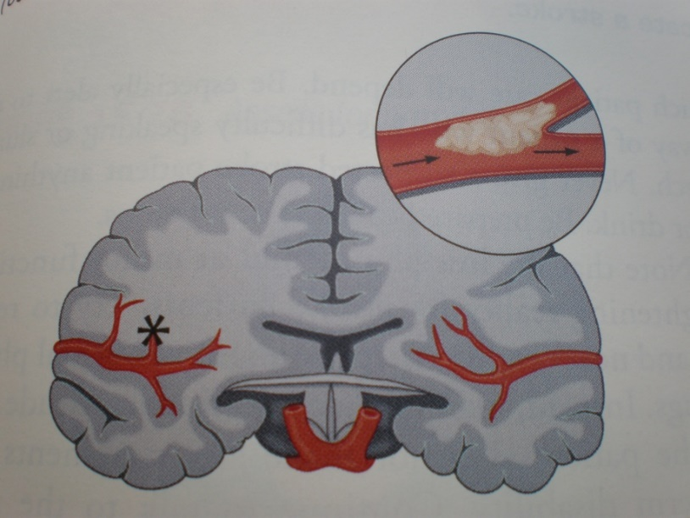
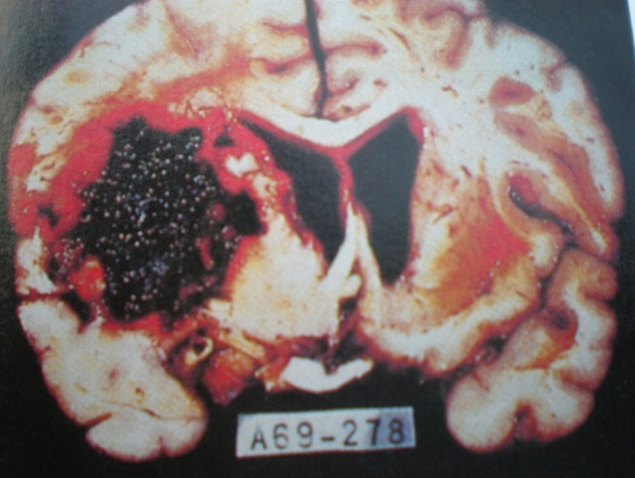
Cerebral Vascular Accident
Causes
Cerebral thrombosis
Cerebral hemorrhage

Slide 21
Cerebral Vascular Accident
Signs and symptoms
Headache (may be the first and only symptom)
Fainting
Altered mental status

Slide 22
Cerebral Vascular Accident
Signs and symptoms
Cont.
Tingling or paralysis of the extremities or face
Difficulty speaking
Blurred vision

Slide 23
Cerebral Vascular Accident
Signs and symptoms
Cont.
Convulsions
Unequal pupils
Loss of bladder or bowel control

Slide 24
Definition: sharp , severe abdominal pain.
Abdominal pain can have sudden onset or build up gradually over a period of time.
Severe abdominal pain may not always reflect a serious condition, but must always be treated as serious by the MFR until a full diagnosis is made by a doctor.
Abdominal distress

Slide 25
There are multiple causes of abdominal pain, all requiring immediate attention.
These disorders have four general causes:
Inflammation,
Infection,
Obstruction &
Hemorrhage.
Causes of abdominal distress

Slide 26
Signs and symptoms of abdominal distress
Abdominal pain, local or diffuse
Colicky pain (cramps that occur in waves)
Abdominal tenderness, local or diffuse
Anxiety, reluctance to move
Loss of appetite, nausea, vomiting

Slide 27
Signs and symptoms of abdominal distress
Fever
Rigid , tense or distended abdomen
Signs of shock
Vomiting blood , bright red or dark brown, resembling coffee grounds
Blood in stool, bright red or tarry black

Slide 28
Use universal precautions & secure the scene
Maintain open airway & prevent aspiration of vomit.
Have patient lie in comfortable position, preferably the left side if nauseated
Use universal precautions & secure the scene
Maintain open airway & prevent aspiration of vomit.
Have patient lie in comfortable position, preferably the left side if nauseated
Pre-hospital treatment

Slide 29
Review
Now you are able to:
1
  Define seizures.
  List four steps for the pre-hospital treatment for seizures when arriving while the patient is still having a seizure.
2

Slide 30
Review
Now you are able to:
3
  List five additional steps for
  the pre-hospital treatment for seizures to take after the seizure is over.
  List seven signs and symptoms for hyperglycemia and list three steps
  for pre-hospital treatment.
4

Slide 31
Review
Now you are able to:
5
  List nine signs and symptoms hypoglycemia and describe
  pre-hospital treatment.
  List nine signs and symptoms for a cerebral vascular accident (CVA).
6

Slide 32


THANK YOU

