Slide 1
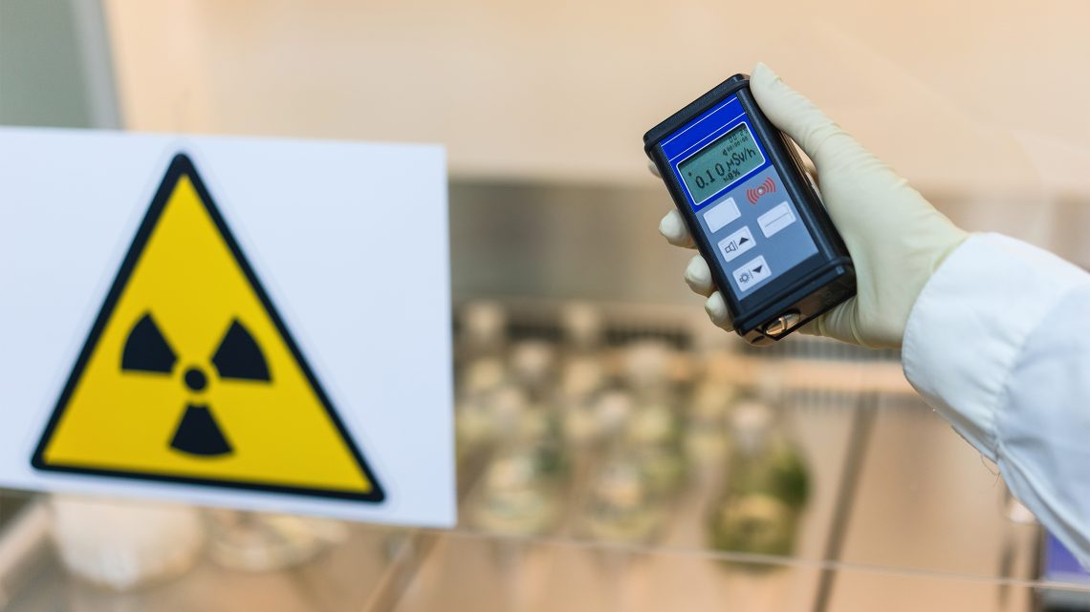



CBRN Module: Radiological-Nuclear
LESSON 05
RADIATION DETECTING EQUIPMENT AND THEIR
PRINCIPLES
Presented By:- Kamal Mehra,2IC
NDRF | CBRN | INDIA
PPT 5 - 1

Slide 2
OBJECTIVES
Upon completing this lesson, you will be able to:
1
Get a general overview about radiological detectors and requirement for radiation detectors
  Know about characteristics of radiation detectors.
  Acquaint with various operating principles of radiation detectors.
2
3

Slide 3
RADIATION DETECTORS
A radiation detector is a device that identifies and quantifies ionizing radiation, such as alpha particles, beta particles, gamma rays, and X-rays, by taking advantage of their interactions with matter, typically by causing ionization.

Slide 4
What are REQUIREMENT FOR RADIATION DETECTORS?
Identify Radiological Hazards
Ensure Public Safety
Protect Responders
Guiding response efforts
PPT 5 -

Slide 5
CHARACTERISTICS OF RADIATION DETECTORS
Good Energy Resolution
Good Counting efficiency
Low Inherent Dead Time
Sensitivity
Specificity
Accuracy
Durability & Portability
PPT 5-

Slide 6
GENERAL CONFIGURATION OF RADIATION DETECTORS
Detector
Processing electronics
Display

Slide 7
TYPE OF DETECTOR
GAS-FILLED DETECTORS
SCINTILLATION DETECTORS
SEMICONDUCTOR DETECTOR
PPT 1 -

Slide 8
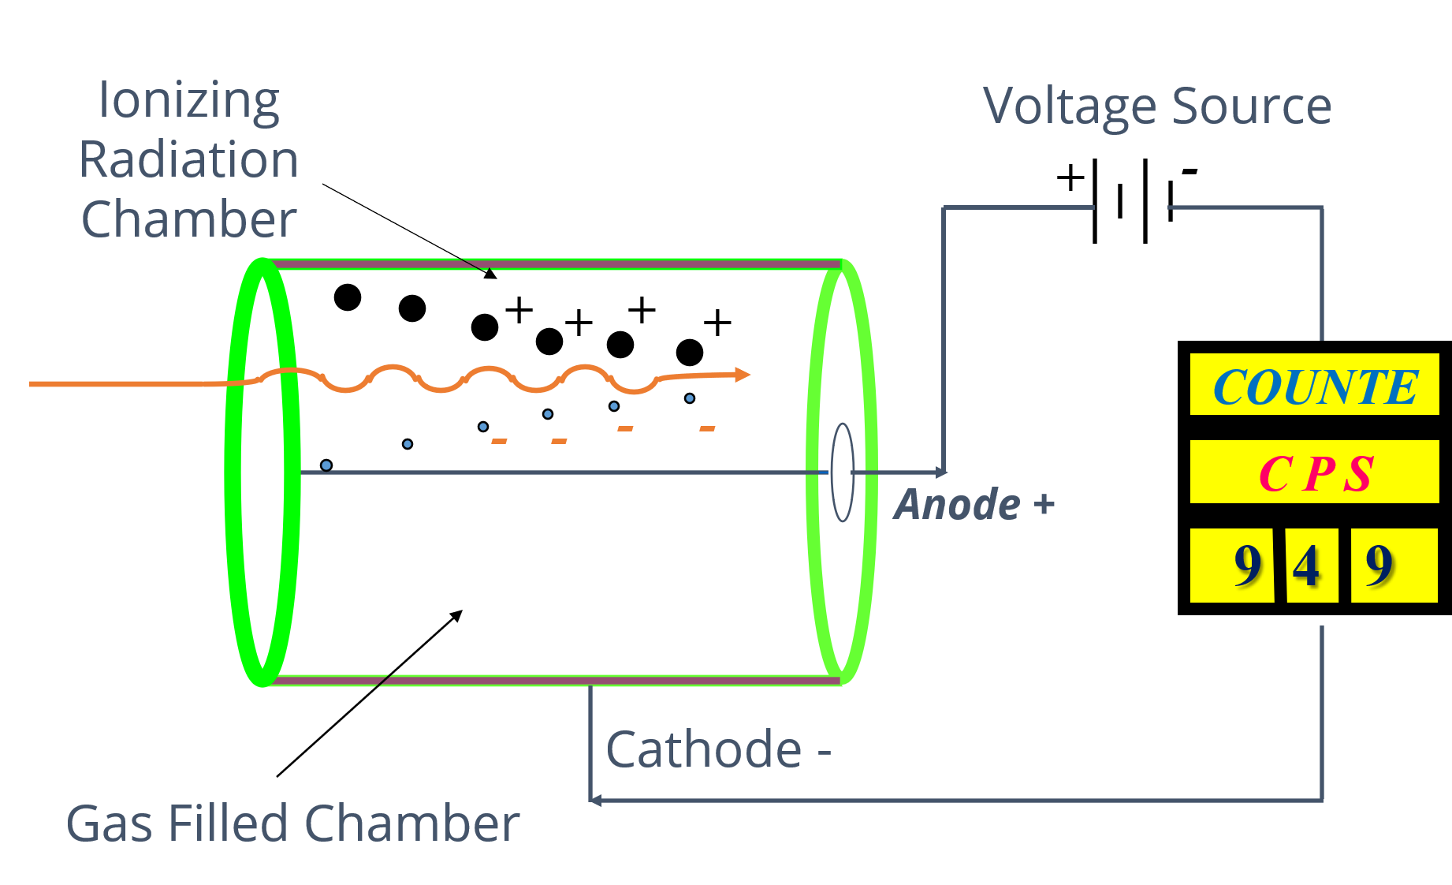
GAS-FILLED DETECTORS

Slide 9
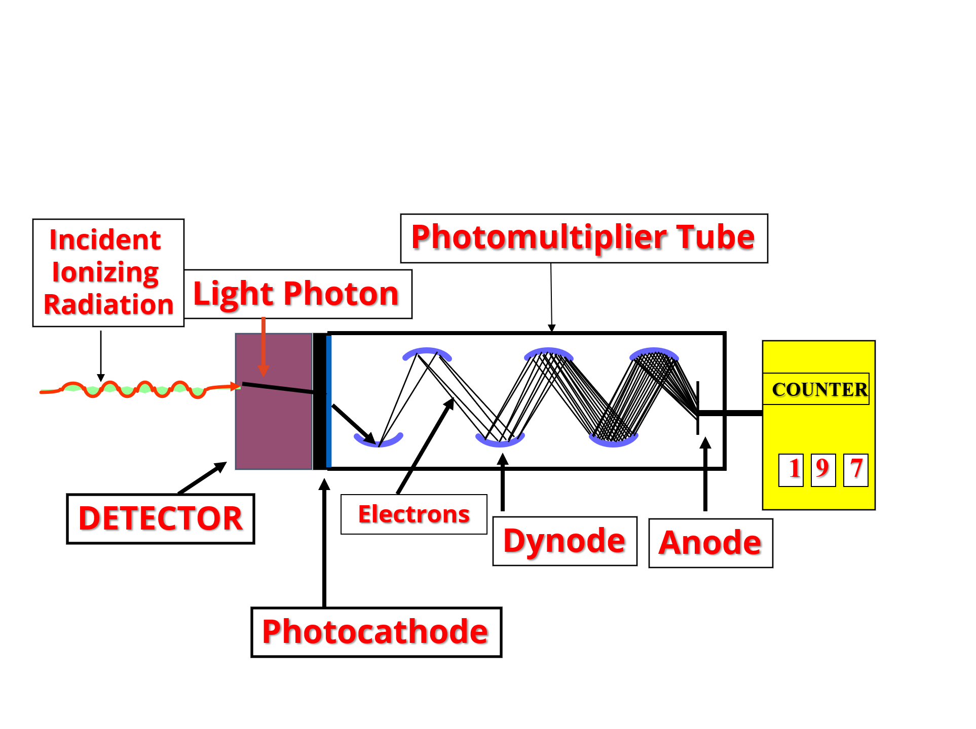
SCINTILLATION DETECTORS

Slide 10
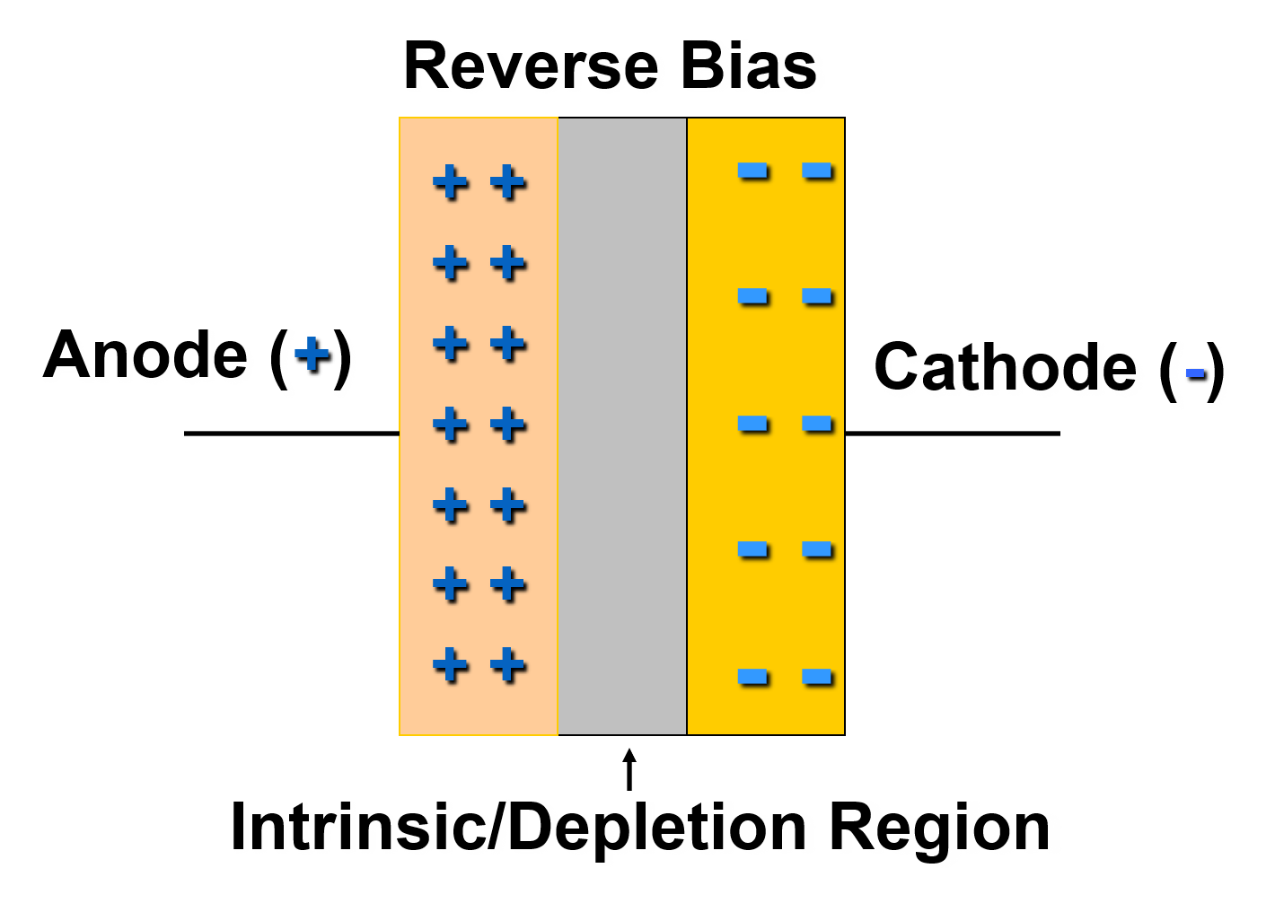
SOLID STATE (SEMICONDUCTOR) DETECTORS

Slide 11
TELETECTOR (TELERAD)
PURPOSE : Beta/ Gama / X-Ray detection
ADVANTAGE : 4 Mtr long Telescopic Probe
WORKS ON : GMT (D1&D2)
RANGE : (X-Ray & Gamma Ray) 0 to1000 R/hr
Beta : 0 to 900 CPS
BATTERY : (1.5 V) 5 Pencil Cells
PRINCIPLE : Gas Filled Detector
ACCURACY : (+/-) 15%

Slide 12
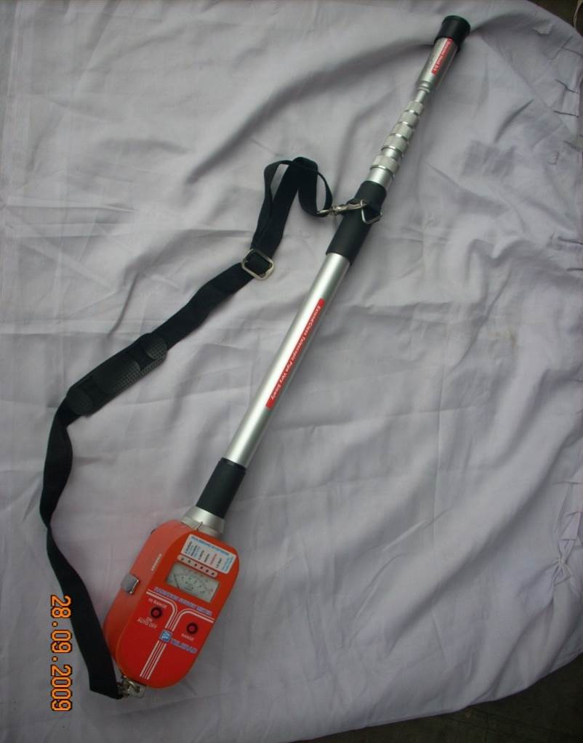
TELETECTOR (TELERAD)
NO | RANGES | SCALE | LED | RADIATION | DETECTOR
01 | 0-1000R | RED | RED | X &Gamma | D-2
02 | 0-50R | BLACK | RED | X &Gamma | D-2
03 | 0-2.5R | BLACK | RED | X &Gamma | D-2
04 | 0-50mR/ 900CPS | BLACK | GREEN | X, Gamma & Beta | D-1
05 | 0-2.5mR/ 45cps | BLACK | GREEN | X, Gamma & Beta | D-1
Cont…

Slide 13
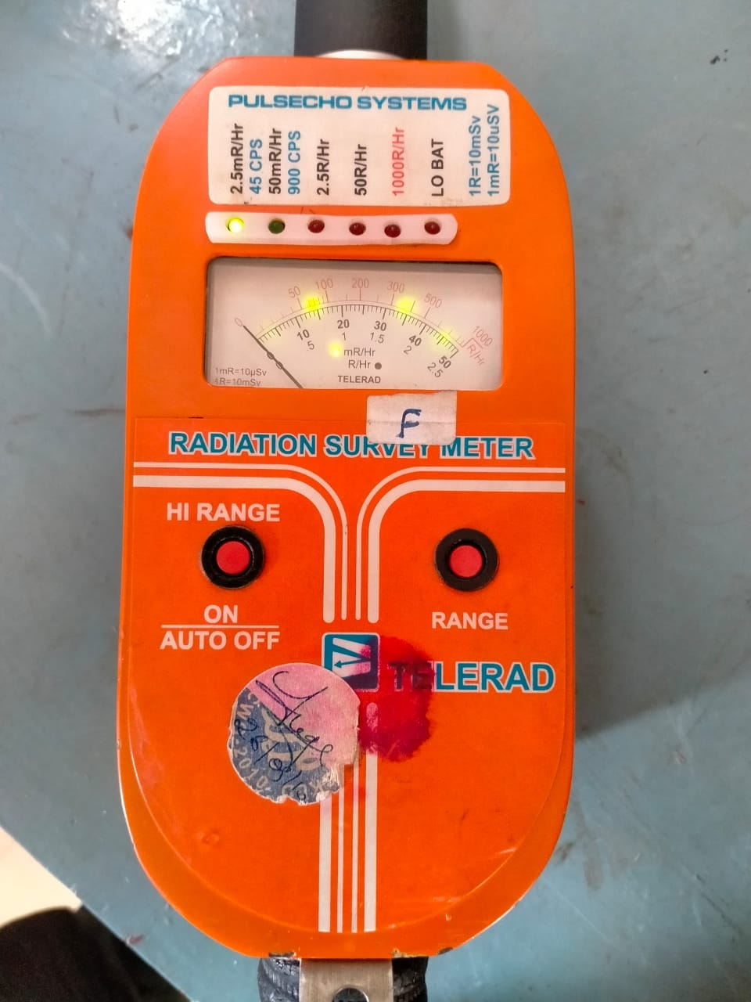
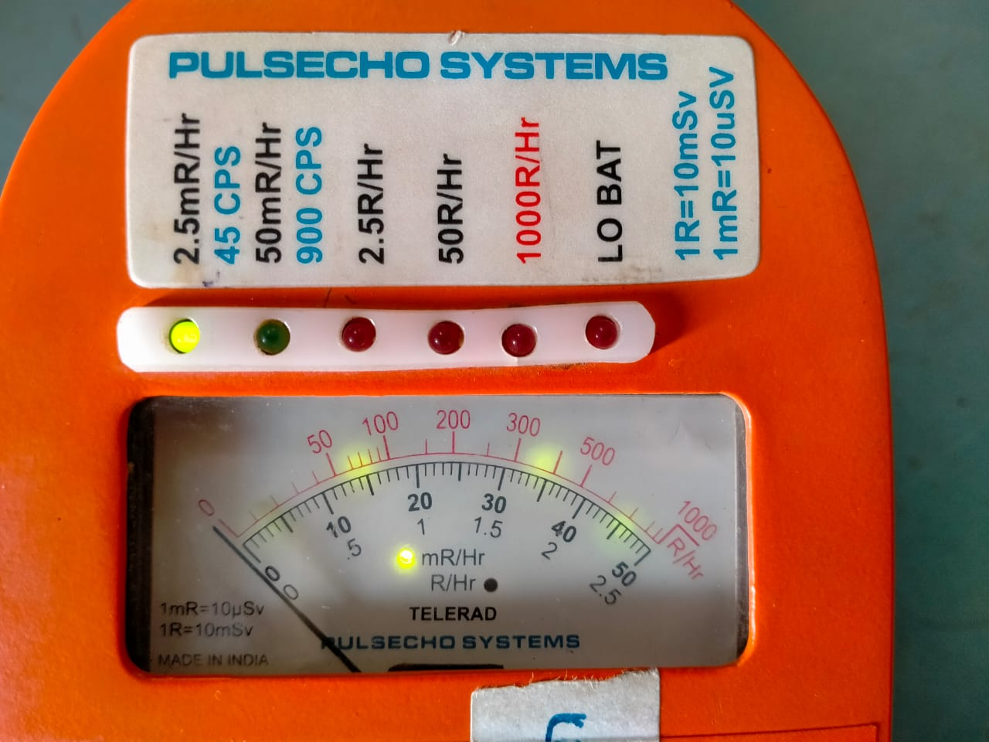
TELETECTOR (TELERAD)
Cont…

Slide 14
ALSCIN MONITOR
PURPOSE : Detects Alpha particle
ADVANTAGE : Portable & Accurate Device
READING : In PPS (Particles per Second)
PRINCIPLE : Scintillator detector(PMT)
RANGE DISTANCE : 4 – 5 Cm
DISPLAY : 4 digit LCD
MODES : Auto & Manual
WORKING TIME : 1 Min (in Auto Mode) & Continuous (in Manual Mode)
BATTERY : (1.5V) DC-R14 size 05 cells

Slide 15
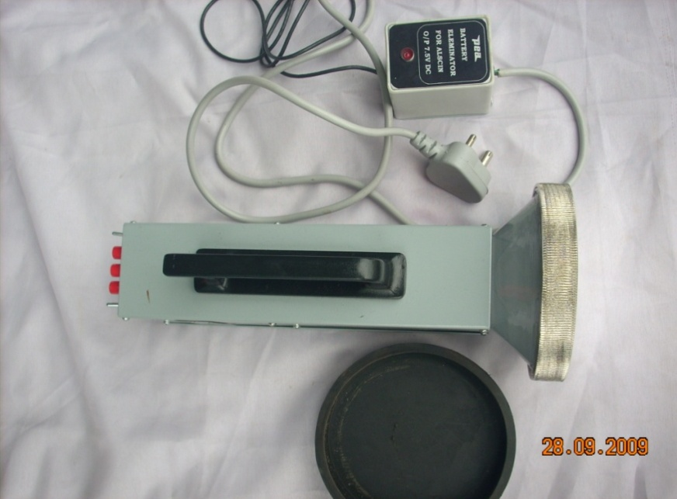
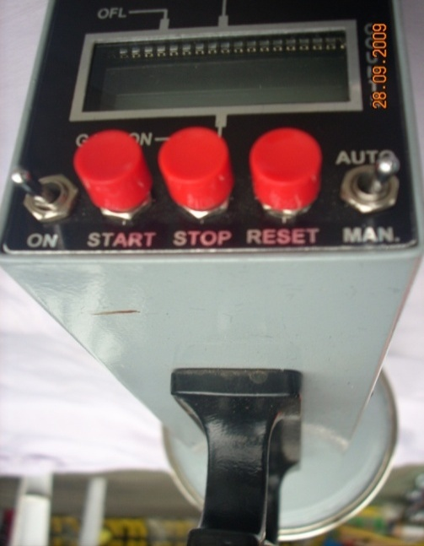
ALSCIN MONITOR
Cont…

Slide 16
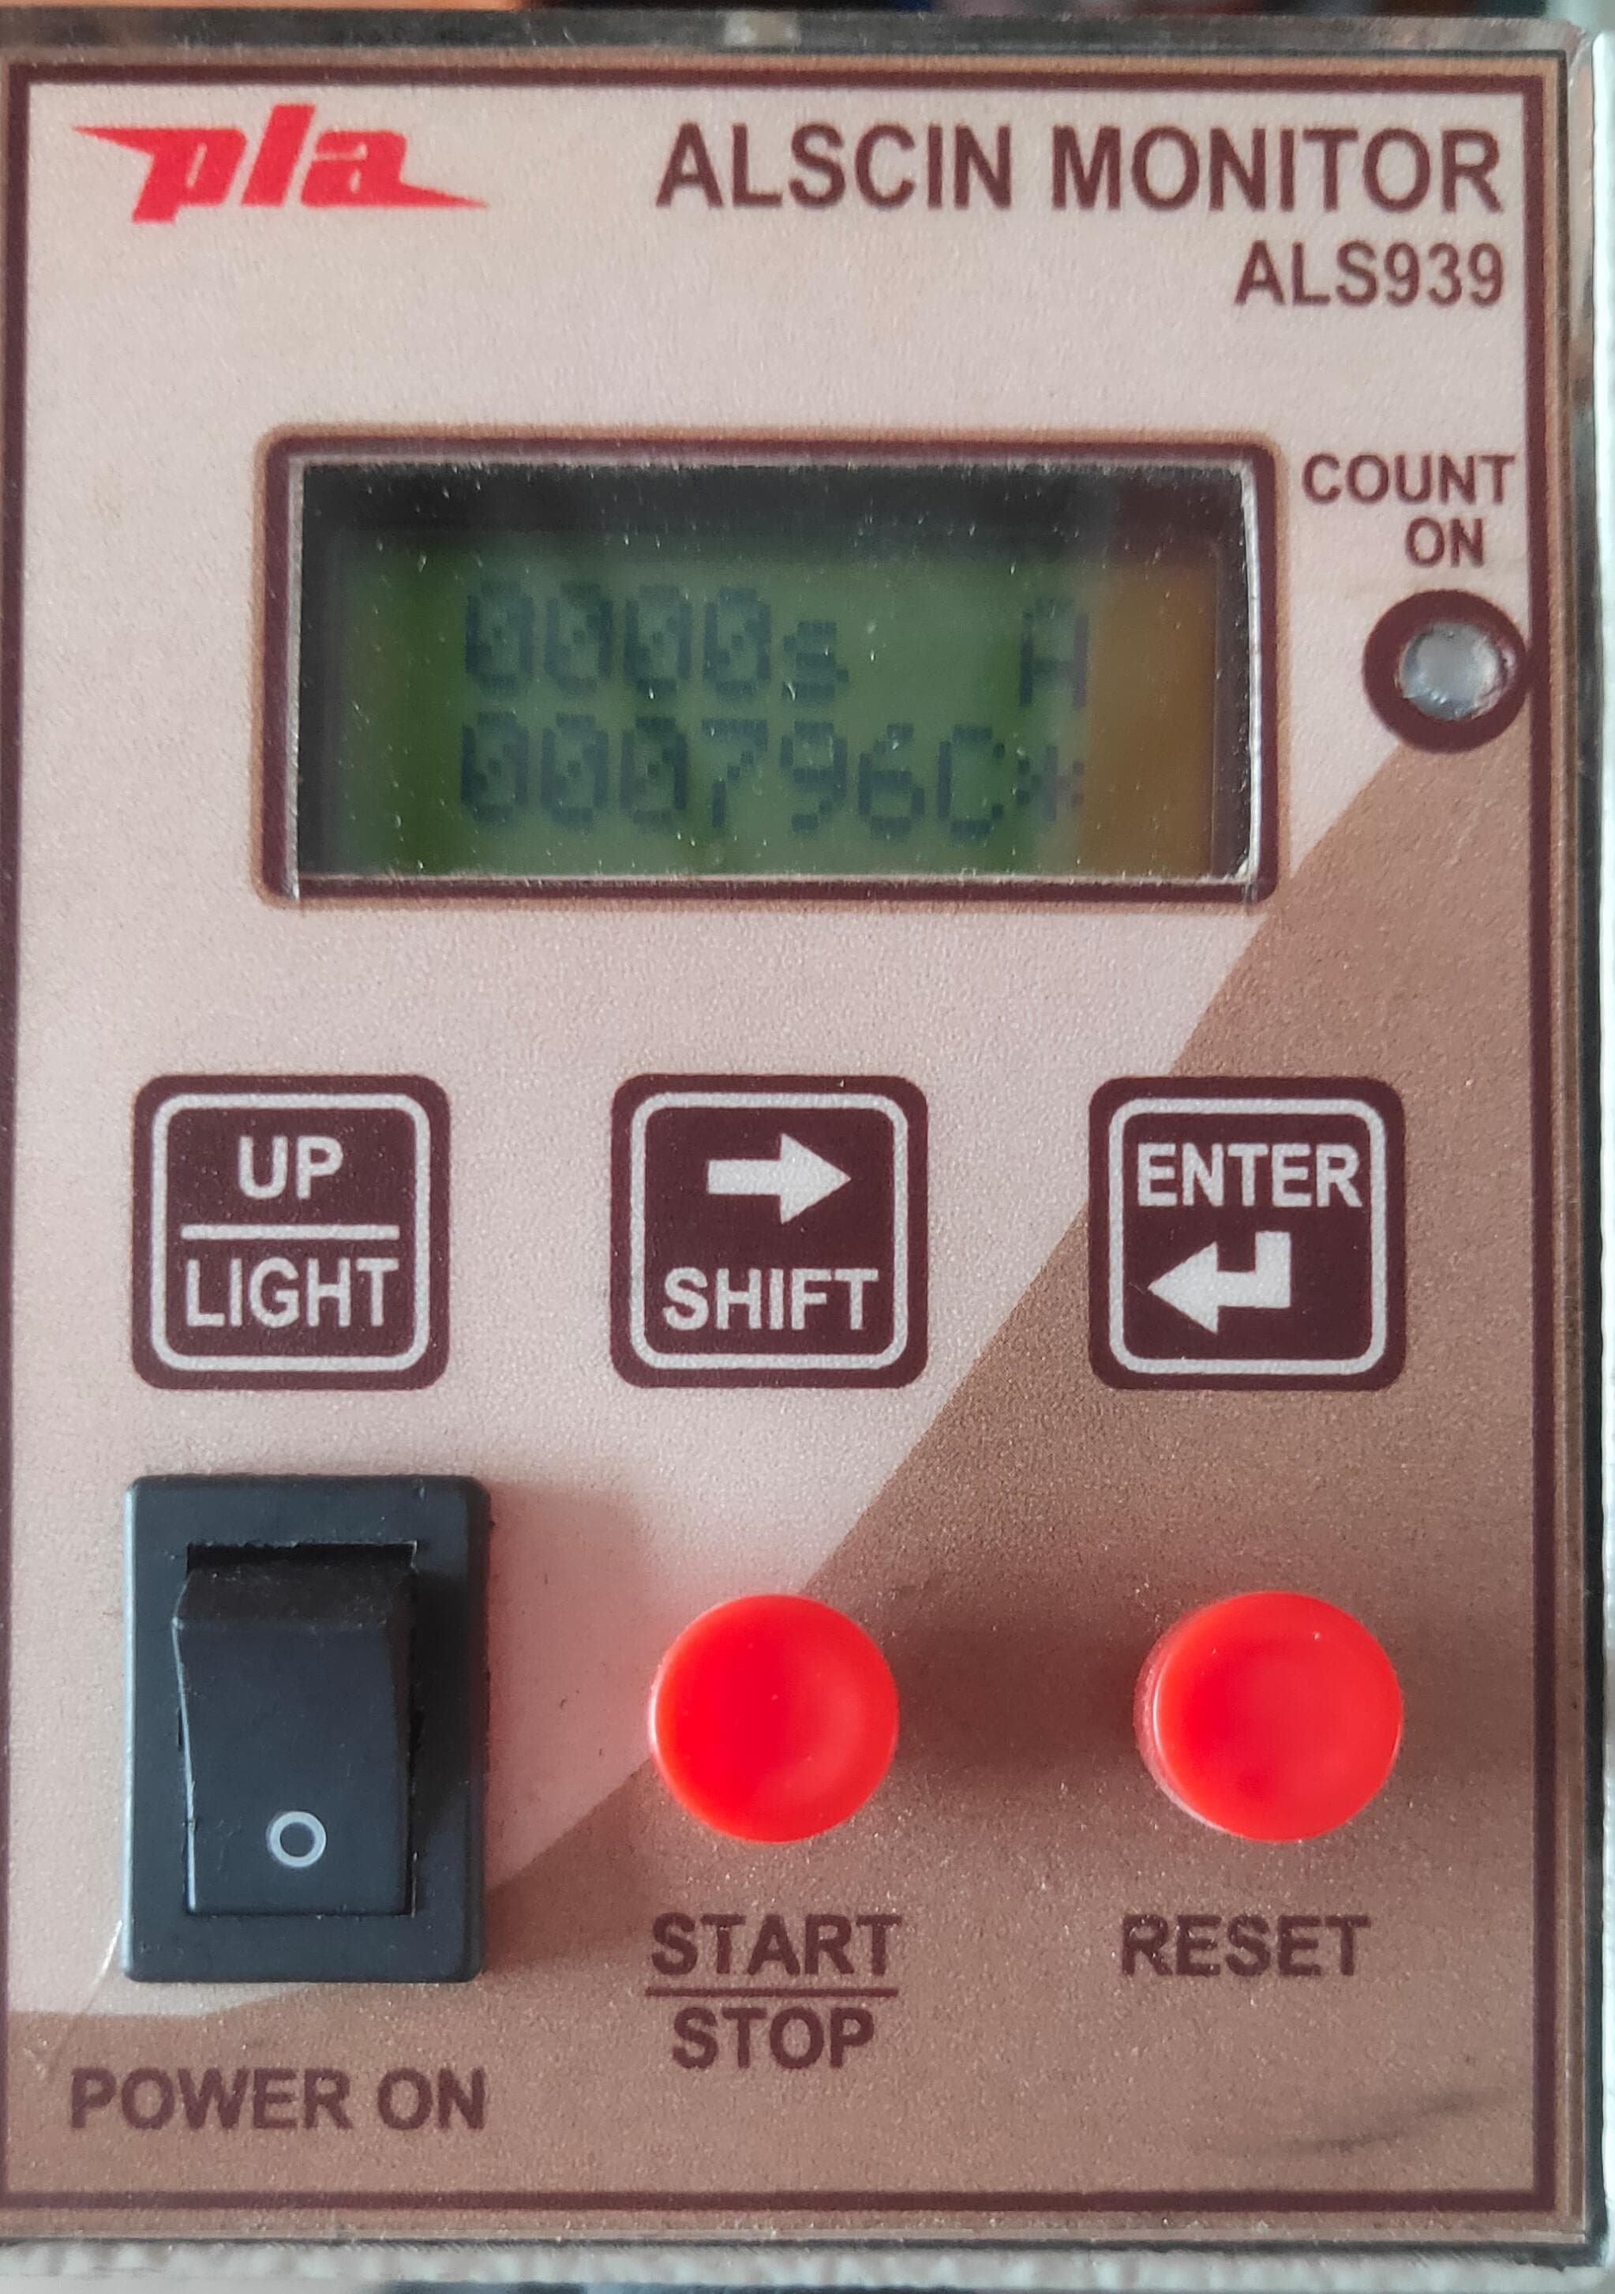
ALSCIN MONITOR
Cont…

Slide 17
RADIATION SURVEY METER
(MINIRAD INTERNAL)
PURPOSE : Beta/ Gama / X-Ray detection
ADVANTAGE : Light, Portable, gives Fast & Accurate measurement.
READING : 4 LED Display to indicate
* Range
* Incident RADIATION
* Low Battery
PRINCIPLE : (Gas Filled Detector) GM Tube
LOW RANGE : 0 – 50 mR/Hr, 0 – 54000cpm
BATTERY : 05 Pencil Cells (1.5V)

Slide 18
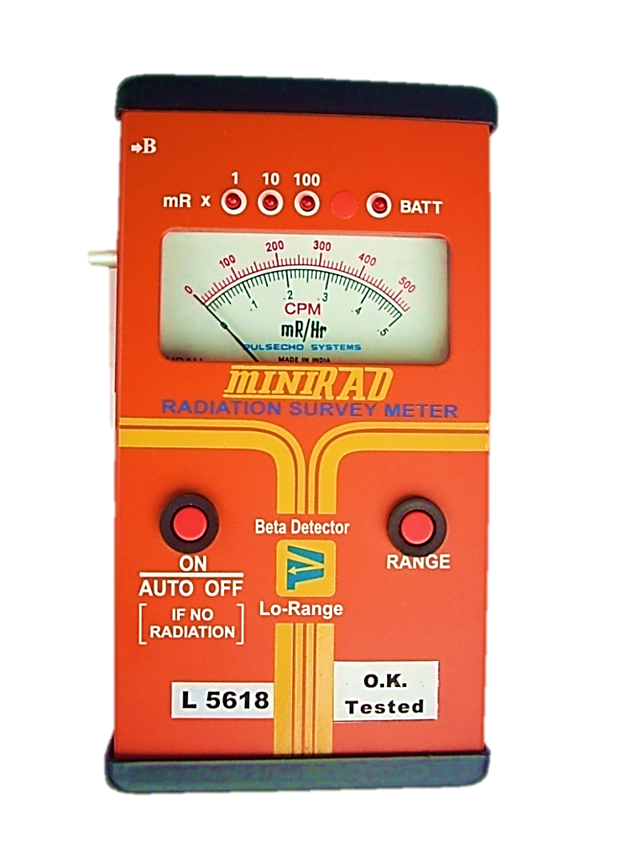
RADIATION SURVEY METER
(MINIRAD INTERNAL)
Cont…

Slide 19
RADIATION SURVEY METER
(MINIRAD EXTERNAL)
PURPOSE : Beta/ Gama / X-Ray detection
ADVANTAGE : Light, Portable, gives Fast & Accurate measurement.
READING : 4 LED Display to indicate
* Range
* Incident RADIATION
* Low Battery
PRINCIPLE : (Gas Filled Detector) GM Tube
LOW RANGE : 0 – 50 mR/Hr, 0 – 54000cpm
BATTERY : 05 Pencil Cells (1.5V)

Slide 20
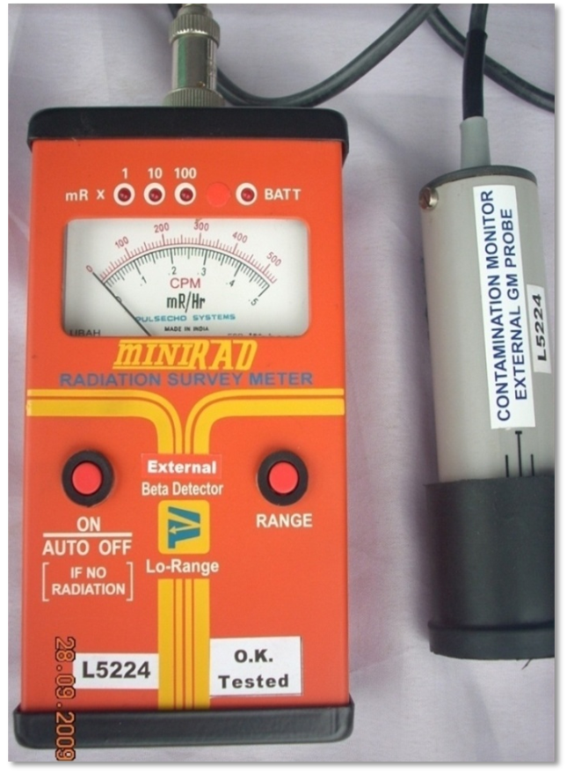
RADIATION SURVEY METER
(MINIRAD EXTERNAL)
Cont…

Slide 21
MICRO “R” SURVEY METER
PRINCIPLE:- Scintillation
ADVANTAGE: Hand held, portable , light weight and analog dose rate meter.
DETECTOR : Gamma & x-ray (PMT)
RANGE : 0 to 2,00,000 μR/h
ACCURACY : (+/-) 20 %
BATTERY : (1.5 V) 6 pencil battery
Before use always checkup the battery and its high voltage

Slide 22
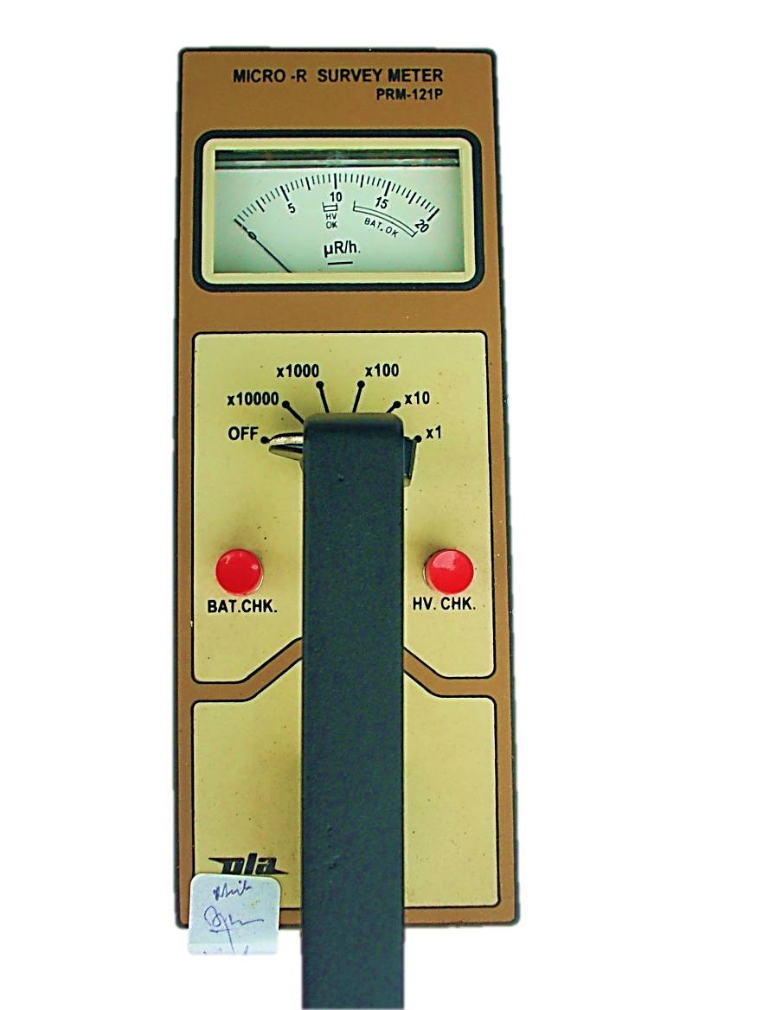
MICRO “R” SURVEY METER
Cont…

Slide 23
CONTAMINATION MONITOR (BETA & GAMMA)
PURPOSE : Beta/ Gama / X-Ray detection
ADVANTAGE : Portable, gives Fast & Accurate measurement.
PRINCIPLE : (Gas Filled Detector) GM Tube
RANGE : 0.01 mR/Hr TO 200 mR/Hr, 0 – 99999cpm
BATTERY : 04 Pencil Cells (1.5V)
ACCURACY : (+/-) 15% CS-137
DISPLAY : Digital
RESPONSE TIME : appx 5sec

Slide 24
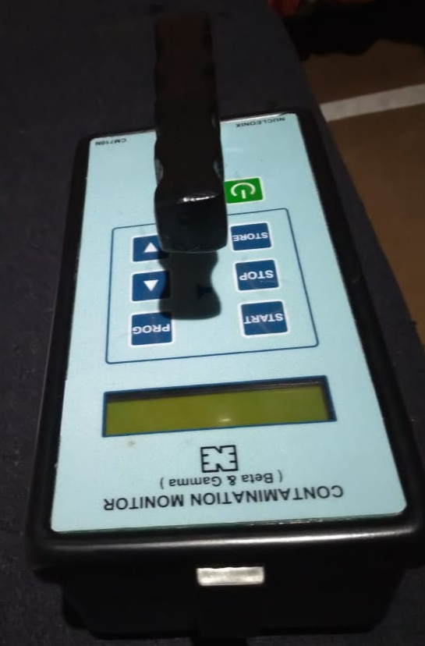
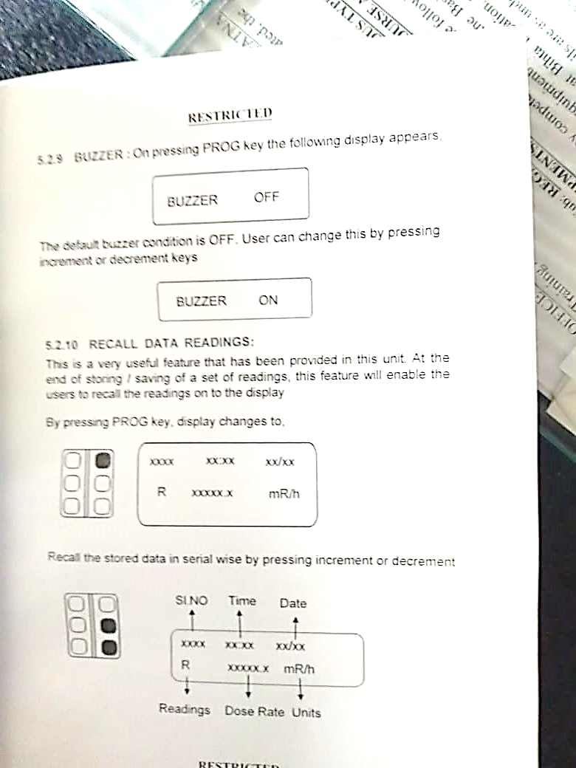
CONTAMINATION MONITOR (BETA & GAMMA)
Cont…

Slide 25
HAZMAT VEHICLE MOUNTED CBRN SENSORS
Chemical detector (IMS based)
Bio detector with sample collector (LIF based)
Gamma detector with external probe
Gas Chromatogram Mass Spectrometer (Analysis)
CO₂, O₂ level monitor
Chemical detector (IMS based)
Raman Spectrometer (Analysis)
Weather Station (VM)
GPS System (VM)
Thermal Imager

Slide 26
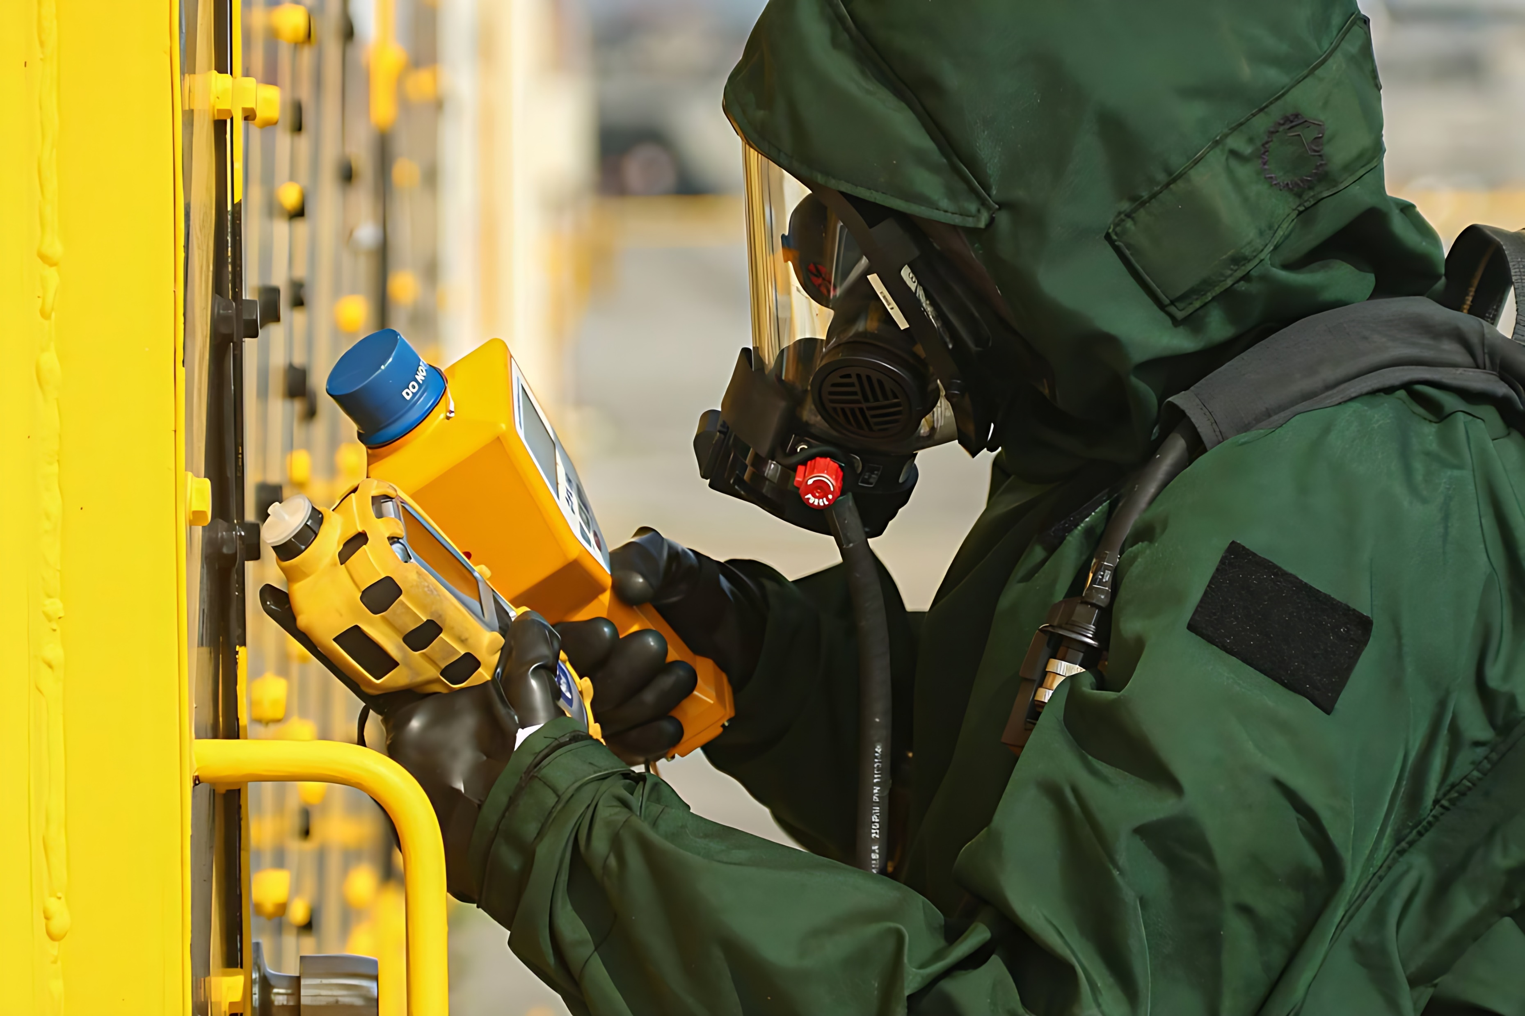

THANK YOU

