Slide 1
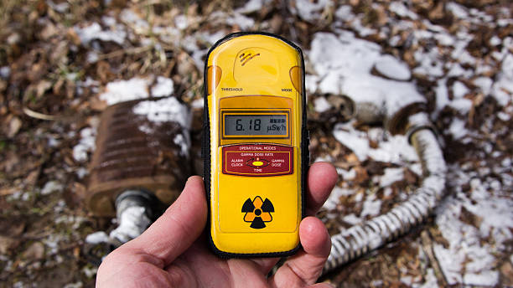


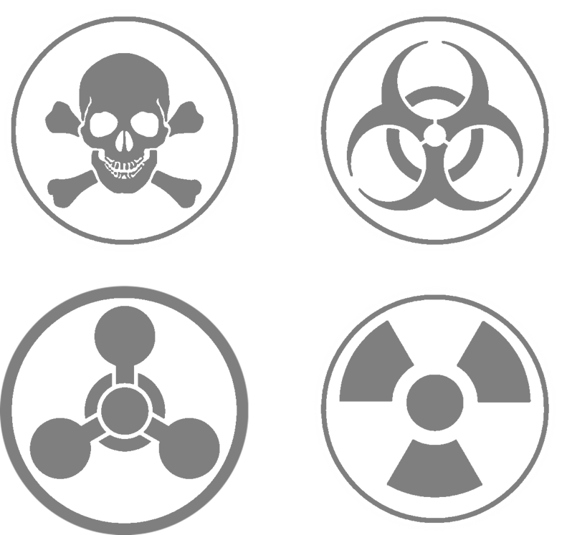
CBRN Module: Radiological-Nuclear
LESSON 02
Dosimetric Quantities
Presented By:- Kamal Mehra,2IC
NDRF | CBRN | INDIA
PPT 2 - 1

Slide 2
OBJECTIVES
Upon completing this lesson, you will be able to:
1
  Acquaint with various types of Dosimetric quantities and their units
  Define absorbed dose, equivalent Dose and effective dose and know its uses
  Acquaint with CPM and CPS and its importance.
2
3

Slide 3
OBJECTIVES
Upon completing this lesson, you will be able to:
4
  Know About annual dose limitation Derived Air Concentration.

Slide 4
DOSIMETRIC QUANTITIES
Dosimetric quantities are specific measurements used in radiological protection to quantify the amount of radiation energy absorbed or transferred within a material, such as the human body.

Slide 5
REQUIREMENT AND IMPORTANCE OF QUANTIFYING DOSIMETRIC QUANTITIES
Risk Assessment and Emergency Response Planning
Regulatory Compliance
Operational Decision Making and Execution
Post-Incident Monitoring
Scientific Research
Medical and Industrial Use
Environmental Monitoring

Slide 6
Dosimetric Quantities
Physical Quantities
Operational Quantities
Protection Quantities
CATEGORIZATION OF DOSIMETRIC QUANTITIES

Slide 7
Physical Quantities
The activity of a radioactive material is a measure of its spontaneous transformation. It is defined as the number of disintegrations or transformations that take place per unit time.
The quantity (intensity) of radiation released from a radiation source is proportional to its activity.
The unit of activity is Becquerel (Bq).
1 Bq= 1 disintegration per second (1dps)
The old unit of activity is Curie (Ci).
1 Ci= 3.7x1010 disintegration per second
Activity λ
PPT 2 -

Slide 8
Physical Quantities
The energy of radiation refers to the amount of energy carried by individual radiation particles or photons.
The energy of radiation is a critical factor in determining its ability to ionize matter and cause biological damage. High energy radiation generally poses a greater health risk than low energy radiation.
It is conventionally measured in Electron volt (eV) or Joule (J).
01 eV = 1.602 Eˉ¹⁹ Joules
1000 eV = 1 keV
Energy (E)
PPT 2 -

Slide 9
Physical Quantities
Exposure is a fundamental Dosimetric quantity used to measure the amount of X-ray or gamma radiation at a specific point of interest.
Exposure quantifies the amount of electric charge (in coulombs) generated per kilogram of air due to the ionization caused by radiation.
The unit of exposure in the International System (SI) is coulomb per kilogram (C/kg) and traditional unit is Roentgens per hour.
The conversion between the traditional and SI units of exposure can be expressed as - 1 C/kg = 3,381 R
Exposure (X)
PPT 2 -

Slide 10
Physical Quantities
KERMA is a measure of the amount of total energy transferred by photons (X-rays or gamma rays) interacting in the medium.
Kerma is an important concept in radiation dosimetry, particularly for high-energy photons and neutrons. It provides an estimate of the energy transferred from the radiation field to the irradiated material.
Kerma is expressed in joules per kilogram (J/kg). SI unit of Kerma is Gray (Gy).
1 Gy=1 J Kg-1
KERMA (Kinetic Energy Released in Matter)
PPT 2 -

Slide 11
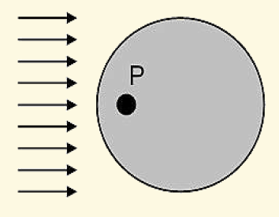
Operational Quantities
Ambient Dose Equivalent is defined as the equivalent dose at point P at a depth of d mm in the ICRU-sphere.
The corresponding unit is sievert (Sv).
Ambient Dose Equivalent {H*(d)}
PPT 2 -

Slide 12
Operational Quantities
The directional dose equivalent is one of the operational quantities defined for use in area monitoring against external exposures.
The unit of directional dose equivalent is joule per kilogram (J Kg-1)
Directional Dose Equivalent {H' d,Ω}
PPT 2 -

Slide 13
Operational Quantities
The operational dose quantity personal dose equivalent (Hp(d)) is defined as the equivalent dose in soft tissue at a suitable depth under a specified point on the body.
The corresponding unit is sievert (Sv).
Personal Dose Equivalent {Hp(d)}
PPT 2 -

Slide 14
Protection Quantities
Absorbed dose is the amount of energy deposited by ionizing radiation per unit mass of irradiated matter such as tissue.
Absorbed dose is a fundamental quantity in radiation protection and is used to assess the potential for radiation induced biological effects.
Traditional unit of Absorbed Dose is RAD.
1 RAD=0.01 joules/Kg (J/Kg)
SI Unit of Absorbed Dose is Gray (Gy).
1 Gy=100 RAD
Absorbed Dose (D)
PPT 2 -

Slide 15
Protection Quantities
Equivalent dose is a measure of the biological effectiveness of different types of ionizing radiation.
This is taken to account by multiplying the absorbed dose by a suitable weighting factor. This factor is known as Radiation Weighting Factor, Wᵣ.
The weighted absorbed dose is called Equivalent dose H_{T}
The unit of equivalent dose is Sievert (Sv)
H_{T} =Σ W_{R} * D_{TR}
Traditional (old) unit of equivalent dose is REM (roentgen equivalent man) and the new unit is Sievert (SV), where 1Sv = 100 REM.
Equivalent Dose (H)
PPT 2 -

Slide 16
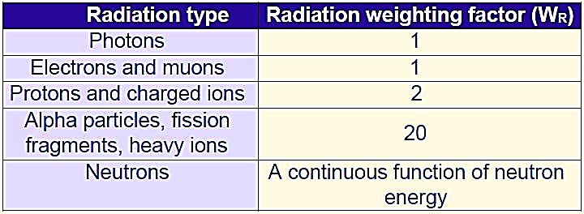
RADIATION WEIGHTING FACTOR

Slide 17
EQUIVALENT DOSE : IMPORTANT POINTS
If the absorbed dose from α is 1Gy ; equivalent dose is 20 Sv.
If the absorbed dose from γ is 20Gy ; equivalent dose is 20 Sv.
Hence in terms of biological damage 1Gy of α dose is equivalent to 20Gy of γ dose.

Slide 18
Protection Quantities
Effective dose is a measure of the overall health risk associated with exposure to ionizing radiation. It accounts for the different sensitivities of different organs and tissues to radiation.
The sensitivity of different tissues to radiation is different. A number of organs are considered on the basis or their sensitivity and the seriousness of the damage. Risk factors are age and sex dependent.
Effective Dose (E)
PPT 2 -

Slide 19
Protection Quantities
The Effective dose is computed by multiplying the tissue dose by a Tissue weighting factor (W_{T}) appropriate to the tissue.
  Effective Dose(E) = Σ W_{T}* H_{T}
  Unit of effective dose = Sievert
  WT represents the contribution of tissue T to the total risk due to stochastic effects resulting from uniform irradiation of whole body.
Effective Dose (E)
PPT 2 -

Slide 20
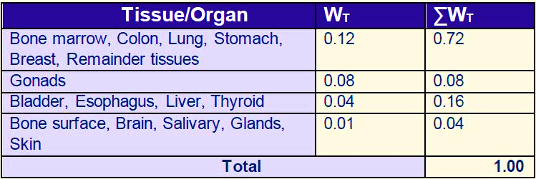
TISSUE WEIGHTING FACTOR

Slide 21
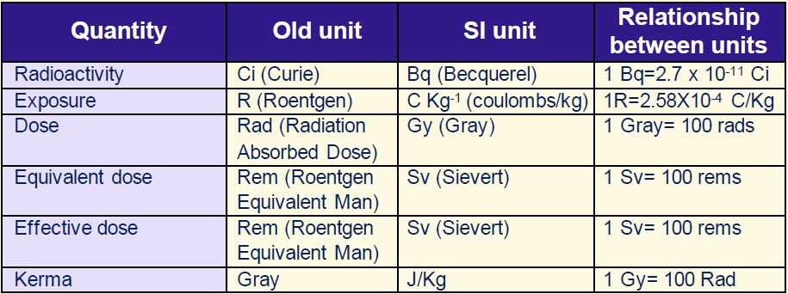
SUMMARY OF DOSIMETRIC UNITS

Slide 22
COUNTS PER MINUTE (CPM)
This indicates the number of radiation particles or photons detected by the instrument in one minute. It’s commonly used in handheld devices for environmental monitoring, as it smooths short-term fluctuations in radiation levels.

Slide 23
COUNTS PER SECOND (CPS)
This indicates the number of radiation particles or photons detected by the instrument in one second. It is used for measurements when higher count rates are being encountered, or if handheld radiation survey instruments are being used which can be subject to rapid changes of count rate when the instrument is moved over a source of radiation in a survey area.

Slide 24
ANNUAL LIMIT INTAKE (ALI)
Annual Limit on Intake, ALI, is defined as the activity intake (Bq) of a radionuclide which would lead to an effective dose corresponding to the annual limit.

Slide 25
DERRIVED AIR CONCENTRATION
Concentrations of radioactive materials in air are limited by the Derived Air Concentration (DAC), which are derived from the ALI.
DAC denotes the max concentration of a radionuclide (or activity concentration) in the ambient air which, if inhaled by a person for 2000 hrs in a year, at a breathing rate 1.2 m3 /hr, will not result in annual effective dose equivalent in excess of the limits prescribed by the competent authority.
PPT 2 -

Slide 26
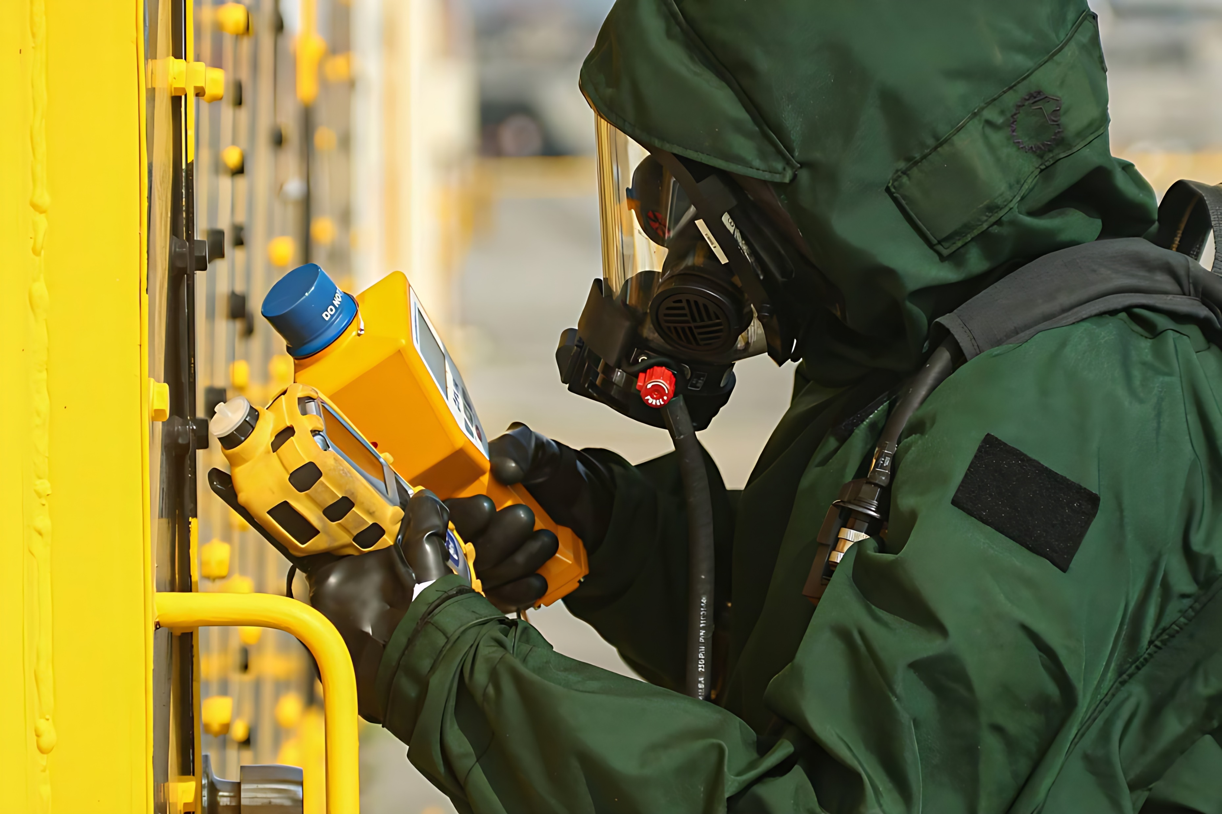

THANK YOU

