Slide 1

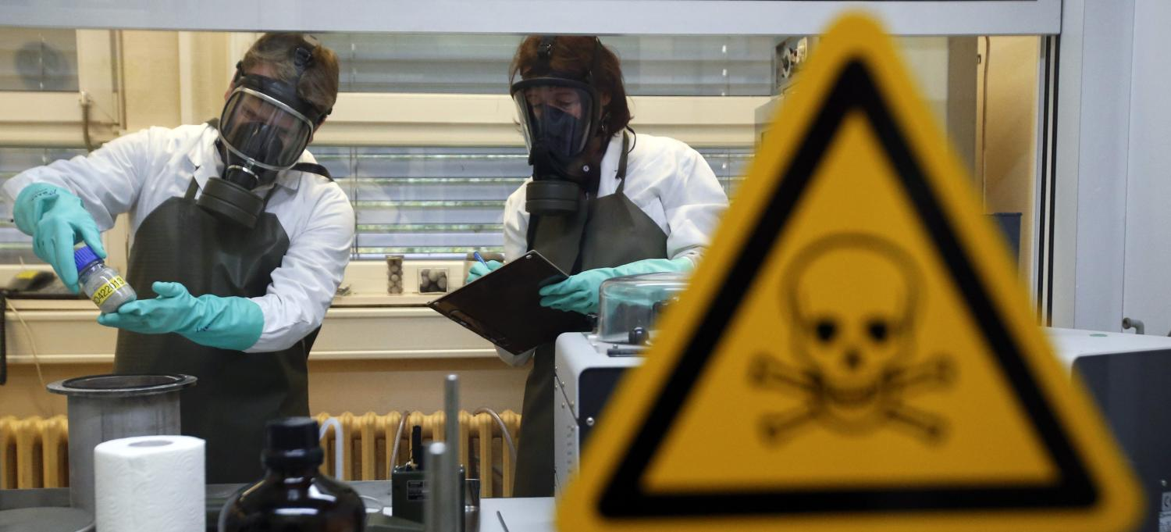



BACTERIA VIRUS, TOXIN AS A BIOLOGICAL AGENT
Presented By:- Kamal Mehra,2IC
PEER | CSSR | INDIA
PPT 2 -

Slide 2
OBJECTIVES
1
To get an overview about the Biological Warfare Agent
To know about various Classification of BWAs and their characteristics
To acquaint with Bacteria as BWA
To acquaint with Virus as BWA
To acquaint with Toxin as BWA
To acquaint with other types of Pathogens as BWA
Upon completing this lesson, you will be able to:-
2
3
4
5
6

Slide 3
Bacteria – Single-celled organisms that can reproduce in the body and cause diseases.
Examples: Bacillus anthracis (Anthrax), Yersinia pestis (Plague), Brucella spp. (Brucellosis).
Viruses – Infectious agents that require host cells to reproduce.
Examples: Variola virus (Smallpox), Viral haemorrhagic fevers (Ebola, Marburg)
BIOLOGICAL
WARFARE AGENTS

Slide 4
BIOLOGICAL
WARFARE AGENTS
Toxins – Poisonous substances produced by living organisms.
Examples: Botulinum toxin (from Clostridium botulinum), Ricin (from castor beans)
Fungi & Rickettsiae – Less commonly used but still potential agents.
Examples: Coccidioides immitis (causes Valley Fever), Rickettsia prowazekii (Typhus)

Slide 5
Category A | Category B | Category C
High priority agents include organisms that pose a risk to national security because they are. Easily disseminated Cause high mortality Cause public panic and social disruption Require special action for public health preparedness | Second highest priority agents include those that are. Moderately easy to disseminate Cause moderate morbidity Require enhanced disease surveillance and public health diagnostic capacity | Third highest priority agents include emerging pathogens. That could be engineered for mass dissemination in the future Have potential for high morbidity, mortality and major health impact
Agents, which can
be used as a
Biological Weapon.
CLASSIFICATION
OF BWA

Slide 6
Category A | Category B | Category C
Bacillus anthracis (anthrax) Clostridium botulinum toxin (botulism) Francisella tularensis (tularemia) Variola major (smallpox) Yersinia pestis (plague) | Alpha viruses Eastern and western equine encephalomyelitis viruses (EEE, WEE) Venezuelan equine encephalomyelitis virus (VEE) Brucella species (brucellosis) Burkholderia mallei (glanders) Coxiella burnetii (Q fever) | Hanta viruses Multidrug-resistant tuberculosis Nipah virus Tickborne encephalitis viruses Tickborne haemorrhagic fever viruses
CLASSIFICATION
OF BWA

Slide 7
CLASSIFICATION
OF BWA
Category A | Category B | Category C
6. Filo viruses 7. Ebola virus (Ebola hemorrhagic fever) 8. Marburg virus (Marburg haemorrhagic fever) 9. Arena viruses 10. Junin virus (Argentinian haemorrhagic fever) and related viruses 11. Lassa virus (Lassa fever) | 4. Epsilon toxin of Clostridium perfringens 5. Ricin toxin from Ricinus communis 6. Staphylococcal enterotoxin B | 4. Yellow fever

Slide 8
OVERVIEW ABOUT
THE BIOLOGICAL
WARFARE AGENT
Biological warfare agents are living organisms or their toxins used intentionally to cause disease or death in humans, animals, or plants. These agents can be bacteria, viruses, fungi, or toxins produced by them. Biological warfare differs from conventional weapons because its effects are not immediate, and it can cause large-scale mortality and morbidity.

Slide 9
Examples of Biological Warfare Agents:
Anthrax, Botulism, Plague, Smallpox, Tularemia, Ricin
OVERVIEW ABOUT
THE BIOLOGICAL
WARFARE AGENT

Slide 10
1
To get an overview about the Biological Warfare Agent
To know about various Classification of BWAs and their characteristics
To acquaint with Bacteria as BWA
To acquaint with Virus as BWA
To acquaint with Toxin as BWA
To acquaint with other types of Pathogens as BWA
REVIEW
Upon completing this lesson, you are be able to:-
2
3
4
5
6

Slide 11
Incorporate formative assessments during the lesson to gauge student understanding in real-time.
What are the purpose of guidelines on Biological Emergency Response?
What is the role of NDRF in Bio-Emergency as per NDMA guidelines?
What aspects of WHO guidelines on Bio-emergency has been adhered by India?
EVALUATION

Slide 12


Any question ?

Slide 13
EVALUATION
What is Bacteria, Virus and Toxins?

Slide 14


THANK YOU
NDRF | CBRN | INDIA
14
PPT -

