Slide 1


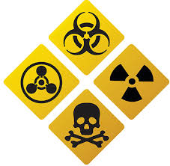
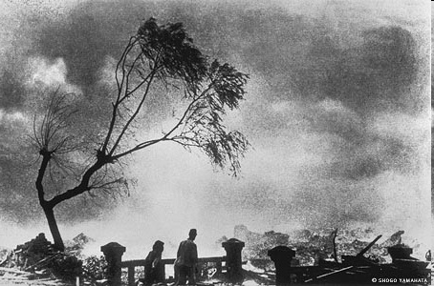

CASE STUDY : HIROSHIMA & NAGASAKI
Presented By:- Kamal Mehra,2IC
NDRF | CBRN | INDIA
1
PPT -
PEER | CSSR | INDIA
PPT 2 -

Slide 2
OBJECTIVES
Know about Hiroshima Know about Nagasaki Effects of atomic bombs Review
Upon completing of this lesson, you will be able to :-
Notes:
On August 9th 1945, three days later, at 11.02 A.M., another B-29 dropped the second bomb on the industrial section of the city of Nagasaki totally destroying 1 1/2 square miles of the city, killing 39,000 persons and injuring 25,000 more.
73,884 people died and 74,909 people injured by a blistering blast wind, heat rays, and radiation.

Slide 3
6th AUGUST 1945
HIROSHIMA
08:15 MORNING
Notes:
On August 9th 1945, three days later, at 11.02 A.M., another B-29 dropped the second bomb on the industrial section of the city of Nagasaki totally destroying 1 1/2 square miles of the city, killing 39,000 persons and injuring 25,000 more.
73,884 people died and 74,909 people injured by a blistering blast wind, heat rays, and radiation.

Slide 4
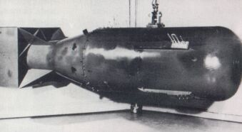
First Nuclear Weapon In The World
Name : Little Boy
Type : Uranium gun-type fission
Weight : 4400 kg
Length : 10 ft, 6 in (3.2m)
Diameter : 29 in (0.737m)
Explosive yield :15 k tons of TNT
Casualty : 80 thousand appx
HIROSHIMA

Slide 5
The nuclear bomb was detonated at the height of 580 mtr above a hospital.
5 sq mile area completely converted into an ash and destroyed 76,000 buildings.
Blast waves-5 km (50%)
Thermal rays- 4 km (35%)
Radiation- 2.5 km (15%)
Effect

Slide 6
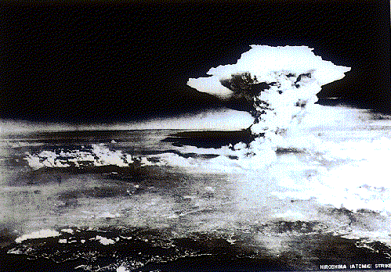
Effect
Aerial photograph from the 80 kilometers away of the inland sea, taken about 1 hour after the dropping.
Notes:
huge atomic cloud

Slide 7
9th AUGUST 1945
NAGASAKI
11:02 MORNING
Notes:
On August 9th 1945, three days later, at 11.02 A.M., another B-29 dropped the second bomb on the industrial section of the city of Nagasaki totally destroying 1 1/2 square miles of the city, killing 39,000 persons and injuring 25,000 more.
73,884 people died and 74,909 people injured by a blistering blast wind, heat rays, and radiation.

Slide 8
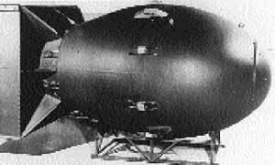
Name : Fat Man
Type : Plutonium fission
Weight : 4535 kg
Length : 11 ft, 4 inch
Diameter : 5 ft (1.52 m)
Explosive Yield :21 k tons of TNT
NAGASAKI
BOMB
Notes:
On August 9th 1945, three days later, at 11.02 A.M., another B-29 dropped the second bomb on the industrial section of the city of Nagasaki totally destroying 1 1/2 square miles of the city, killing 39,000 persons and injuring 25,000 more.
73,884 people died and 74,909 people injured by a blistering blast wind, heat rays, and radiation.

Slide 9

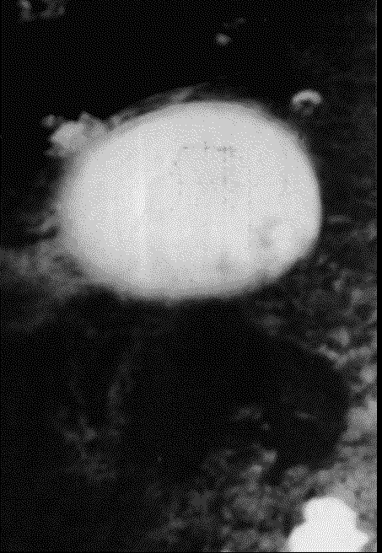
Nagasaki, Japan (August 9, 1945)

Slide 10
NAGASAKI
Nicknamed 'Fat Man‘ Bomb was dropped by parachute
at 1102 hours on 9 August 1945 by an American B29 bomber from the Pacific island of Tinian.
The aircraft's first target was the city of Kokura, now part of Kitakyushu, but as it was covered by heavy cloud the aircraft was diverted to its second target, Nagasaki.
Notes:
Nagasaki, Japanese city on which the second operational atomic bomb was dropped. Nicknamed 'Fat Man' (a reference to Churchill), the bomb, which used plutonium 239, was dropped by parachute at 1102 on 9 August by an American B29 bomber from the Pacific island of Tinian. It measured just under 3.5 m. (11 ft. 4 in.) in length, had the power of 22 kilotons of TNT, and weighed 4,050 kg. (nearly 9,000 lb.). The aircraft's first target was the city of Kokura, now part of Kitakyushu, but as it was covered by heavy cloud the aircraft was diverted to its second target, Nagasaki.
Unlike Hiroshima, Nagasaki lies in a series of narrow valleys bordered by mountains in the east and west. The bomb exploded about 500 m. (1,625 ft.) above the ground and directly beneath it (the hypocentre) was a suburb of schools, factories, and private houses. The radius of destruction for reinforced concrete buildings was 750 m. (2,437 ft.), greater than at Hiroshima where the blast caused by the bomb was more vertical. But because of the topography, and despite the Nagasaki bomb being more powerful, only about 6.7 sq. km. (2.6 sq. mi.) of Nagasaki was reduced to ashes compared with 13 sq. km. (5 sq. mi.) of Hiroshima. Of the 51,000 buildings in the city 22.7% were completely destroyed or burt, with 36.1 % escaping any damage.
Among the 270,000 people present when the bomb was dropped, about 2,500 were labour conscripts from Korea and 350 were prisoners-of-war. About 73,884 were killed and 74,909 injured, with the affected survivors suffering the same long-term catastrophic results of radiation and mental trauma as at Hiroshima.
Committee on Damage by Atomic Bombs in Hiroshima and Nagasaki, Hiroshima and Nagasaki: The Physical, Medical and Social Effects of the Atomic Bombings (London, 1981).

Slide 11
NAGASAKI
Among the 270,000 people present when the bomb was dropped, about 2,500 were labour conscripts from Korea and 350 were prisoners-of-war.
About 73,884 were killed and 74,909 injured, with the affected survivors suffering the same long-term catastrophic results of radiation and mental trauma as at Hiroshima.

Slide 12
NAGASAKI
The devastation of Hiroshima and Nagasaki resulted in three main types of effects:
a) Blast.
b) Thermal Radiation.
c) Nuclear Radiation.
Notes:
The devastation of Hiroshima and Nagasaki resulted in three main types of effects: a) Blast. b) Thermal Radiation. c) Nuclear Radiation.

Slide 13
NAGASAKI

Slide 14
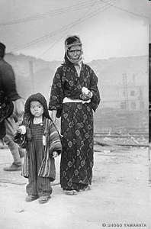
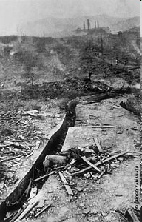
NAGASAKI

Slide 15
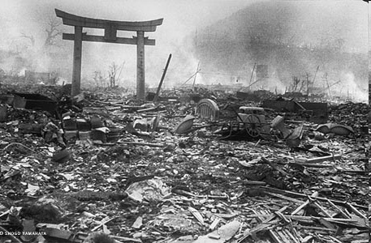
NAGASAKI

Slide 16
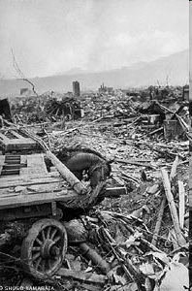
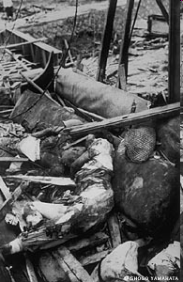
NAGASAKI

Slide 17
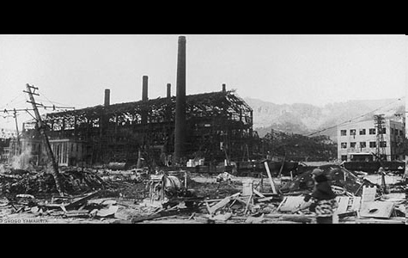
NAGASAKI

Slide 18
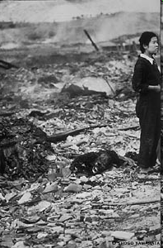
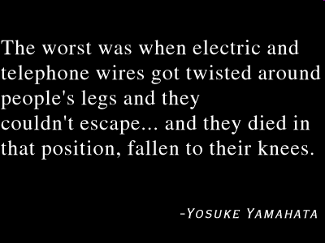
NAGASAKI

Slide 19
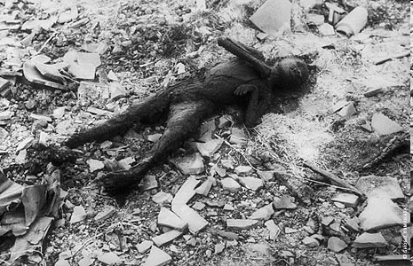
NAGASAKI

Slide 20
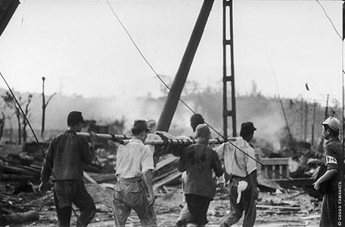
NAGASAKI

Slide 21
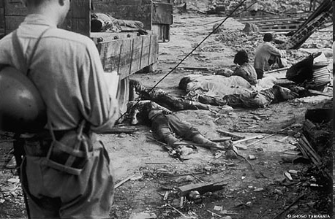
NAGASAKI

Slide 22
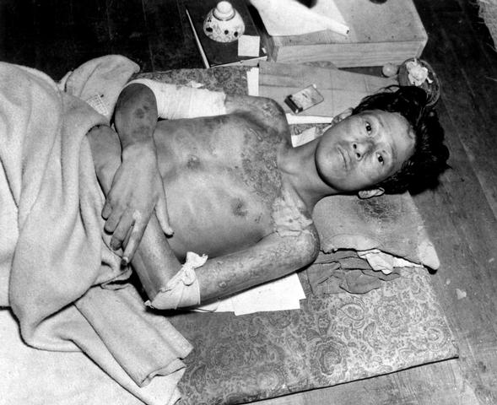
Victim of the Atom Bomb Explosion
Notes:
(Corps of Engineers) Exact Date Shot Unknown NARA FILE #: 077-AEC-48-27 WAR & CONFLICT BOOK #: 1245 (Released to Public)

Slide 23
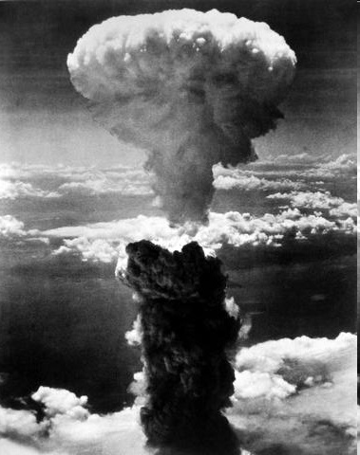
A dense column of smoke rises more than 60,000 feet into the air over the Japanese port of Nagasaki, the result of an atomic bomb, the second ever used in warfare, dropped
NAGASAKI
Notes:
OWI) NARA FILE #: 208-N-43888 WAR & CONFLICT BOOK #: 1242 (Released to Public)

Slide 24
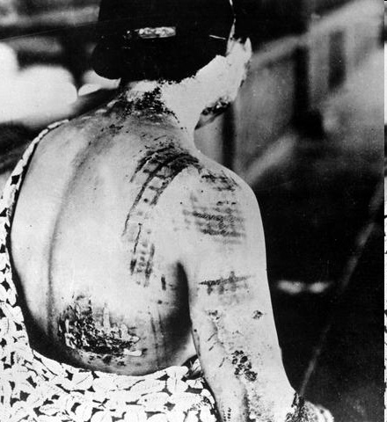
NAGASAKI
The patient's skin is burned in a pattern corresponding to the dark portions of a kimono worn at the time of the explosion. Japan, ca. 1945.

Slide 25
REVIEW
1. Know about Hiroshima 2. Know about Nagasaki 3. Effects of atomic bombs
4. Conclusion
Upon completing of this lesson, you are able to learn :-

Slide 26

Any question ?

Slide 27
EVALUATION
Question:- What is the name of Nagasaki Bomb ?
Ans:-

Slide 28


THANK YOU

