Slide 1
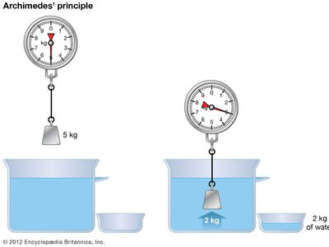
UNDER WATER FORMULA
Presented by:- Vimal Bounthiyal , 2IC

Slide 2
OBJECTIVE
Upon completion of this lesson, you will be able to –
Define Buoyancy
Describe Archimedes Principle
Understand Under water pressure

Slide 3
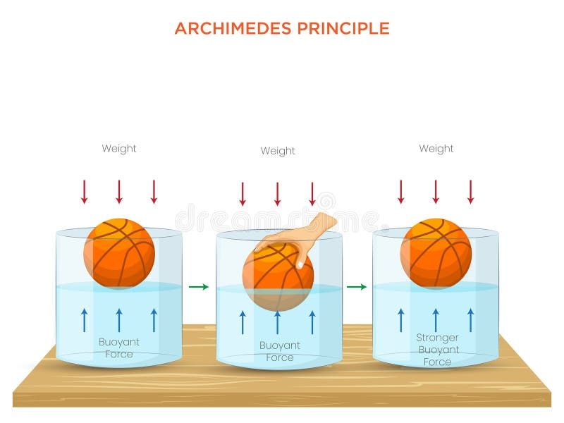
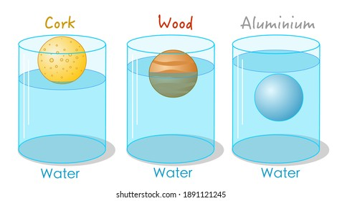
INTRODUCTION
The buoyant force is the upward force caused by the difference in pressure on submerged objects.
Because pressure increases as a fluid gets deeper , there is more pressure on the bottom of the object in a fluid.

Slide 4
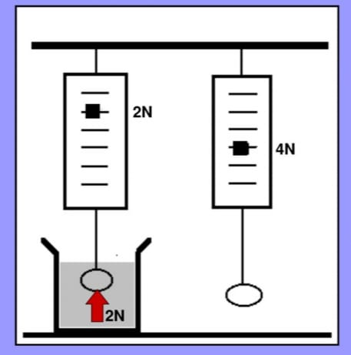
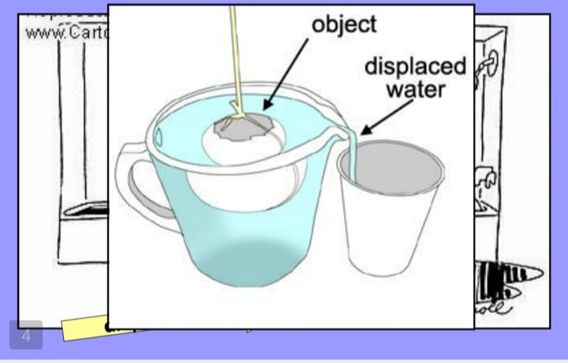
BUOYANCY
The buoyant force pushes up all
objects in a fluid.

Slide 5
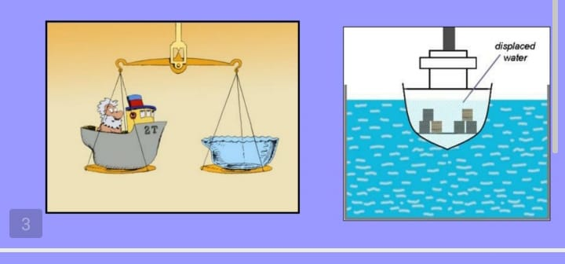
ARCHIMEDES PRINCIPLE
The magnitude (size) of the buoyant force is equal to the weight of the fluid that is displaced by the object.

Slide 6
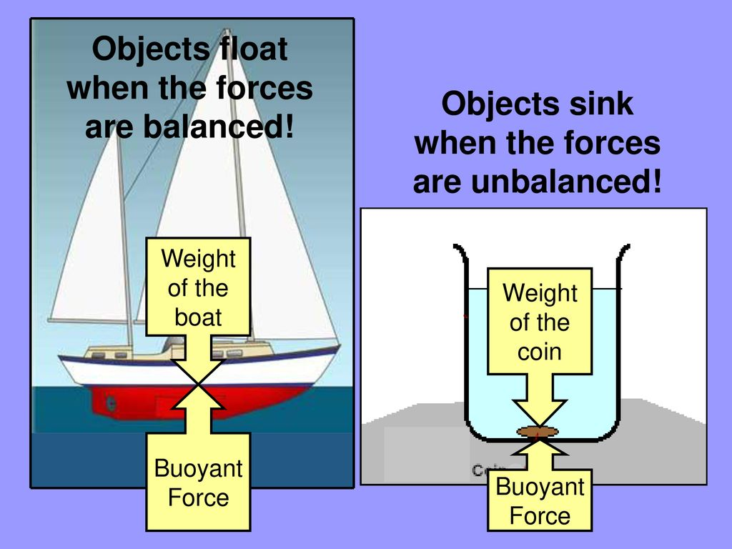
ARCHIMEDES PRINCIPLE

Slide 7
WHAT DOES DISPLACED FLUID MEAN?

Slide 8
BASIC CONCEPT OF VOLUME
Volume = Area × Depth
Units used: cubic meters (m³), liters (L)
Importance of using uniform units

Slide 9
COMMON TANK SHAPES
• Rectangular
• Cylindrical
• Spherical (rare, but possible)
• Diagram examples

Slide 10
VOLUME OF RECTANGULAR TANK
• Formula: V = Length × Width × Height
• Example: 5m × 3m × 2m = 30 m³
• Convert to liters: 30,000 L

Slide 11
VOLUME OF CYLINDRICAL TANK
• Formula: V = π × r² × h
• Example: radius = 1m, height = 3m
• Volume = 3.14 × 1² × 3 = 9.42 m³

Slide 12
PARTIAL TANK VOLUME (VARYING DEPTH)
• Calculating volume when tank is not full
Use proportion: (Filled depth / Total depth) × Full volume
• Useful in estimating during partial fills

Slide 13
REVIEW
Upon completion of this lesson, you are now able to –
Define Buoyancy
Describe Archimedes Principle
Understand Under water pressure

Slide 14
ANY QUESTION ???

Slide 15
EVALUATION
Q. 1. The magnitude (size) of the buoyant force is equal to the -------of the fluid that is displaced by the object.
Ans. Weight
Q. 2. What are the common tank shapes?
Ans.
Rectangular
• Cylindrical
• Spherical (rare, but possible)
• Diagram examples

Slide 16


THANK YOU

