Slide 1


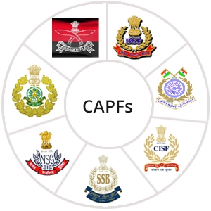

MEDICAL FIRST RESPONDER
LESSON 12
INJURIES TO SKULL, SPINAL COLOUMN AND CHEST
Presented by:- Pavan Dev Gaur, 2IC
CAPF | MFR | INDIA
-

Slide 2
OBJECTIVES
Upon completing this lesson, you will be able to:
1
List five signs and symptoms of a skull fracture.
List six signs and symptoms of a spinal injury.
List five signs and symptoms of chest injuries.
2
3

Slide 3
OBJECTIVES
Upon completing this lesson, you will be able to:
4
Demonstrate the procedures for the evaluation and pre-hospital treatment of injuries to the skull and spine.
Demonstrate the procedures for the evaluation and pre-hospital treatment of rib fractures, flail chest and penetrating chest injuries.
5

Slide 4
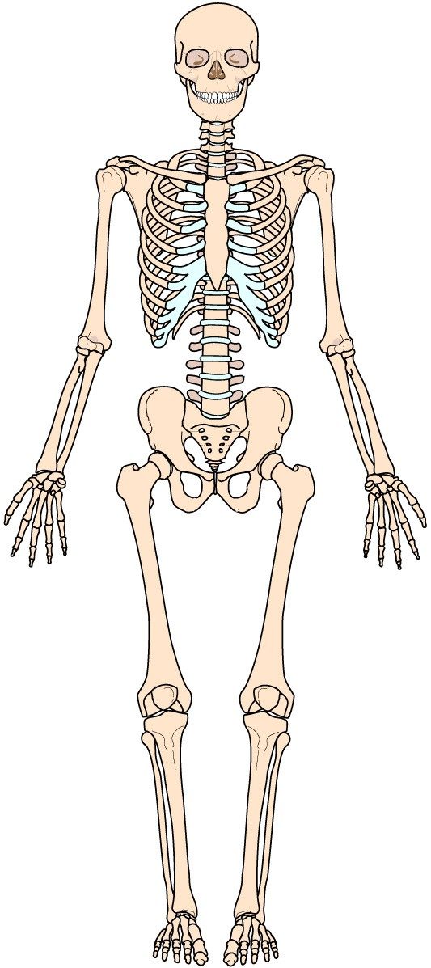
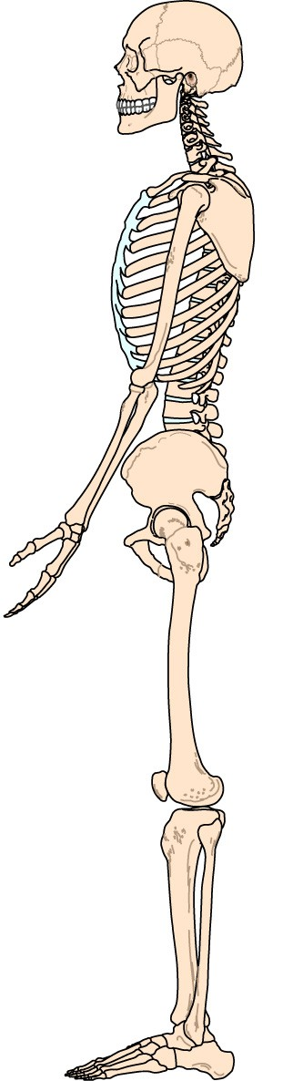
Skeletal System

Slide 5
The skull has a number of broad, flat bones that form a hollow shell.
The top (including the forehead), back and sides of the skull make up the cranium.
It houses and protects the brain.
THE SKULL

Slide 6
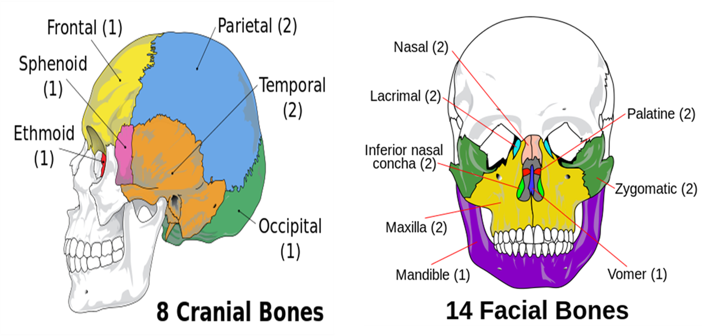
BONES OF THE SKULL

Slide 7
CEREBROSPINAL FLUIDS (CSF) is a clear, water-like cushion that protects the brain and spinal cord from trauma.
The cranial vault is quite strong and provides effective protection. However, even without a skull fracture, the brain can be damaged by trauma.
THE SKULL

Slide 8
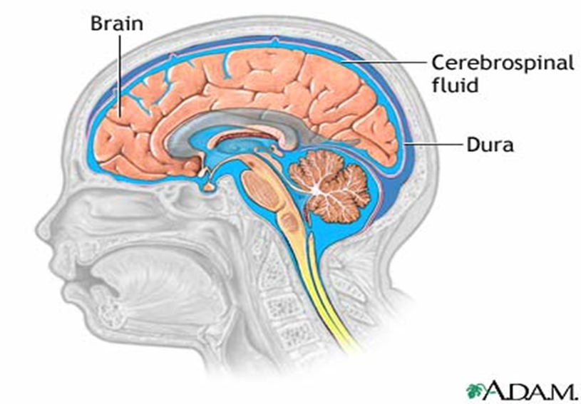
THE SKULL

Slide 9
It houses and protects the spinal cord.
It is the central supportive bony structure of the body.
Consists of 33 bones known as vertebrae.
The spine are divided into 05 sections:
SPINAL COLUMN

Slide 10
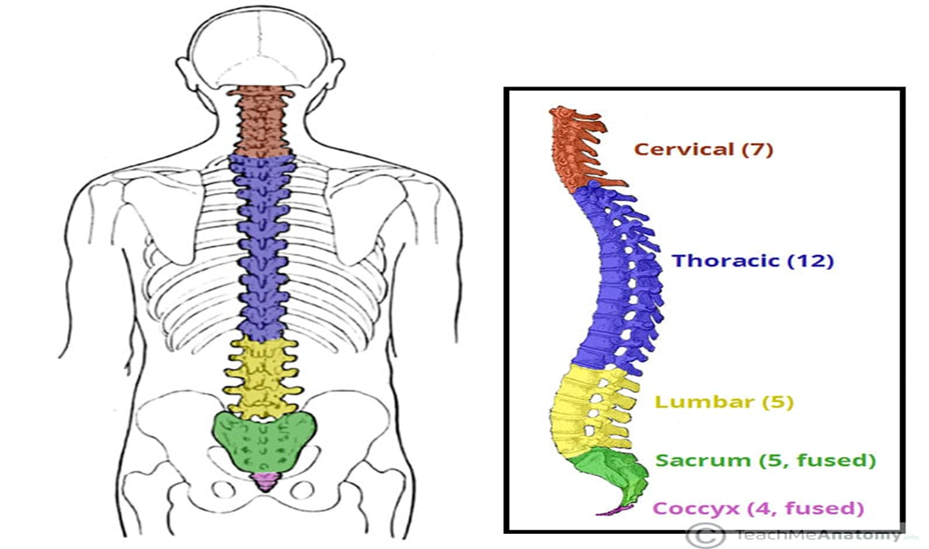
SPINAL COLUMN

Slide 11
CHEST
The Chest or rib-cage include the ribs, the thoracic vertebrae and the sternum.
The ribs are attached at the back to the vertebrae.
All but the bottom two ribs are not attached to the sternum.

Slide 12
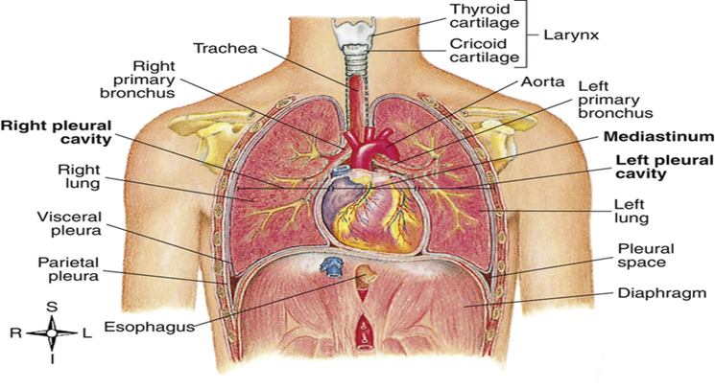
Thoracic cavity contains the lungs, the heart and the major blood vessels (arteries and veins).
Damage to the rib cage can cause injury to the vital organs.
ORGANS

Slide 13
Do not try to remove an object impaled in the skull-stabilize it with bulky dressings.
Do not try to stop the flow of cerebrospinal fluid if the fluid is leaking from the ears or a head wound.
Cover the opening loosely with sterile gauze dressing.
DANGER!

Slide 14
Altered mental status, ranging from confusion to Unresponsiveness.
Pain or inflammation at the injury site.
Softness or depression of the skull.
Facial bruising.
Bruising around the eyes or “RACCOON Eyes”
One or both eyes appear sunken.
Unequal pupil size.
SIGNS & SYMPTOMS OF SKULL FRACTURES:

Slide 15
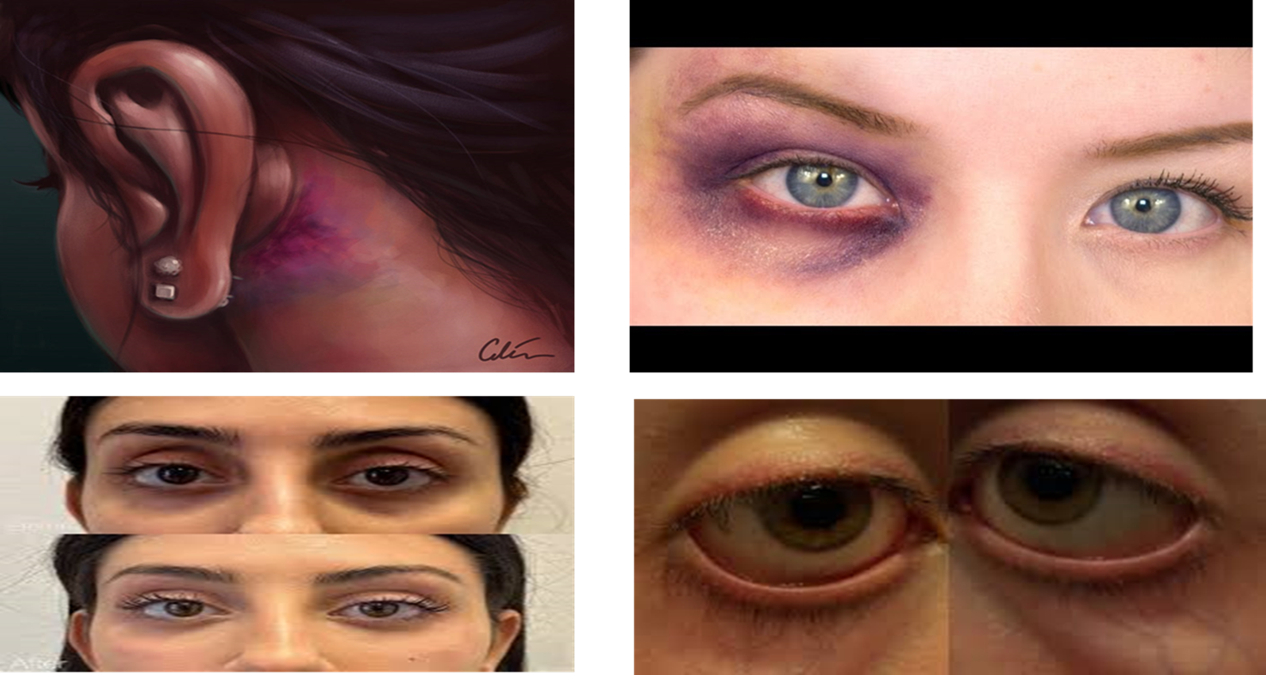
SIGNS & SYMPTOMS OF SKULL FRACTURES:

Slide 16
Perform initial assessment. Treat life-threatening conditions.
Control bleeding. Do not try to stop the draining of blood or cerebrospinal fluid from the nose and ears. 3) Suspect cervical injury or another type of injury to the spinal column. Manually immobilize head and neck in neutral in-line position. Apply cervical collar.
Administer oxygen if needed.
Cover and bandage open wounds.
PHT FOR SKULL FRACTURES

Slide 17
Open/penetrating: An open brain injury is accompanied by a break in the skull, such as that caused by a fracture or an impaled object. This usually implies exposure of the cranial cavity.
Closed: A closed brain injury does not involve a break in the skull although the skin may be broken; even so, the brain can be seriously injured.
BRAIN INJURIES

Slide 18
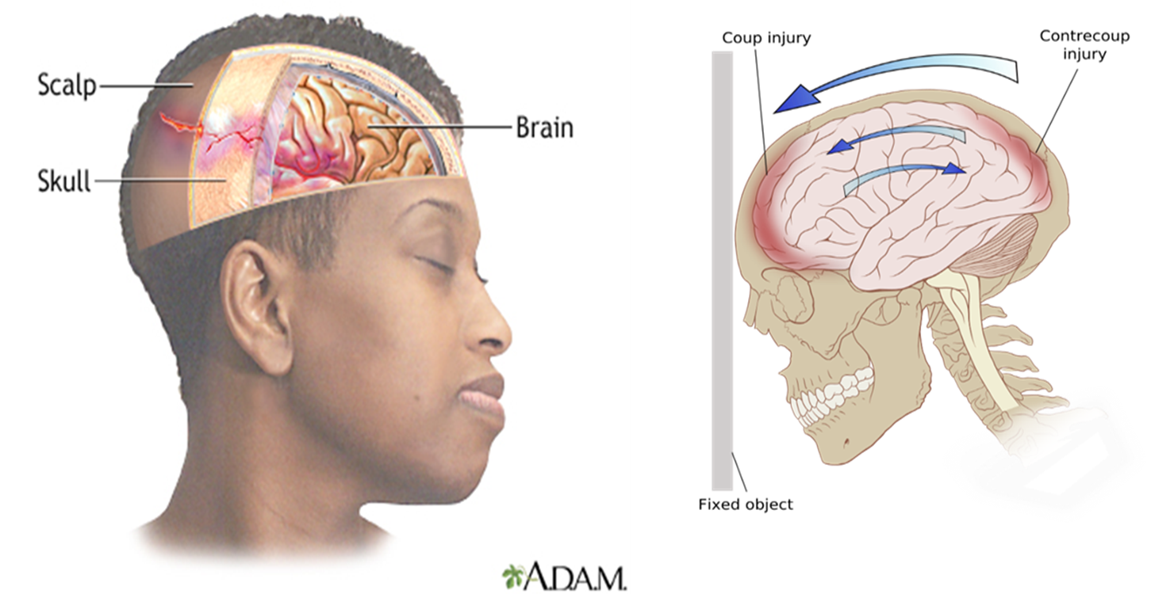
BRAIN INJURIES

Slide 19
SIGNS AND SYMPTOMS OF BRAIN INJURY
Pre-hospital treatment for brain injuries is the same as those indicated for skull fractures.

Slide 20
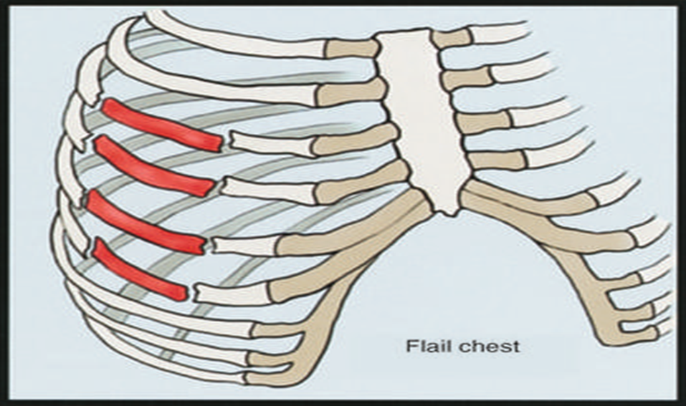
It is a closed chest injury.
Causing the chest wall unstable.
Multiple fractures of the sternum/ribs.
Cartilage connecting the ribs to the sternum or fractured ribs.
The chest between the fractures becomes unstable
RIB FRACTURES
FLAIL CHEST

Slide 21
Locate the flailed section of the chest.
Stabilize flail chest by applying a pillow or bulky dressing.
Use adhesive tape to secure the bulky dressing. If no tape is available, use your hand to secure the injured site.
PRE-HOSPITAL TREATMENT

Slide 22
PENETRATING WOUNDS
Penetrating chest injuries are open chest wounds in which the chest wall is torn, typically by a foreign object. Look for possible exit wound.

Slide 23
Chest injuries: A penetrating chest wound can prevent a patient from breathing adequately. These wounds are called “sucking chest wounds” because they produce a sucking sound every time the patient breathes. In this case, apply an occlusive dressing, leaving an open side as a relief valve.
PENETRATING WOUNDS

Slide 24
An impaled object should always be fixed in its place, unless it is located in the patient’s cheek, or if it interferes with airway management or CPR. It should be stabilized with bulky dressing and adhesive tape to secure the dressing in place.
Impaled Objects

Slide 25

Cranium
Skeletal System
Thorax
Vertebrae

Slide 26
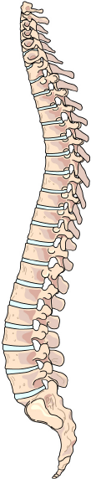
Cervical vertebrae
Spinal Column
Thoracic vertebrae
Lumbar vertebrae
Sacral vertebrae
Coccygeal vertebrae

Slide 27
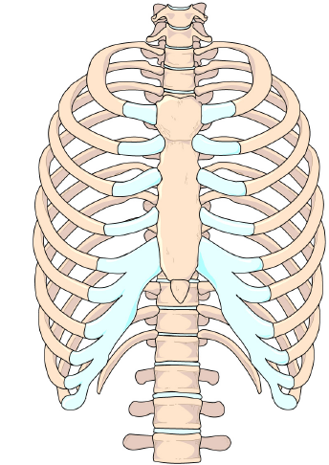
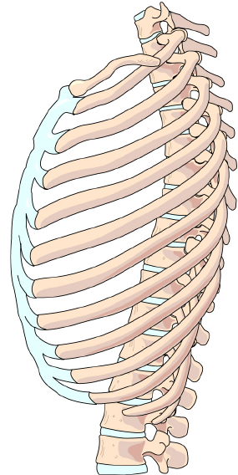
Thorax
Sternum
Ribs

Slide 28
Review
Now You are able to:
1
List five signs and symptoms of a skull fracture.
List six signs and symptoms of a spinal injury.
List five signs and symptoms of chest injuries.
2
3

Slide 29
Review
Now You are able to:
4
Demonstrate the procedures for the evaluation and pre-hospital treatment of injuries to the skull and spine.
Demonstrate the procedures for the evaluation and pre-hospital treatment of rib fractures, flail chest and penetrating chest injuries.
5

Slide 30



THANK YOU

