Slide 1
LIFTING MOVING AND PHT
Presented by:- Vimal Bounthiyal , 2IC

Slide 2
OBJECTIVE
After completion of this lesson, you able to…
What is underwater diving ?
Common illness in underwater.
Describe of nitrogen narcosis.
What is oxygen toxicity ?
Ear barotrauma
Pulmonary over inflation syndrome
Pneumothorax
First aid of drowning victim.

Slide 3
UNDERWATER DIVING
When human beings descend beneath the water, the pressure around them increases greatly.
To keep the lung from collapsing, air must be supplied at very high pressure to keep them inflated.

Slide 4
UNDERWATER DIVING
The exposes the blood in the lungs also to extremely high alveolar gas pressure, a condition called hyperbolism.
Beyond certain limits, these high pressures can cause great alterations in body physiology and can be lethal.

Slide 5
UNDERWATER DIVING
Depth (feet) Atmosphere
Sea level 01
33 02
66 03
100 04
133 05
166 06
200 07
300 10
400 13
500 16

Slide 6
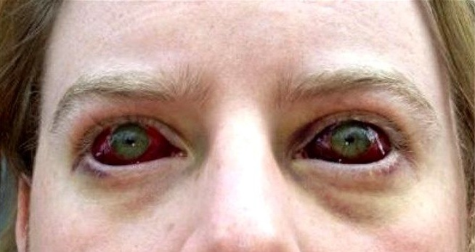
COMMON ILLNESS IN UNDERWATER
Decompression sickness
Hypothermia
Hypoxia
Nitrogen narcosis
Oxygen toxicity
Ear barotrauma
Pulmonary over inflation syndrome
Pneumothorax

Slide 7
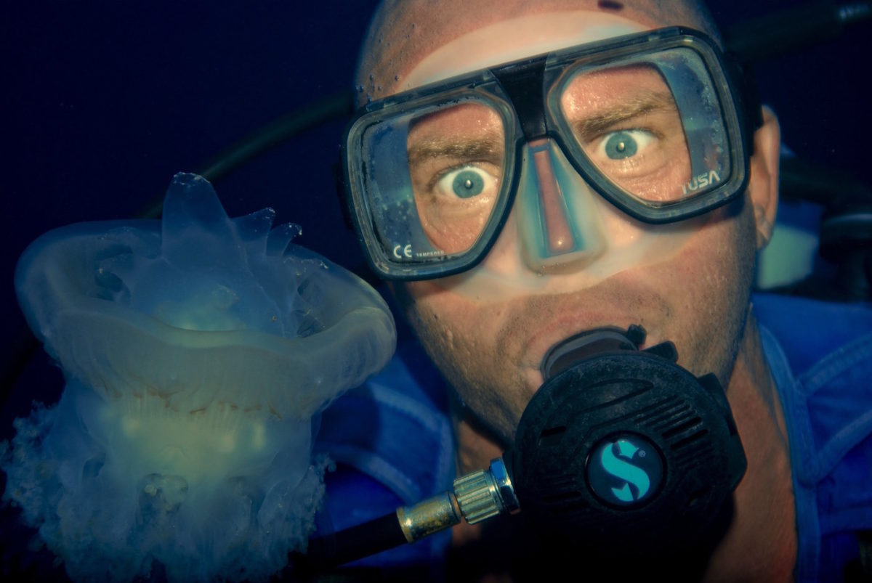
Nitrogen narcosis is a condition that affect deep sea divers. It goes by many other name, including:-
Narks
Rapture of the deep
The martini effect
Inert gas narcosis
NITROGEN NARCOSIS

Slide 8
Deep-sea divers use oxygen tanks to help them breath underwater. These tanks usually contain a mix of oxygen, nitrogen and other gasses.
Once divers swim deeper than about 100 feet, the increased pressure can alter these gases.
When inhaled, the altered gasses can produce unusual symptoms that often make a person appear to be drunk.
NITROGEN NARCOSIS

Slide 9
Most divers filling drunk or dazed.
Poor judgment
Short term memory loss
Trouble concentrating
Reduced nerve and muscle function
Hyper focusing on a specific area
SYMPTOMS OF NITROGEN NARCOSIS

Slide 10
More severe cases can also cause someone to go into a coma or even die.
Nitrogen narcosis symptoms tend to start once a diver reaches a depth of about 100 feet.
Symptoms star to become more serious at a depth of about 300 feet.
SYMPTOMS OF NITROGEN NARCOSIS

Slide 11
Once a diver returns to the waters surface, the symptoms usually go away within a few minutes. However, some of the symptoms like poor judgment, cause divers to swim deeper.
This can lead to more serious symptoms.
SYMPTOMS OF NITROGEN NARCOSIS

Slide 12
COUSE OF NITROGEN NARCOSIS
When you inhale compressed air from an oxygen tank while under a lot of pressure from water, it increase the pressure of oxygen and nitrogen in your blood.
This increased pressure affects your central nervous system.

Slide 13
DIAGNOSED OF NITROGEN NARCOSIS
Nitrogen narcosis usually happens in the middle of a deep-sea dive, so its rarely diagnosed by a doctor.
The main treatment is simply getting yourself to the waters surface.

Slide 14


Slide 15
OXYGEN TOXICITY
Oxygen toxicity is a condition resulting from the harmful effects of breathing molecular oxygen at increased partial pressures.
The metabolites of oxygen are more damaging than the parent molecule itself.
There are formed in the process of conversion of O2 to water in the electron transport chain in mitochondria.
The superoxide and hydroxyl radicals are free radials very active chemically.

Slide 16
TYPE OF OXYGEN TOXICITY
Central nervous system:- Central nervous system oxygen toxicity can cause seizures, brief period of rigidity followed by unconsciousness.
Pulmonary toxicity:- Pulmonary oxygen toxicity results in damage to the lungs, cause pain and difficulty in breathing.

Slide 17
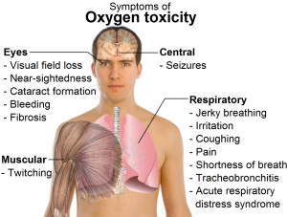

Slide 18
SIGN & SYMPTOMS
Nausea.
Muscle twitching.
Dizziness.
Disturbances of vision.
Irritability.
Disorientation.

Slide 19
DIAGNOSIS
Diagnosis of oxygen toxicity in divers prior to seizure is difficult as the symptoms of visual disturbance, ear problems, dizziness, confusion and nausea can be due to many factor common to the underwater environment such as narcosis, congestion and coldness.
However, these symptoms may be helpful in diagnosing the first stage of oxygen toxicity in patients undergoing hyperbaric oxygen therapy.

Slide 20
EAR BAROTRAUMA
Ear barotrauma is a condition that cause ear discomfort due to pressure change.
In each ear there is a tube that connects the middle of your ear to your throat and nose. It also helps regulate ear pressure.
This tube is called the Eustachian tube. When the tube is blocked, you may experience ear barotrauma.

Slide 21
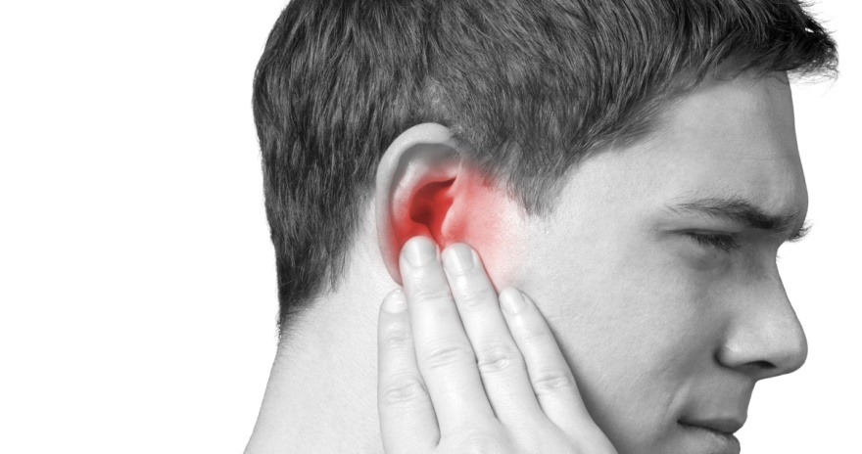
SYMPTOMS
Dizziness
General ear discomfort
Slight hearing loss or difficulty hearing
Stuffiness or fullness in the ear

Slide 22
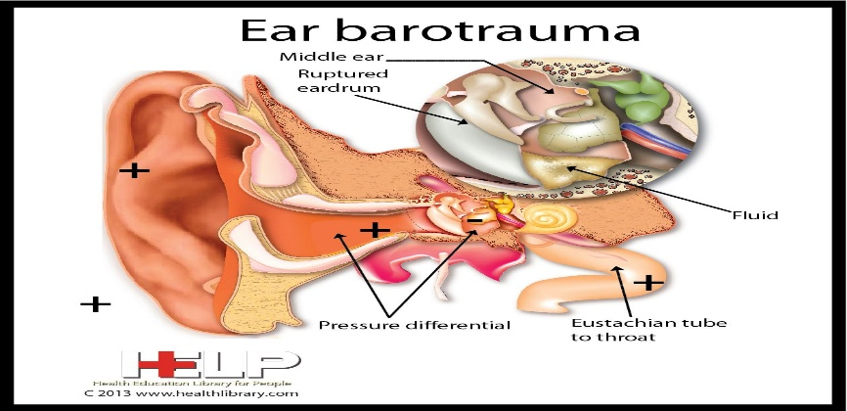
CAUSE OF EAR BAROTRAUMA
Eustachian tube blockage is one of the cause of ear barotrauma.
Scuba diving
Hiking
Pressure underwater (first 14 feet)

Slide 23

EAR BAROTRAUMA TREATMENT
Most cases of ear barotrauma generally heal without medical intervention. There are some self-care step you can take for immediate relief.
Yawning
Chewing gum
Practicing breathing exercises.

Slide 24
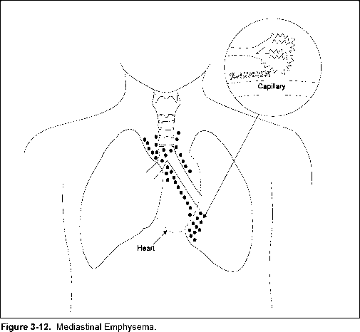
PULMONARY OVER INFLATION SYNDROME
Pulmonary over inflation syndrome (POIS) is a group of barotrauma related diseases caused by the expansion of gas trapped in the lung, or over pressurization of the lung with subsequent over expansion and rupture of the alveolar air sacs.

Slide 25
CAUSES
Breath holding during ascent.
Inhaling while pushing purge button.
Rapid uncontrolled ascent (blow-up)
Air trapped in lung.

Slide 26
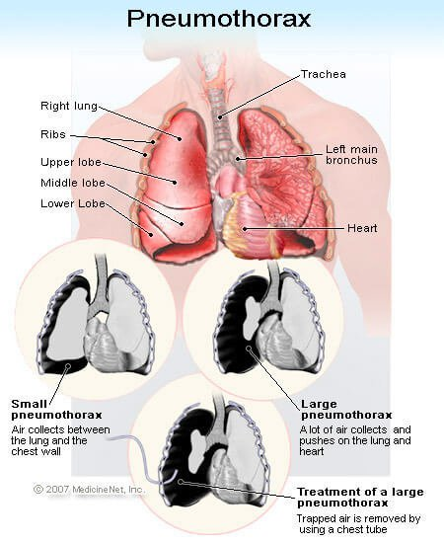
PNEUMOTHORAX
Pneumothorax is the medical term for a collapsed lung.
Pneumothorax occurs when air enters the space around your lungs.
Pneumothorax can be a complete lung collapse or a collapse of only a portion of lung.

Slide 27
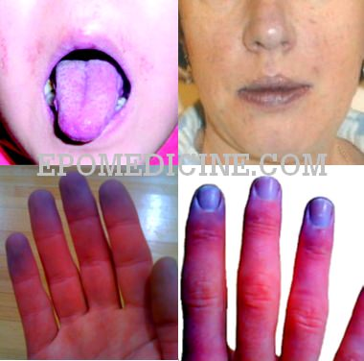
SYMPTOMS
A sudden attack of chest pain is often the first symptoms.
Shortness of breath
Cyanosis
Tightness in the chest
Breaking out in a cold sweat

Slide 28

DROWNING
Drowning is the condition when the victim inhales or ingests water through his/her respiratory tract or alimentary tract.
Death occurs within 24 hrs. due to suffocation.

Slide 29
CAUSES
Suicide
Seizure, unconscious near water.
Drowning in swimming pool.
Small children have drowning in bath tubs.
Fall during boating.

Slide 30
SIGN & SYMPTOMS
Body is wet, cold hands and legs.
Bluish discoloration of body especially lips.
Frothy discharge from mouth, vomiting.
Increased / decreased rate of breathing / absent breathing.
Abnormal sound.
Decreased heart rate.
No breathing and no pulse.

Slide 31

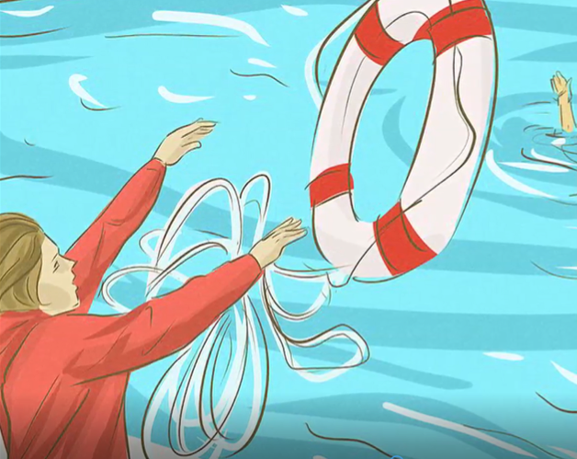
FIRST AID MANAGEMENT
During drowning
Your safety first: don’t just jump in the water.
Throw a light object
(life jacket, wooden piece,
rope) for the patient to catch.

Slide 32
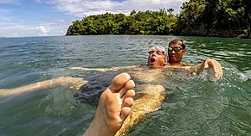
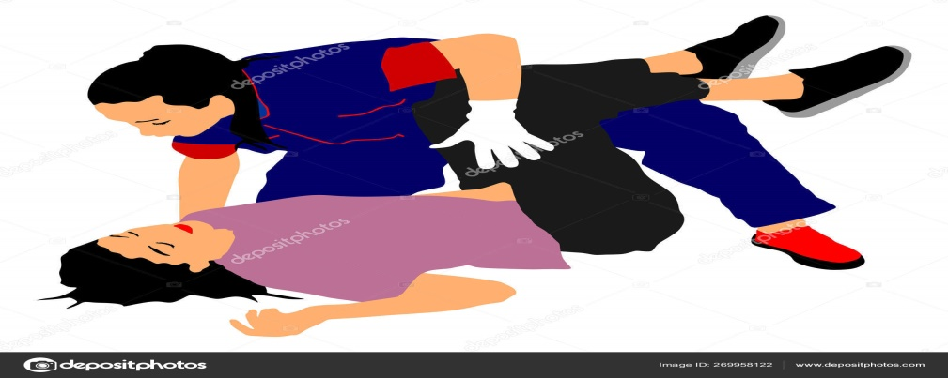

FIRST AID MANAGEMENT
Rescue the patient from under water.
Lie the patient in flat surface.
Remove all the wet clothes and make the patient warm.

Slide 33
ASSESS THE PATIENT
Look :- Alertness (AVPU) chest movement.
Listen :- Heart sound and Respiration sound.
Feel :- Air passage through nostrils.

Slide 34
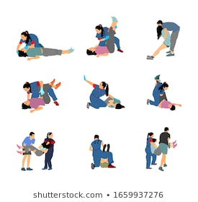
ASSESS THE PATIENT
No pulse no respiration.
Start CPR.
Patient breathing but
has difficulty.
Maintain ABC.
Manage if injuries.

Slide 35
Maintain Airway
Left lateral position.
Clear foreign body.
Don’t insert anything in mouth (e.g. Spoon)
Air way open through head tilt chin lift or jaw thrust.
Loosen tie, clothing around the neck.
Remove artificial dentures if possible.

Slide 36
Maintain Airway
Remove excess water from lungs and abdomen:
1. By turning upside down
2. Or pressing over the abdomen
Reassure the patient shows sign of become responsive such as coughing, opening eyes, speaking and start to breathe normally put them it the recovery position.

Slide 37
You may also need to treat them for hypothermia covering them with warm clothes and blankets.
Immediately transfer to hospital.
Maintain Airway

Slide 38
REVIEW
Upon completion of this lesson, you are able to know -
What is underwater diving ?
Common illness in underwater.
Describe of nitrogen narcosis.
What is oxygen toxicity ?
Ear barotrauma
Pulmonary over inflation syndrome
Pneumothorax
First aid of drowning victim.

Slide 39
ANY QUESTIONS??

Slide 40
EVALUATION
Q. 1. What are the two causes of drowning?
Suicide & Seizure, unconscious near water
Q. 2. What are the signs and symptoms of Pneumothorax.
A. Shortness of breath, Cyanosis & Tightness in the chest etc.

Slide 41


THANK YOU

