Slide 1




COMMUNITY PARTICIPATION IN RURAL AND FOREST FIRE FIGHTING
Presented By:- Sachin Chauhan,2IC
PEER | CSSR | INDIA
PPT 2 -

Slide 2
OBJECTIVES
Community participation in rural and forest fire fighting.
Integrated forest fire management (IFFM)
Challenges and consideration
1
Upon completing of this lesson, you will be able to :-
2
3

Slide 3
INTRODUCTION-
Community involvement plays a critical role in effectively managing and controlling rural and forest fires.

Slide 4
Early Detection and Response
Local Knowledge and Expertise
Resource Mobilization
Fire Prevention and Mitigation
Increased Awareness and Education
Building Community Resilience
HERE’S WHY

Slide 5
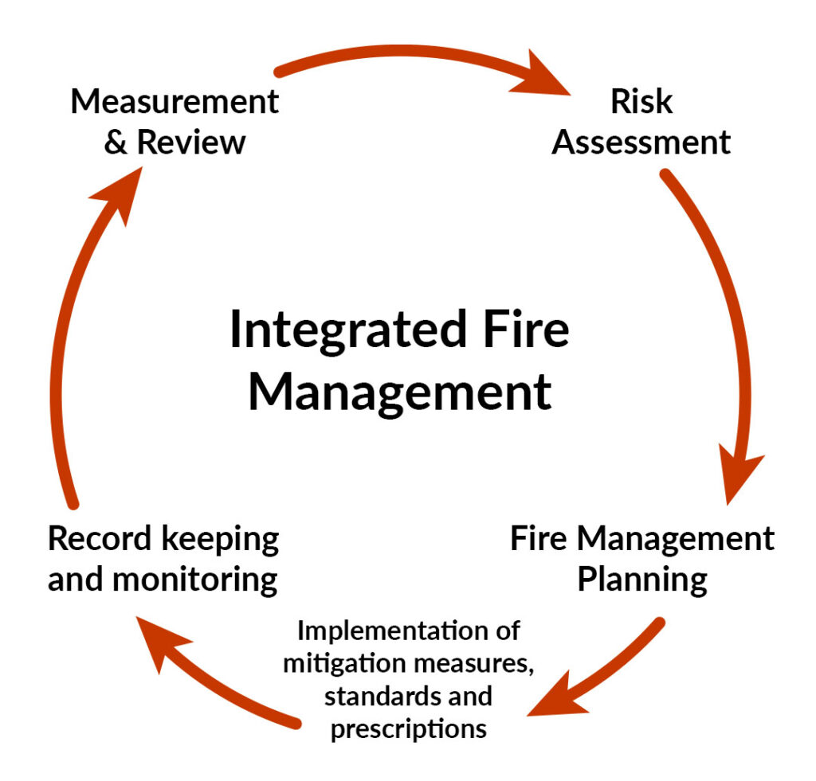
INTEGRATED FOREST FIRE MANAGEMENT (IFFM)

Slide 6

Community Empowerment: Enabling communities to actively participate in decision-making and resource allocation for fire management.
Integration of Traditional Knowledge: Combining scientific knowledge with traditional fire management practices and indigenous knowledge systems.
Capacity Building: Providing training and resources to enhance communities' skills and knowledge in fire management.
Stakeholder Collaboration: Fostering partnerships and information sharing among various stakeholders involved in fire management.
INTEGRATED FOREST FIRE MANAGEMENT (IFFM)

Slide 7
Despite the numerous benefits of community participation in fire fighting and management, several challenges need to be addressed:-
Policy and Legal Frameworks: Existing legislation often criminalizes traditional fire use for livelihood practices, hindering community engagement. Policies need to be revised to acknowledge and support the responsible use of fire and the integration of community-based approaches.
Limited Resources: Insufficient funding and resources allocated to fire management, particularly at the community level, can limit the effectiveness of their efforts.
Conflicting Interests: Different stakeholders may have varying perspectives and priorities regarding fire use and management, requiring dialogue and negotiation to build consensus.
CHALLENGES AND CONSIDERATIONS

Slide 8
Despite the numerous benefits of community participation in fire fighting and management, several challenges need to be addressed:-
Data and Information Gaps: Lack of standardized data collection and analysis hinders effective decision-making and resource allocation in fire management.
Social and Cultural Factors: Traditional practices and social norms can influence fire use and management, requiring a nuanced understanding of community dynamics and potential barriers to participation
CHALLENGES AND CONSIDERATIONS

Slide 9
Community participation in rural and forest fire fighting.
Integrated Forest fire management (IFFM)
Challenges and consideration
REVIEW

Slide 10

ANY QUESTION ?

Slide 11

1. What is the IFFM.
Ans- IFFM recognizes the crucial role of local communities in fire management, promoting a collaborative approach between communities, government agencies, non-governmental organizations (NGOs), and other stakeholders.
2. What is the role of community.
Ans-Community involvement plays a critical role in effectively managing and controlling rural and forest fires.
Early Detection and Response
Local Knowledge and Expertise
Resource Mobilization
Fire Prevention and Mitigation
Increased Awareness and Education
Building Community Resilience
EVALUATION

Slide 12

THANK YOU

