Slide 1




TABLE TOP EXERCISE (TTX)
Presented by:- Amit Kumar, AC
PEER | CSSR | INDIA
PPT 2 -

Slide 2
AIM
  To discuss School Disaster Management Plan of School.
  To know the activation of response mechanism.
  To discuss the level of preparedness of different teams and their role & tasks.

Slide 3
PURPOSE
To understand the importance of school Disaster Management Plan in accordance with various guidelines.
To know the role & responsibilities of school disaster management team.

Slide 4
Primary Briefing – Through events of the scenario.
Usage of written and verbal injects.
METHODOLOGY

Slide 5
Representatives of
  SDMC & various teams of school.
STAKEHOLDERS

Slide 6
No fault/No blame environment.
Scenario artificially design for exercise.
Maintain stress free environment.
Response should be based on the information provided in the scenario.
Respond as per your present capacity.
Do not limit your thinking, be open with new ideas.
Think fast & take notes.
We are looking for creative ideas for our improvement.
EXERCISE GROUND RULES

Slide 7
SCENARIO

Slide 8
BACK GROUND
On 16/09/2022, an Earthquake of intensity 6.8 on Richter scale struck Nagpur district of Maharashtra at 0940 Hrs.
Epicenter of the earthquake was 150 km North West of Nagpur.
Initial inputs indicate that Bhavans School, Nagpur is affected due to structural/non-structural damage.
Duration of shock waves was approximately for 45 seconds in Nagpur.

Slide 9
OPENING NARRATIVE
Approximately 12 students sustained injuries.
Cause of injury is falling of structural/non structural elements.
Others have been injured due to chaos, as few students ran over broken glass panes/fallen objects.

Slide 10
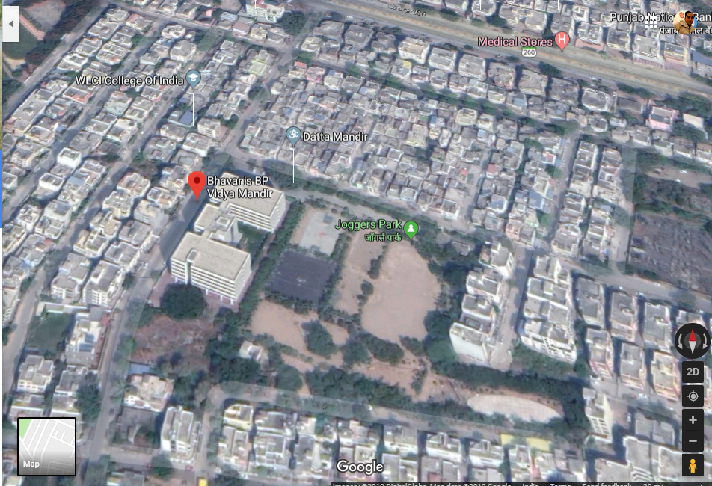
BHAVANS SCHOOL

Slide 11

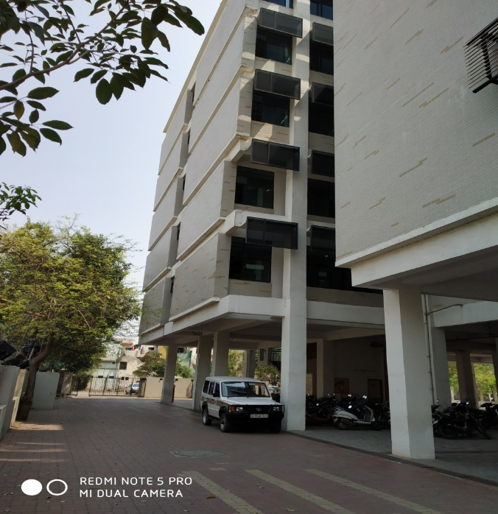
FRONT SIDE OF BUILDING
LEFT SIDE
RIGHT SIDE

Slide 12
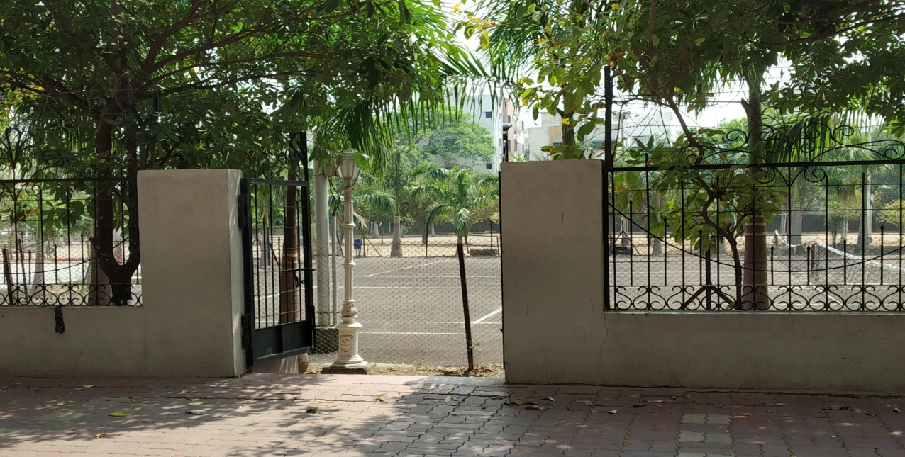
EXIT TOWARDS ASSEMBLY AREA

Slide 13
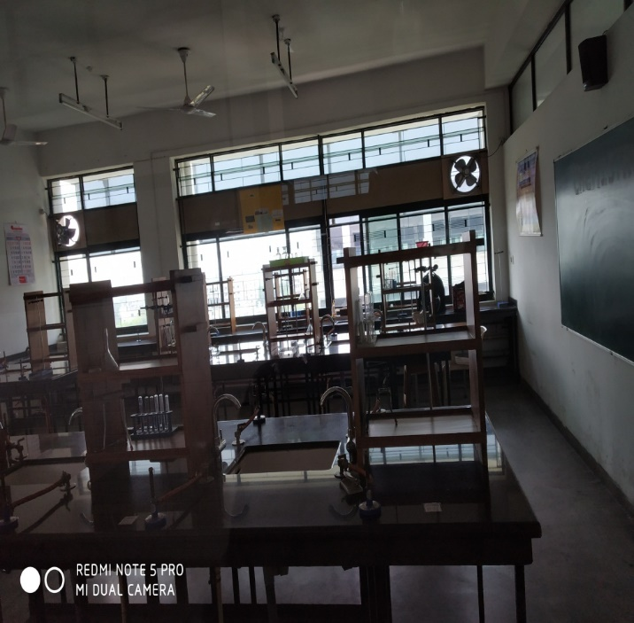
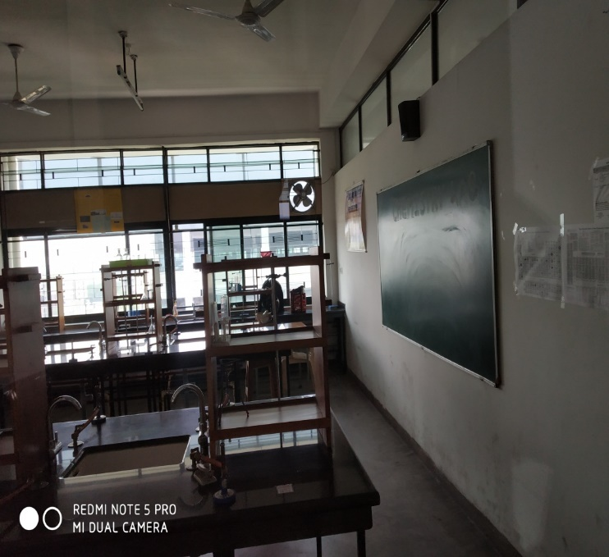
LAB. SECTION

Slide 14
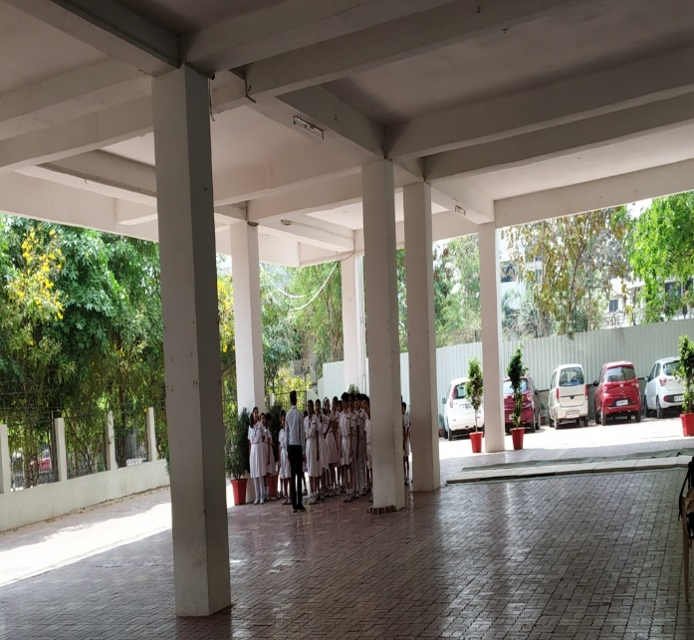
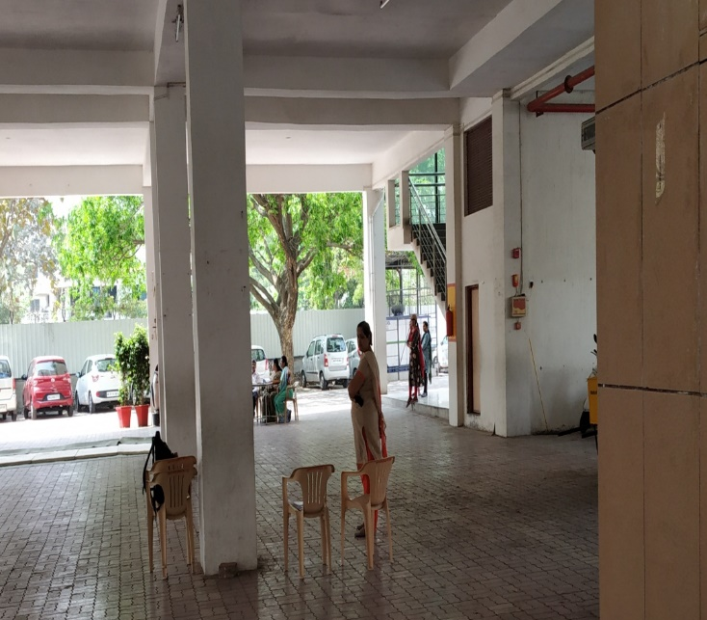
GROUND FLOOR

Slide 15
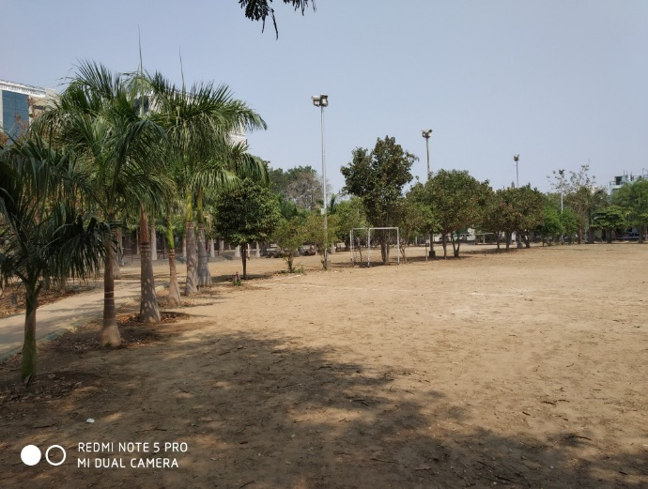
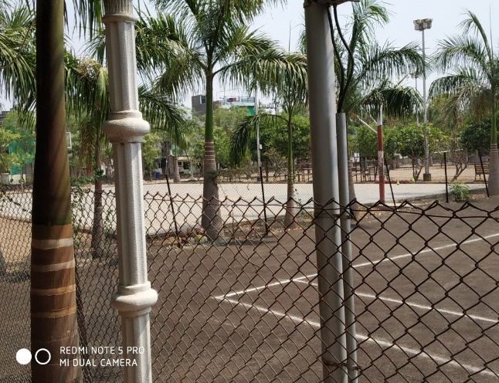
ASSEMBLY AREA (MAIN GROUND)

Slide 16
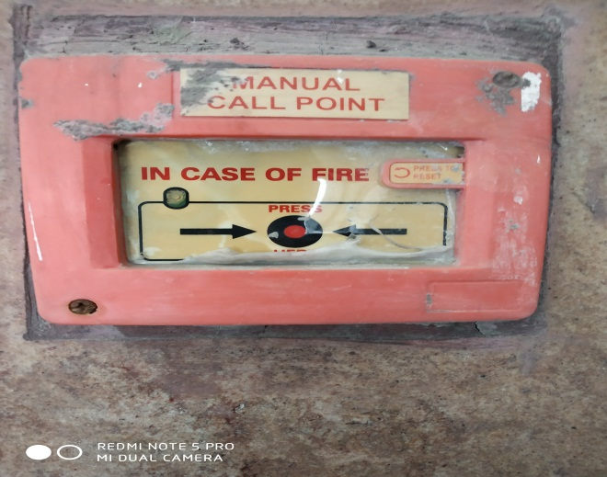
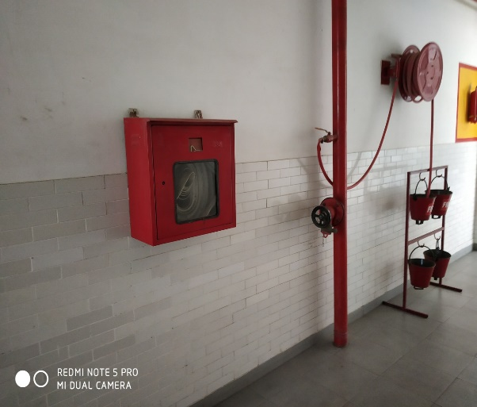
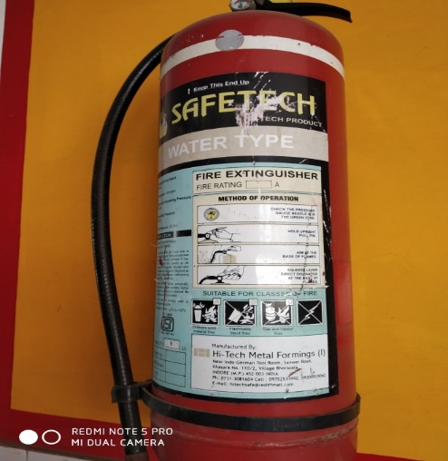
FIRE EXTINGUISHER

Slide 17
ASPECTS
Based on the situation what is your plan for response?
(Activation)
What are the procedures for response to an emergency?
What is your role and responsibility?
What is your level of preparedness and capability?
Discuss the evacuation plan of the School.
How will you coordinate with different agencies?

Slide 18
ASPECTS
How school authority will place requisition for help from other agencies?
What is the course of action of School Disaster Management Teams.
Who will be the nodal officer to coordinate with other agencies & How?

Slide 19
PLAN TODAY -
Be ready before, during and after disaster.

Slide 20
Issues to consider after the Exercise
Unresolved issues (Responsibilities for follow up)
Suggested changes to plans, policies or procedures
Identified Resource needs and shortfalls
Additional Capacity building (Training and Exercise) needs
HOT WASH_TTX

Slide 21
ANY QUESTION

Slide 22


THANK YOU

