Slide 1




REGION SPECIFIC THREATS IN SCHOOL AND THEIR DOS AND DON’T’S
Presented by:- Amit Kumar, AC
PEER | CSSR | INDIA
PPT 2 -

Slide 2




OBJECTIVES
After completion of this lecture you will be able to know about
1
School safety, Disasters- definition, classification and its types and types of disaster may be harm to school safety.
2
To sensitize children and the school community on the issue of disaster preparedness, safety measures and various strategies.
3
Fire safety for schools
Earthquake safety……Before…During…..and After..
Effects and Factors of disaster

Slide 3


SCHOOL SAFETY
A safe and secure environment is a prerequisite for teaching and learning.
Thus ensuring the safety of children, teachers and staff members during a disaster.
It becomes of utmost importance that the safety of children is given due consideration

Slide 4
AIM OF SCHOOL SAFETY
The aim of school safety is to ensure that the safety of the students and the staff is maintained during an emergency.
The emergency management plan is a means by which this can be achieved.

Slide 5
STRATEGY-1 Promoting awareness and education activities (students should be sensitize by).
Dissemination of knowledge through mass awareness campaigns.
Community Awareness Programmes.
Development of information tool-kit.
PRIMARY STRATEGIES-SSP

Slide 6
STRATEGY-2 DISASTER MANAGEMENT EDUCATION
Disaster management in the curriculum of schools and professional education will be helpful to raise awareness and sensitise students and teachers on preventive and precautionary measures of various hazards.

Slide 7
STRATEGY-3
Demonstrating disaster risk management
Training on first aid and basic search and rescue operation
Simulation
Mock drill on earthquake, fire and other hazard
Preparation of the school disaster management plan/Emergency evacuation plan

Slide 8

STRATEGY-4
TRAINING PROGRAMME
MOCK DRILL
Capacity building workshop in first aid, firefighting, search & rescue, and preparation of school DM plan.

Slide 9
STRATEGY-5 STRUCTURAL MITIGATION
Highlighting of unsafe buildings
Promotion of disaster-resistant construction technology.
Training and capacity building of the construction artisans.
Sensitization workshops.
Meetings with decision makers, educational administrators, engineers/ architects to address the issue of structural safety of the school building.

Slide 10
SCHOOL SAFETY PREVENTION, MITIGATION & PREPAREDNESS
  Safety inspection team.
  Fire safety team.
  First aid team.
  Safe evacuation team.
  Bus safety team.
  Search and rescue team.

Slide 11
What do you understand by Disasters?
Disaster Definition- (AS PER DM ACT, 2005)
Catastrophe, mishap, calamity or grave occurrence in any area,
Arising from natural or manmade causes, or by accident or negligence
Which results in substantial loss of life or human suffering or damage to, and destruction of, property, or damage to, or degradation of, the environment,
And such a nature or magnitude as to be beyond the coping capacity of the community of the affected area.

Slide 12
CLASSIFICATION OF DISASTER
Water and Climate related disasters
Floods
Cyclones
Droughts
Geological disasters
Landslides and Mudflows
Earthquakes

Slide 13
CLASSIFICATION OF DISASTER
Accident related disasters
Forest Fires
Urban Fires
Mine Flooding
Biological disasters
Biological Disasters and Epidemics
Cattle Epidemics
Chemical and Industrial
Nuclear Disasters

Slide 14
Effects of Disasters
There are three types of effects:-
Primary Effects
Secondary Effects
Long-term Effects
Primary Effects:-
Physical damage to building, bridges, roads/ railway, canals & other structures.
Casualties:- People, livestock, environment, etc.

Slide 15
Water Supply, Electric Supply, Communication
Diseases
Crops & food supplies.
SECONDARY EFFECTS

Slide 16
Economic hardship
Rebuilding Cost, food shortage,
Mental Trauma/Psycho-Socio problems.
LONG TERM EFFECTS

Slide 17
EFFECTS OF DISASTERS ON SCHOOLS
Physical impact
It includes direct impacts like:
Loss of life/injuries to school building occupants.
Collapsed/damaged school buildings and other infrastructure.
Non-structural hazards can also cause death and serious injuries.

Slide 18
EFFECTS OF DISASTERS ON SCHOOLS
Educational impact
It includes direct/ indirect impacts like
Increased dropout rates.
Loss of trust in the educational institution.
Decrease in education quality.
Missing educational records, etc

Slide 19
EFFECTS OF DISASTERS ON SCHOOLS
Economic impact
Unsafe/ damaged schools beyond repair need a level of reinvestment.
Loss of income, housing, etc., makes it difficult for families to support children continuing their education, etc.

Slide 20
EFFECTS OF DISASTERS ON SCHOOLS
Psychological impact
Increased stress.
Students lose a sense of continuity, and their hopes and plans for the future are destroyed, etc.

Slide 21
EFFECTS OF DISASTERS ON SCHOOLS
Direct Effects:
Damaged school buildings and other infrastructure
Injured students, teachers, and school staff
Indirect Effects:
Increased dropout rates
Loss of trust in the educational institution
Decrease in education quality
Increased stress
Psycho Social impacts

Slide 22
School Disaster Management Plan
A document prepared by the schools themselves for their own School Disaster Management. School disaster management is the process of assessment and planning, physical protection and response capacity development designed to:-
Protect students and the staff from physical harm;
Minimise disruption and ensure the continuity of education for all children;
Develop and maintain a culture of safety.

Slide 23
School safety is essential because
Children are our future generation.
Children can carry information to society.
Schools are a key factor in building a culture of disaster prevention.
Schools are considered to be the centre of community activity.

Slide 24
General events are affecting the safety of the school
Fire
Earthquake
Cyclone
Landslide
Road accidents

Slide 25
FACTORS RESPONSIBLE
Weather/Environment/Nature
People
Equipment & Material

Slide 26
Classification of Fire
CLASS ‘A’ FIRE Ordinary Combustible Material
Paper,
Wood,
Plastics etc.
CLASS ‘B’ FIRE Combustible Liquids
Oil
Petroleum
Solvents
Grease
Paints etc.

Slide 27
Classification of Fire
CLASS ‘C’ FIRE Gases
L.P.G
Hydrogen Gas
Gaseous Substance Under Pressure etc.
CLASS ‘D’ FIRE Metals
Sodium
Potassium
Flammable Metals

Slide 28
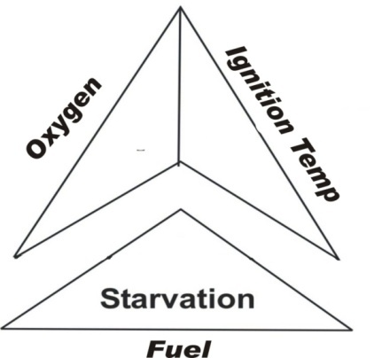
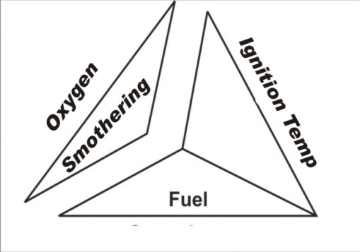

HOW TO EXTINGUISH FIRE?
STARVATION
BLANKETING
CLOSE THE AIR ENTRANCE
TRAP THE SMOKE
MAINTAIN THE SAME FOR SOME TIME
REMOVE FUEL
VACATE PEOPLE

Slide 29
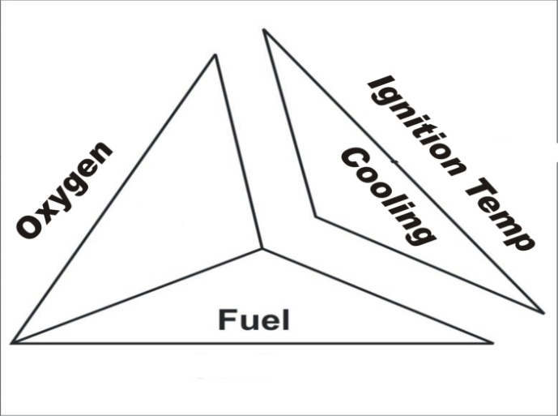
COOLING
Control the flow of heat & the chain reaction by pouring water or any other cooling medium.
COOLING

Slide 30
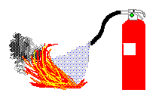
How to use Fire Extinguishers?
Remember the acronym PASS
Pull
Aim
Squeeze
Sweep

Slide 31

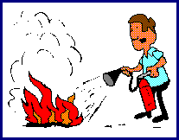
How to use Fire Extinguishers?
Pull the pin…This will allow you to discharge the extinguisher.
Aim at the base of the fire…
Hit the fuel.
If you aim at the flames. the extinguishing agent will fly right through and do no good.

Slide 32

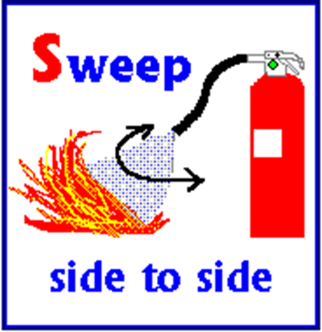
How to use Fire Extinguishers?
Squeeze the top handle…
This depresses a button that releases the pressurized extinguishing agent.
Sweep from side to side…until the fire is completely out. Start using the extinguisher from a safe distance away, then slowly move forward.
“Once the fire is out, keep an eye on the area in case it re-ignites”.

Slide 33
1. Fire hydrant system
2. Water sprinklers system
3. Automatic fire detection system
4. Automatic fire alarm system
FIXED FIRE FIGHTING INSTALLATIONS

Slide 34
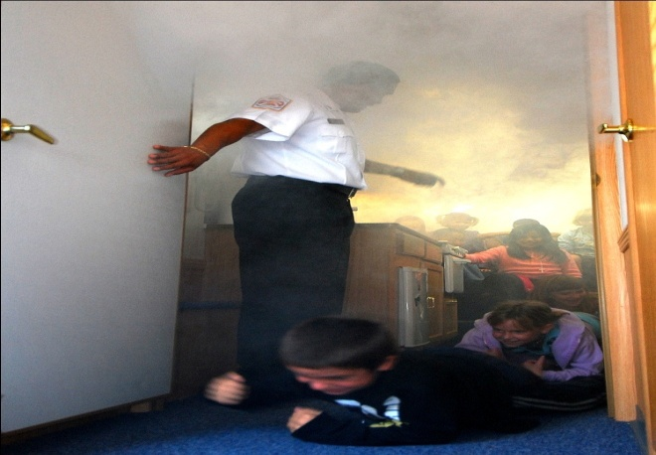
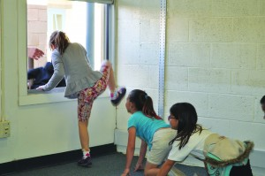
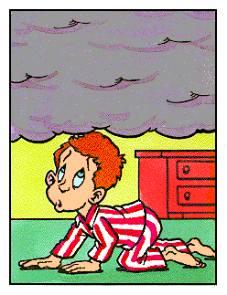
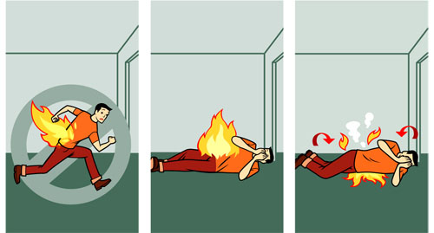
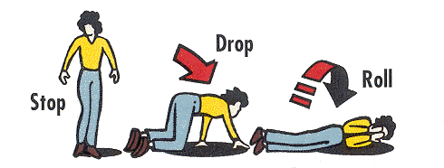
How will you come out of the room?
Coming out of the room in fire/smoke
What to do if your clothing catches fire
IF YOU ARE TRAPPED IN SMOKE OR HEAT

Slide 35
EARTHQUAKE BASIC CONCEPT
Why did it Happen?
Vibrations due to rocks breaking under stress
Sudden release of energy
Seismic waves
Shaking of Ground

Slide 36
Day Time or Night time Earthquake
Night time earthquake kills more people, but
a day time earthquake kills more Children.
Prepare- Yourself, Your Family & Your Workplace

Slide 37
Prepare: Before an Earthquake
Disaster Management Kit
At designated place
Bottled drinking water
Nonperishable food
First-Aid Kit
Torchlight
Battery-operated Radio with extra batteries
ID & Address Proof & Other Imp documents
Training
How to Turn off Electricity & Gas etc.

Slide 38
Prepare: Before an Earthquake
Identify
Safe Havens in the House
Identify
Distant Relative(s)
Address & Contact Nos with all family members
If Separated
Plan for re-union of the family
Training & Regular Drill
Evacuation Techniques
Evacuation using ropes
First Aid

Slide 39
DURING EARTHQUAKE
What will be Your First Reaction in case you feel tremors?
Correct Answer is
“Cover Your Head with Something”
How will you cover your head if you are in?
1. Classroom
2. Bed
3. Kitchen
4. In this room where you now
5. If nothing is near you

Slide 40
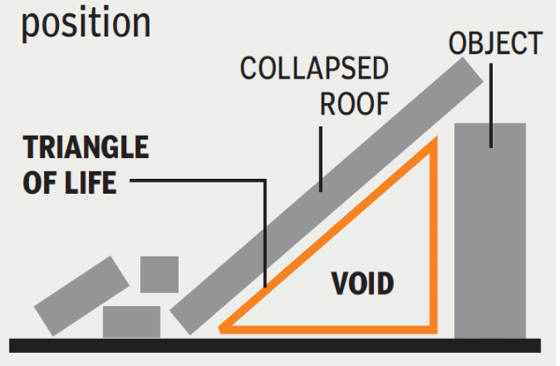
Drop-Cover-Hold
How will you do the Drop, Cover, Hold exercise?
Do you know the Triangle of Life?
What Next?

Slide 41
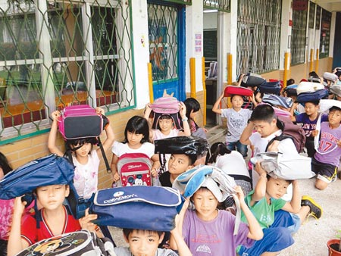
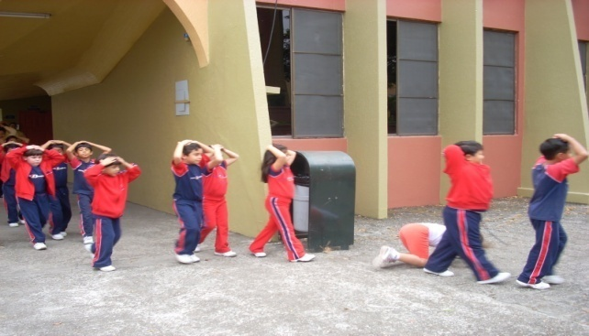
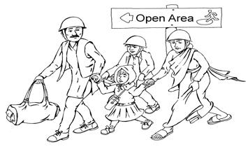
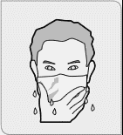




After DCH, What Next?
Do not kick fire
Do not kick up dust
Knock at pipe or wall
Do not kick move
Try to whistle
If trapped under debris

Slide 42
1. Remain prepared for aftershocks
2. Keep wearing shoes/chappals
3. Check for fire hazard
4. Use a torch instead of candles or a lantern
5. Do not enter a damaged building/house
6. If your House is safe, remain inside & listen to the radio messages
After an Earthquake

Slide 43
After an Earthquake
If you’re not sure about the house
1. Evacuate carefully with D.M. Kit
2. Leave a message about where you are going
3. Do not touch downed power lines
4. Help Injured & Trapped Pay Special Attention to Help
5. Infants, Sick, Elderly, Special Needs Listen to the Radio
6. Enter the House if authorities say to do so

Slide 44
REVIEW
School safety, Disasters- definition, classification and its types and types of disaster may be harm to school safety.
To sensitize children and the school community on the issue of disaster preparedness, safety measures and various strategies.
Fire safety for schools
Earthquake safety……Before…During…..and After..
Effects and Factors of disaster

Slide 45
Any question?

Slide 46
Evaluation
1. What is the acronym PASS?
Ans ;-
Pull
Aim
Squeeze
Sweep

Slide 47


THANK YOU

