Slide 1
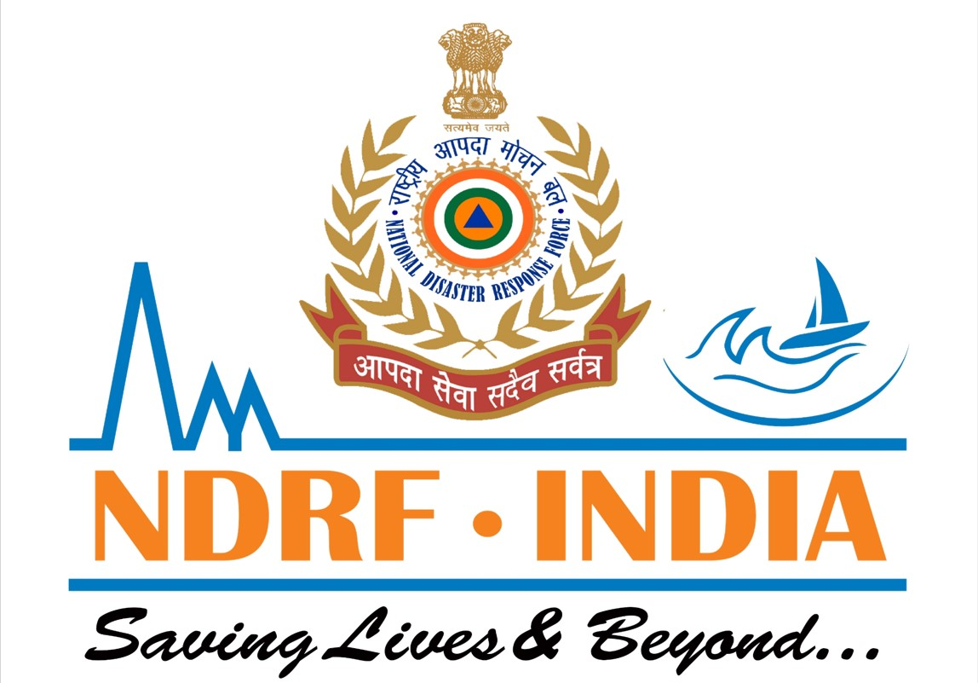



NIGHT – TIME FIRE FIGHTING CONSIDERATION
Presented By:- Sachin Chauhan,2IC
PEER | CSSR | INDIA
PPT 2 -

Slide 2
OBJECTIVES
  Reduced visibility and situational awareness
  Physiological and psychological impacts
  Communication and coordination.
  Strategic and tactical adaptation
1
Upon completing
of this lesson,
you will be able to :-
2
3
4

Slide 3
REDUCED VISIBILITY AND SITUATIONAL AWARENESS
Darkness: Limited or no natural light necessitates reliance on artificial lighting and specialized vision equipment.
Smoke and other obscurants: Smoke, fog, and precipitation further decrease visibility, impacting navigation, hazard identification, and team coordination.
Challenges: Difficulty in identifying trip hazards, structural weaknesses, or victims. Increased risk of slips, trips, falls, and disorientation.

Slide 4
Advanced Helmet Lights: Provide hands-free illumination, improving visibility and allowing firefighters to focus on tasks.
Thermal Imaging Cameras (TICs): Help firefighters see through smoke, locate hotspots, and navigate dark environments.
Right Angle Lights: Offer a powerful, focused beam for search and cutting through dense smoke.
Scene Lighting: Portable scene lights illuminate the surrounding area, highlighting hazards and improving overall awareness.
Night Vision Goggles (NVGs): Enhance perception in low-light conditions, crucial for tasks like aerial firefighting or search and rescue.
SOLUTIONS

Slide 5

Fatigue: Disrupted sleep patterns and extended work hours can lead to fatigue, reduced cognitive function, and impaired decision-making.
Stress: The inherent unpredictability and danger of firefighting are amplified at night, leading to higher psychological stress levels, especially during rescue interventions.
PHYSIOLOGICAL AND PSYCHOLOGICAL IMPACTS

Slide 6
Structured Rest and Recovery: Implement policies that prioritize adequate rest and recovery for firefighters on night shifts.
Stress Management Training: Provide training and resources to help firefighters cope with the emotional and psychological demands of the job.
Crew Well-being Programs: Foster a supportive environment that prioritizes the mental and physical health of the firefighting team.
SOLUTIONS

Slide 7
Visual Communication Challenges: Reduced visibility makes it harder to use visual cues and hand signals for communication.
Radio Communication Reliance: Increased dependence on clear and concise radio communication.
COMMUNICATION AND COORDINATION

Slide 8
Clear Radio Protocols: Establish clear and concise communication protocols to minimize misunderstandings.
Training and Practice: Regular drills and simulations in low-light conditions can improve communication and coordination skills.
Thermal Imaging and Drones: Provide overhead views and real-time information to enhance tactical decision-making and crew coordination.
Visual Aids: Utilizing scene lighting, reflective gear, and colored lights can improve visual communication and help track personnel movement.
SOLUTIONS

Slide 9
Night Attack Opportunities: Lower temperatures, increased humidity, and reduced wind speeds can create more favorable conditions for direct attack and fire suppression.
Initial Attack Focus: Catching fires when they are small and containable is critical for effective night firefighting.
Specialized Equipment and Logistics: Night operations require specialized equipment, such as night vision technology, and adaptations to support structures like flight following and base locations for aerial firefighting operations.
STRATEGIC AND TACTICAL ADAPTATION

Slide 10
Comprehensive Risk Assessment: Thorough reconnaissance and risk assessments before and during night operations are essential for safety.
Training in Realistic Conditions: Training exercises in low-light environments are crucial for developing the skills and experience needed for effective night operations.
STRATEGIC AND TACTICAL ADAPTATION

Slide 11
  Reduced visibility and situational awareness
  Physiological and psychological impacts
  Communication and coordination.
  Strategic and tactical adaptation
REVIEW

Slide 12

ANY QUESTION ?

Slide 13
1.What are the Strategic and tactical adaptation during the nighttime fire fighting?
Ans-There are 05 types of strategic and tactical adaptation are essential during the nighttime fire fighting. Details are under-
Night Attack Opportunities
Initial Attack Focus
Specialized Equipment and Logistics
Comprehensive Risk Assessment
Training in Realistic Conditions
EVALUATION

Slide 14
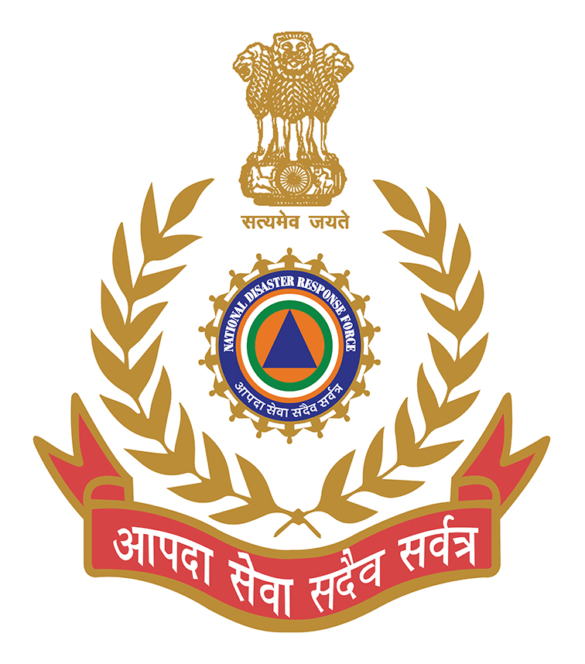
THANK YOU

