Slide 1




PSYCHOSOCIAL CARE FOR AFFTECTED SCHOOL CHILDREN
Presented by:- Amit Kumar, AC
PEER | CSSR | INDIA
PPT 2 -

Slide 2




After completion of this lesson you will be able to :-
Psycho social care for affected school children in disaster.
Psychosocial support in safe school.
Role of different care givers.
Disability and safe school practices and special care.
OBJECTIVE

Slide 3
What is disaster.
Psycho social care after disaster
Psycho social effect in school
Age wise effect
Psycho social care technique
Psychosocial among children
OBJECTIVE

Slide 4
23 December 1995, nearly 442 people, most of them school children perished as they tried to escape the flames during a school prize giving ceremony in the town of DABWALI, Haryana.
SOME MAJOR INCIDENT

Slide 5
Fire Tragedy in KUMBAKONNAM, Tamilnadu On 16/07/2004 A deadly fire raged through Lord Krishna School killing 94 children, all below the age of 11 years.
SOME MAJOR INCIDENT

Slide 6
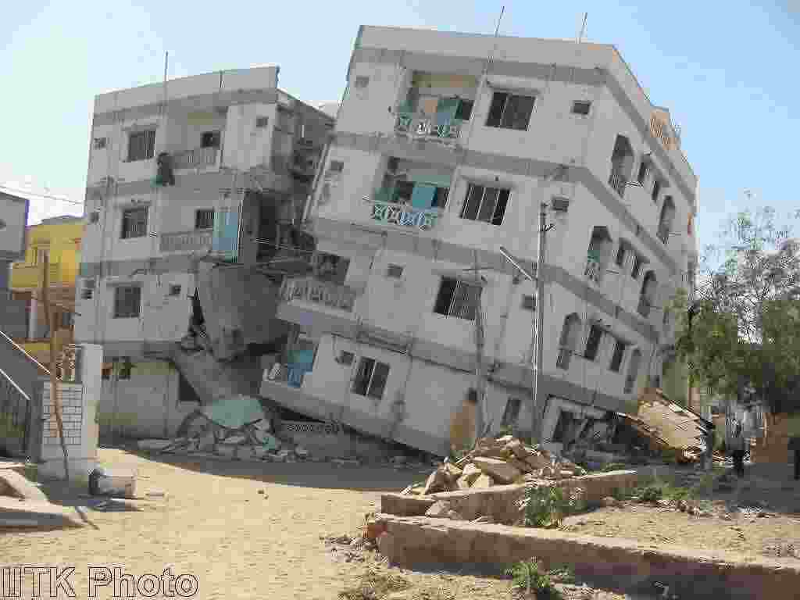
26 January 2001,Bhuj Earthquake. nearly 400 school children who assembled for school functions.
SOME MAJOR INCIDENT

Slide 7
“Disaster” means a catastrophe, mishap, calamity or grave occurrence in any area, arising from natural or man made causes, or by accident or negligence which results in substantial loss of life or human suffering or damage to, and destruction of, property, or damage to, or degradation of, environment, and is of such a nature or magnitude as to be beyond the coping capacity of the community of the affected area.
-DM Act 2005 Chapter I para 2(d)
Definition of Disaster

Slide 8
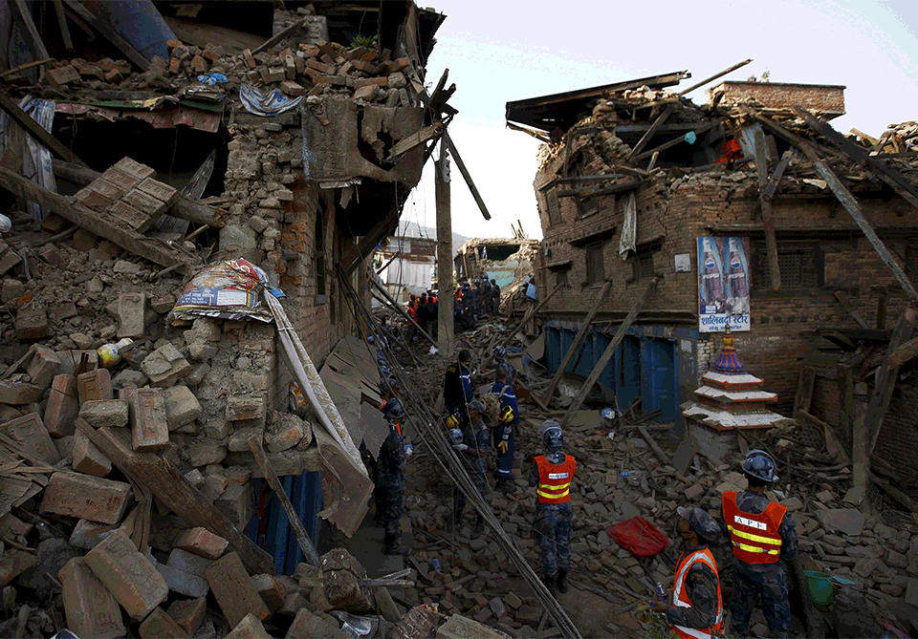
Disaster is a severe disruption of ecological and psycho social situation which greatly exceeds the coping capacity of the affected community.
WHO, 1992
DISASTER

Slide 9
India’s vulnerability profile to disaster
58.6% of the landmass is prone to earthquakes of moderate to very high intensity. 12% of these is vulnerable to severe earthquake.
68% of the cultivable area is vulnerable to Drought.
Over 40 million hectares (12% of land) is prone to Floods & River Erosion.

Slide 10
India’s vulnerability profile to disaster
About 8% land is vulnerable to cyclone.
Coastline close to 5,700 Km is prone to Cyclone.
Further, the vulnerability to Chemical,
Biological, Radiological and Nuclear
(CBRN) emergencies have also increased
.

Slide 11
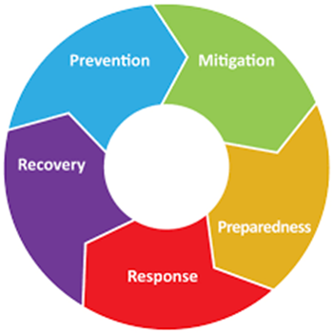
Disaster Management Cycle
Before event
Disaster Management Cycle
After the event
Event

Slide 12
While the safe school training programme is planned and implemented, training the students of EFA (Emotional first aid) is equally important with physical first aid and other rescue techniques.

Slide 13
Recovery and Reconstruction
Try and Understand the children | Reduce the impact of the disaster on them | Give them care and support
Serve their behaviour and listen to what they say | Listen to what they say | Use play to offer support and help
Accept their behaviour and what they say completely | Give them love and assurance and meet their basic needs | Talk with the children and find out what they need
Continuously monitor what they say to you and how they behave | Model positive living and good coping skills | Try to help them to return to their normal life routines

Slide 14
Guilt
Grief
Shock
Numbness
Intrusive
memories
Fear
Despair
NORMAL REACTIONS FOR ABNORMAL SITUATIONS

Slide 15
Severe physical injury, exposure to extreme,
Witnessing the death of near and dear
Helplessness, hopelessness, separations
Shock, numb and empty
Stunned, dazed and disengaged
Hyper vigilance
Withdrawal symptoms
Immediate Psycho Social Effects

Slide 16
Children – crying, clinging to elders
Inability to sleep, eat, attend to routine
Agitated, suicidal
Survival guilt
Survival happiness
Disaster syndrome Present in 75% of the disaster survivors
Immediate Psycho Social Effects (Cont…)

Slide 17
Anxiety related reactions
Nightmares
Bed wetting
Thumb sucking
Anger
Refusal, Retaliation
Grief reactions
Following Disaster

Slide 18
Loss of familiar environment.
Fear and insecurity.
Struggle for food, shelter and other amenities.
Witnessed death.
Continued threat to their sense of wellbeing.
Psycho Social issues of school children in Disaster

Slide 19
0-5 years old
6-12 year old
Psycho Social Effects of Disaster to Children
. Fear
• Crying
• Dependent towards parents
• Refusing food
• Lack of appetite
. Change in behavior
. Fear, anxiety, tension
. Anger, irritability
. Lack of interest
. Lack of interest in studies

Slide 20
0-5 years old
6-12 year old
Psycho Social Effects of Disaster to Children
. Disturbed sleep
.Lack of energy
.Lack of concentration .Feeling insecure
.Numbness
. Disturbed sleep
.Confusion
.Not respecting others
.Pretending to work
.Aggressive towards classmates.
.Use of substance

Slide 21
13 years and above Girls
.Lack of interest towards future
• Becoming orphan/ single parenthood
• Loss of memory
• Fear
• Emptiness
• Lack of interest in studies
• Loneliness
• Changes in their relationship

Slide 22
• Tension
• insecure feelings
• Unreasonable anger
• Lack of sleep
• Bed wetting
• Lack of appetite
• lack of self care
13 years and above Girls

Slide 23
• Poverty
• Fear, unsecured feeling
• Lack of interest in education
• Lack of sleep
13 years and above Boys
• Antisocial behavior
• Suicidal thoughts
• Loneliness
• Depression

Slide 24
• Change in their behavior
• Forgetfulness
• Change in their mind status
13 years and above Boys
• Child labor
• Early marriage

Slide 25
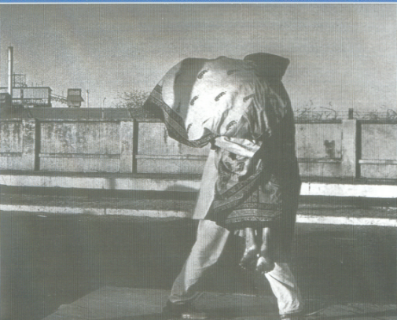
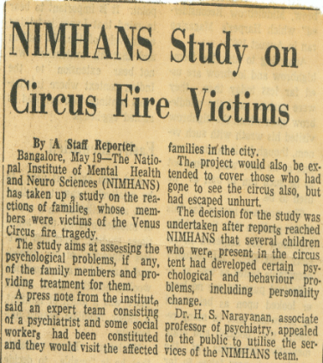
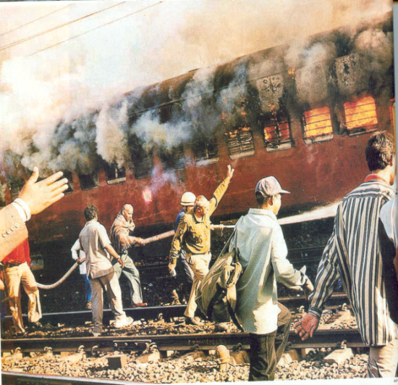
NATURAL
DISASTERS
Psychosocial Care in Disasters
PS CARE IN DISASTERS
HUMAN MADE

Slide 26
How to support a child recovery from a traumatic events

Slide 27
Psychosocial support in safe school programme
Training the teachers and students on psychological aspect
In disaster preparedness, as they could respond adequately and immediately.
Psychological preparedness is most crucial for the students.

Slide 28
Psychosocial support in safe school programme
Students are adequately sensitive each other in case of emergency and crisis.
Ensure empathy for each other for responding adequately
Against the fear psychosis/phobia

Slide 29
Psychological Care techniques for Children &Adolescents
Understand the different impact at different age level
To formulate the interventions according to age.
For the age group of 0 to 5 years the intervention should be mainly by the parents

Slide 30
Psychological Care techniques for Children & Adolescents
In the age group of 6 to 12 years of children, the intervention should be by both parents and teachers.
During adolescent period, children would have more changes and one should address these issues through the peer group meetings as each adolescent is influenced by the group.

Slide 31
While giving the psychosocial Support to children
Be warm and friendly.
Accept the child as he/she is.
Avoid flooding the child with advice.
Respect the child.
Be there – give both time and attention.
Specially PS treatment for the mentally and physically challenged children.

Slide 32
TEACHERS
ANGANWADI
WORKERS
PRIMARY HEALTH
CARE WORKERS
Community Level
COMMUNITY LEVEL
WORKERS
VOLUNTEERS
ARE
VITAL LINKS
NGO
WORKERS
YOUTH CLUB
MAHILA MANDAL
MEMBERS
VOLUNTEERS
VOLUNTARY
ORGANISATIONS

Slide 33
Mediums useful for PSC Among Children
Children can be aided in recovery through the use of various mediums suiting their age group,
Drawing
Story telling
Clay modeling
Games
Worksheets
Puppetry

Slide 34
Now you will be able to define :-
Psycho social care for affected school children in disaster.
Psychosocial support in safe school.
Role of different care givers.
Disability and safe school practices and special care.
REVIEW

Slide 35
Any Question

Slide 36
Evaluation
1.PSC means ?
Ans ;- PSYCHO SOCIAL CARE

Slide 37


THANK YOU

