Slide 1




HOW TO PREPARE ONE DAY SCHOOL SAFETY PROGRAMME
Presented by:- Amit Kumar, AC
PEER | CSSR | INDIA
PPT 2 -

Slide 2
Aim Of The Course
The aim of this course is to provide information of course design

Slide 3
Objectives
After the completion of this lecture, the participants will be able to -
Planning of course design
Selection of personnel
Selection of course material and resources.

Slide 4
TRAINING METHODOLOGY
Interactive lecture method.
Practical.
Group exercise.

Slide 5
Course Co-ordination
Initial meeting
Meeting will be necessary before, during and after the course
Course duration
Schedule

Slide 6
PLANNING CONSIDERATION
Type of presentation – instructional.
Method of instruction –interactive lecture and practice.
Use of visual aid
Length and time – 1 day.

Slide 7
Personnel Requirement
Course monitor
Course coordinator
Course S.O.
Logistic coordinator
Classroom manager
Instructor
Assistant instructor

Slide 8
Other Documents during course
Attendance register
Course directory
Instructor assignments and responsibility sheet

Slide 9
Forms
Registration form
Evaluation form
Feedback form
Instructor evaluation form
Certificate

Slide 10
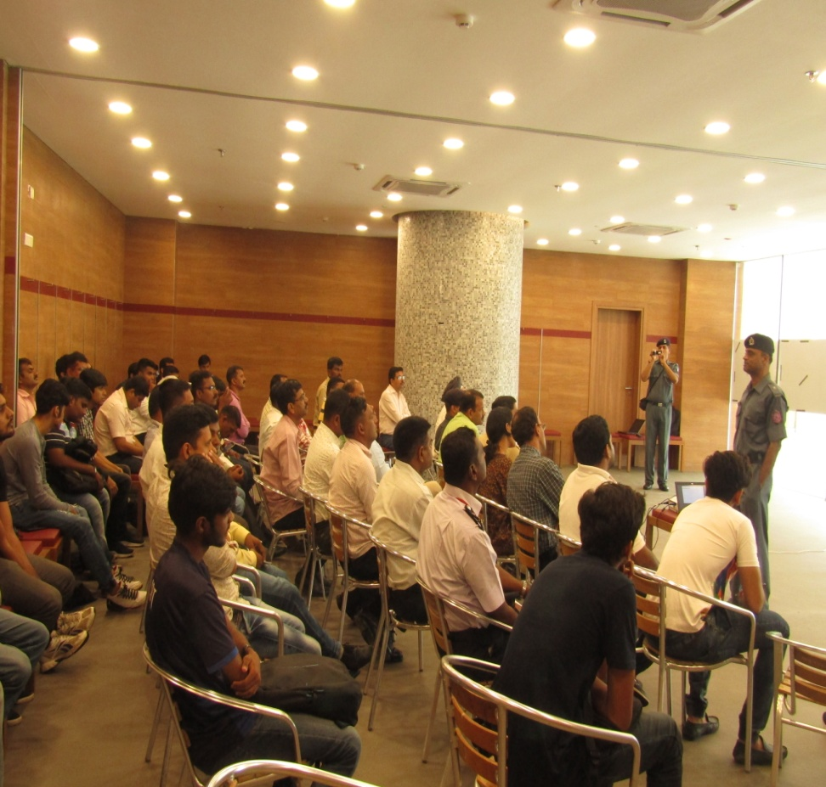
Class room lay out
Seating arrangements
Lighting
Acoustics
Comfortable environment
Easy to deliver a class

Slide 11
Organizing equipment
All instructors are familiar with the operation of audio-visual aids.
Projection screen
All instructors and assistants are familiar with all equipment.

Slide 12
Daily Schedule
TIME | PERIODS
0850-0900 | RECAP
0900-0940 | 1ST
0945-1025 | 2ND
1025-1040 | TEA BREAK
1040-1120 | 3RD
1125-1205 | 4TH
1210-1250 | 5TH
1250-1515 | LUNCH BREAK
1515-1555 | ^{6TH}
1555-1610 | TEA BREAK
1610-1650 | ^{7TH}
1655-1735 | ^{8TH}
1735-1745 | DCE

Slide 13
During course
Ensure regular and scheduled classes as per course program
Policy for late arrivals, absence

Slide 14
After course
Feedback from participants
Closing ceremony
Distribution of the course completion certificate
Internal assessment

Slide 15
REVIEW
Planning of course design
Selection of personnel
Selection of course material and resources.

Slide 16
Any Question ?

Slide 17


THANK YOU

