Slide 1




OVERVIEW OF SCHOOL SAFETY
Presented by:- Amit Kumar, AC
PEER | CSSR | INDIA
PPT 2 -

Slide 2




OBJECTIVE
Upon completion of this lesson you will be able to :-
Overview of school safety.
Nine steps to school safety
DRR

Slide 3
What is School Safety
School safety encompasses the creation and maintenance of a secure, supportive environment where students, teachers, and staff are protected from violence, hazards, and risks. It includes physical safety (infrastructure), psychosocial safety (mental well-being), and preparedness for emergencies.

Slide 4
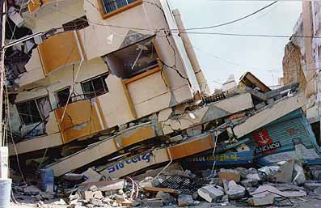
Need For School Safety
Bhuj Earthquake
26 Jan 2001

Slide 5
Bhuj Earthquake-Some Facts
971 students & 31 teachers died.
1884 school buildings collapsed.
5950 classrooms lost.
11761 school buildings suffered major to minor damages.
36584 classrooms unfit for holding instructions.
300 children were killed while marching in narrow lane between two buildings which collapsed.
children started running towards school building when Earthquake struck fearing bomb blast.

Slide 6
Dabwali Fire, 23 Dec 1995
School prize distribution function.
Fire erupted
425 people many of them children perished.

Slide 7
Kumbakonam Fire (16 July 2004)
Fire erupted in Lord Shri Krishna School.
94 children killed, all below 11 yrs.

Slide 8
9 Steps towards School Safety
Step-1
Workshop
Orientation/sensitization

Slide 9
9 Steps towards School Safety
Step-2
Formation of
School Disaster Management Committee

Slide 10
9 Steps towards School Safety
Step-3
Analysis
Hazard, Vulnerability, Risks, Capacity (HVRC)

Slide 11
9 Steps towards School Safety
Step-4
Development of
School Disaster Management Plan

Slide 12
9 Steps towards School Safety
Step-5
Skill Development of
11 Disaster Management Teams

Slide 13
9 Steps towards School Safety
Step-6
Dissemination to Everybody
School D.M. Plan

Slide 14
9 Steps towards School Safety
Step-7
Training of All
Teachers, Staff & Students

Slide 15
9 Steps towards School Safety
Step-8
Regular Mock Drills/ Daily Drills
and Evaluation & Updating D.M. Plan

Slide 16
9 Steps towards School Safety
Step-9
Implementation of Mitigation Plan
Non-Structural
Structural Mitigation (Retrofitting)

Slide 17
It refers to strategies and practices aimed at minimizing vulnerabilities and disaster risks through proactive planning and capacity building. It involves identifying hazards, assessing risks, and taking action to reduce impacts on people and infrastructure.
What is Disaster Risk Reduction (DRR)?

Slide 18
Children are highly vulnerable during disasters.
- Schools are community hubs, so making them resilient protects more than just students.
- Education continuity is vital post disaster to ensure stability and recovery.
Why DRR important in School

Slide 19
Review
Now you will be able to :-
Overview of school safety.
Nine steps to school safety
DRR

Slide 20
ANY QUESTION ?

Slide 21
Evaluation
How many steps of school safety?
Ans ;- 09

Slide 22


THANK YOU

