Slide 1

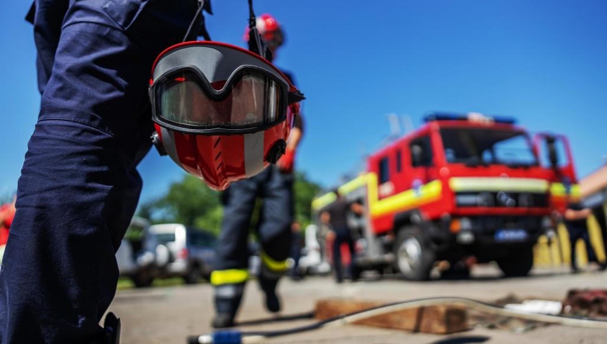


FUNDAMENTALS OF FOREST FIRE FUELS, TYPES & BEHAVIOR
Presented By:- Sachin Chauhan,2IC
PEER | CSSR | INDIA
PPT 2 -

Slide 2
OBJECTIVES
Understanding the science of fire.
Factors influencing fire behavior.
1
Upon completing of this lesson, you will be able to :-
2

Slide 3
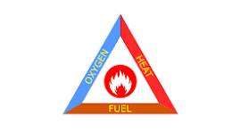
THE FIRE TRIANGLE-
Oxygen- from the surrounding air.
Heat- Ignition caused by lighting or human activity.
Fuel- Trees, vegetation and other organic materials.

Slide 4
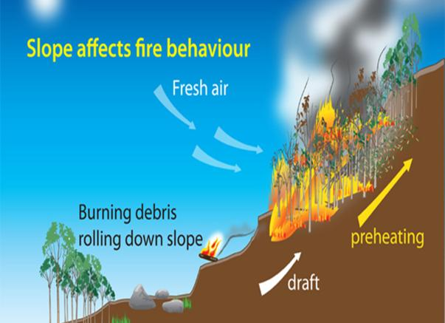
SLOPE AFFECTS FIRE BEHAVIOUR

Slide 5
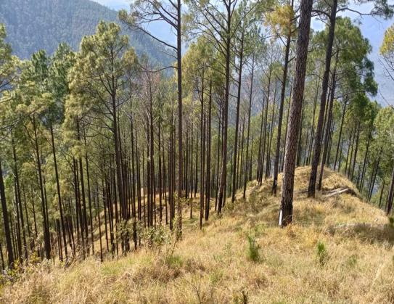
SLOPE AFFECTS FIRE BEHAVIOUR

Slide 6
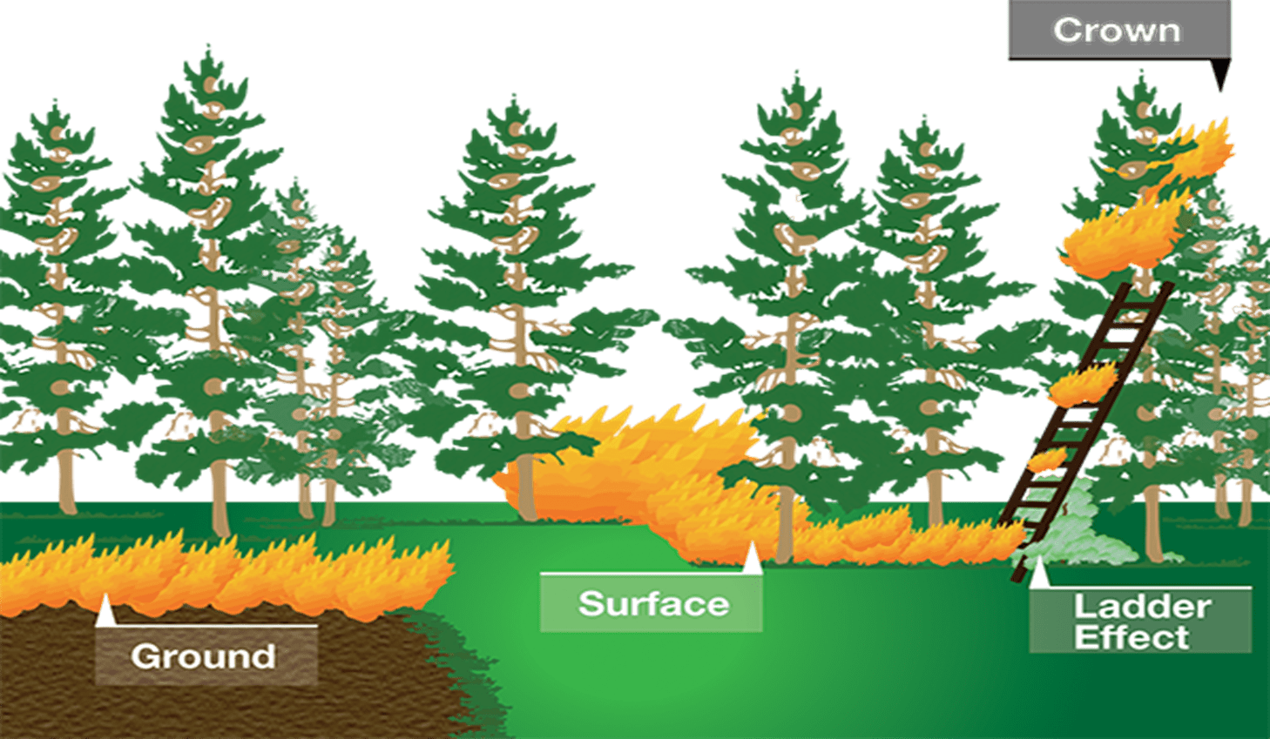
PARTS
OF
FOREST FIRE

Slide 7
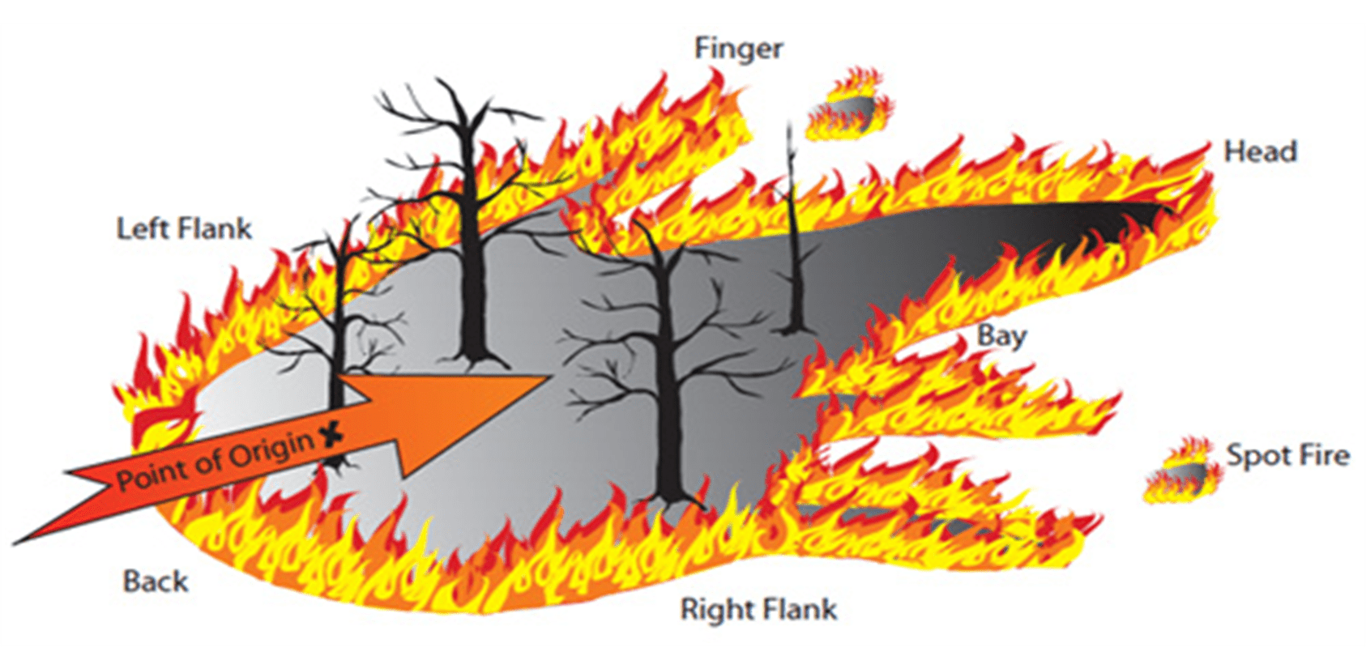
PARTS
OF
FOREST FIRE

Slide 8
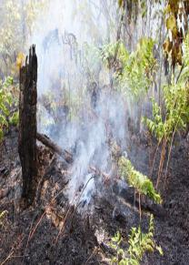
A ground fire, also known as a subsurface fire, is a wildfire that burns organic material below the surface of the ground, such as duff layers, peat, or decaying wood.
These fires are characterized by smoldering combustion, low temperatures, and slow spread. Ground fires can be difficult to detect and extinguish, as they may not produce visible flames and can burn for extended periods.
GROUND
FIRE

Slide 9
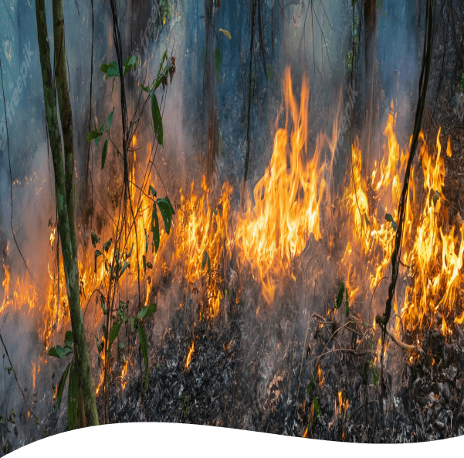
It burns only the leaves and bushes lying on the ground surface.
It does not harm the trees but it definitely harms the regeneration.
It burns the crops on the ground surface as well as bushes and undergrowth.
SURFACE
FIRE

Slide 10
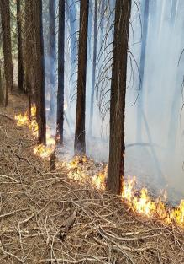
"Creeping fire" refers to a fire that spreads slowly, typically with a low flame and minimal intensity.
It's often described as smoldering and may be difficult to detect. Creeping fires can be a hazard in buildings, forests, and other areas, as they can spread gradually without producing large flames, making them hard to notice and extinguish.
CREEPING FIRE

Slide 11
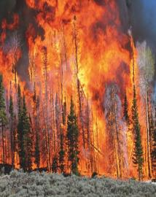
Crown fires burn forest canopy fuels, which include live and dead foliage/ branches, lichens in trees, and tall shrubs that lie well above the surface fuels. They are usually ignited by a surface fire. Crown fires can be passive or active.
CROWN FIRE

Slide 12
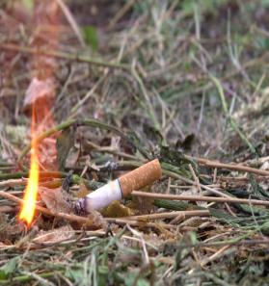
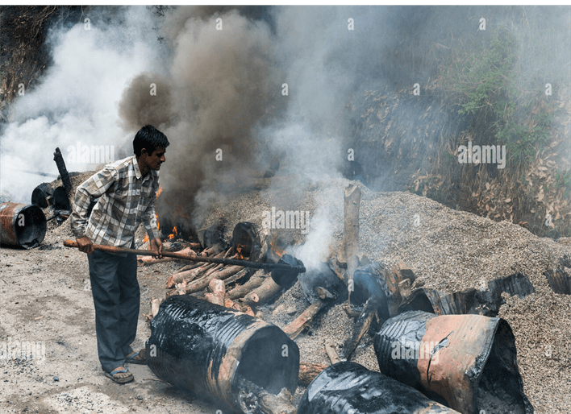
1.Smoking
2. Road maintenance
CAUSES
OF FOREST FIRE

Slide 13
Cooling:
This method involves reducing the heat of the fire, typically by using water to absorb the heat. Water is effective for class A fires (paper, wood, etc.) but should not be used on electrical or oil fires.
Smothering:
Smothering a fire involves cutting off its oxygen supply. This can be done using a fire blanket, foam, or even sand to deprive the fire of the oxygen it needs to burn.
Starving:
This method involves removing the fuel source that is feeding the fire. For example, if a fire is burning a pile of wood, removing the wood will eventually extinguish the fire.
COMMON METHOD OF EXTINGUISHING FIRE

Slide 14
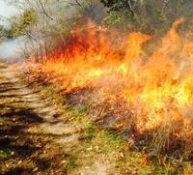
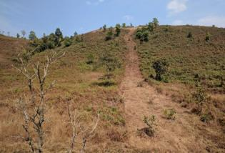
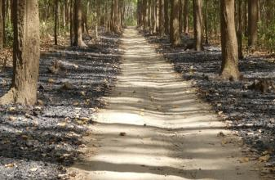
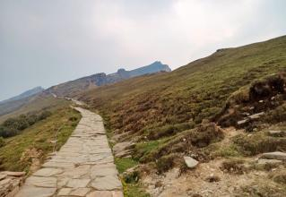
FIRE LINES

Slide 15
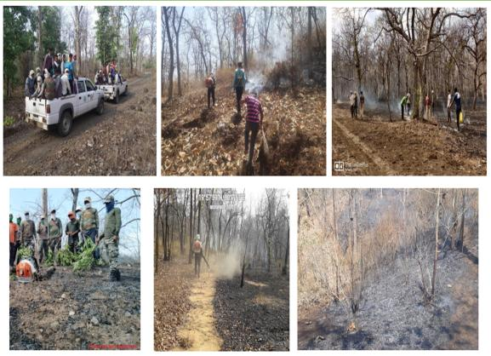
FIRE LINES

Slide 16
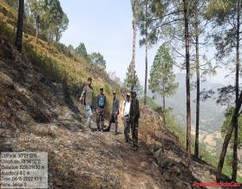
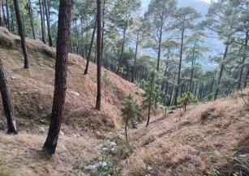
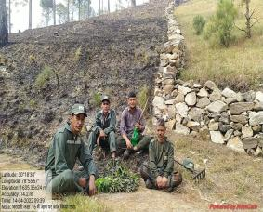
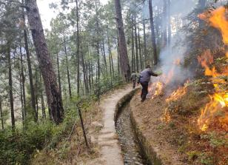
FIRE LINES

Slide 17
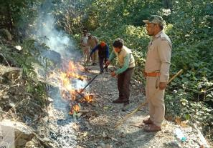
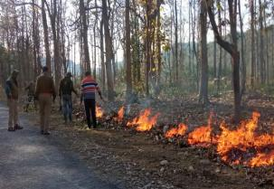
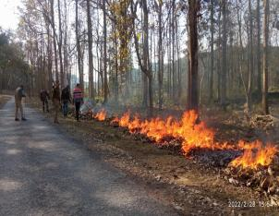
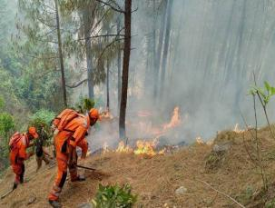
PROCEEDINGS BEFORE FOREST FIRE SESSION
CONTROL BURNING

Slide 18
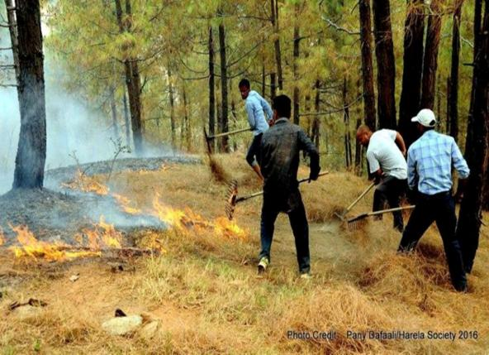
PROCEEDINGS BEFORE FOREST FIRE SESSION
CONTROL BURNING

Slide 19
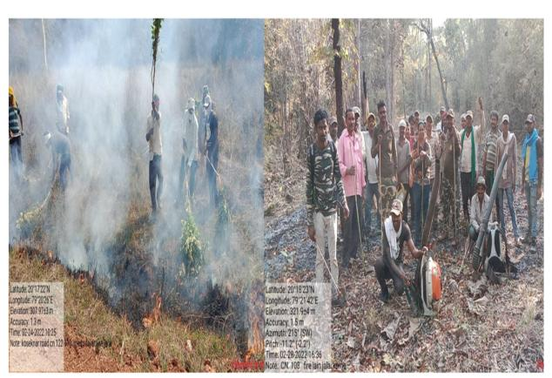
PROCEEDINGS BEFORE FOREST FIRE SESSION
CONTROL BURNING

Slide 20
Understanding the science of fire.
Factors influencing fire behavior.
REVIEW

Slide 21

ANY QUESTION ?

Slide 22
1. What are the common method of extinguishing fire?
Ans- 03 Methods – 1. Cooling, smothering and starvation.
2. What is the creeping fire?
Ans- "Creeping fire" refers to a fire that spreads slowly, typically with a low flame and minimal intensity.
EVALUATION

Slide 23

THANK YOU

