Slide 1




EXERCISE PLANNING
Presented by:- Amit Kumar, AC
PEER | CSSR | INDIA
PPT 2 -

Slide 2


Upon completion of this lesson you will be able to:-
Preparing of Scenario.
Briefing before, after and during of exercise,
Roles and responsibilities of stakeholders in disaster management set up in district.
Conduct of table top exercise on designed exercise.
OBJECTIVE

Slide 3


Earth Quake
Accidents
Road/ Rail/
Air
Fire &
Explosion
Industrial/
Chemical
Nuclear
Building
Collapse
DISASTER SPECTRUM
Sabotage
Terrorist
Attack
Flood
Tsunami
Cyclone
Epidemics/
pandamic

Slide 4
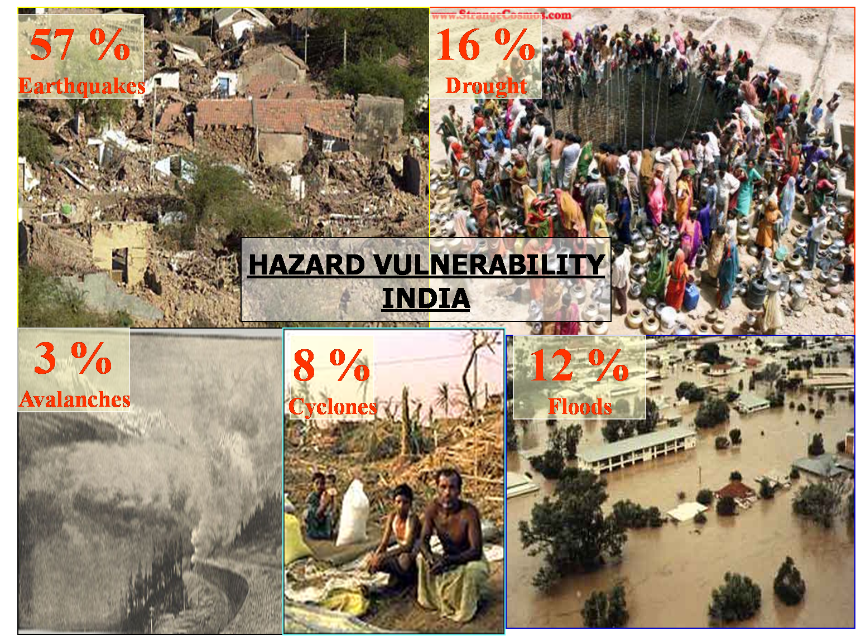
INDIAN SCENARIO

Slide 5
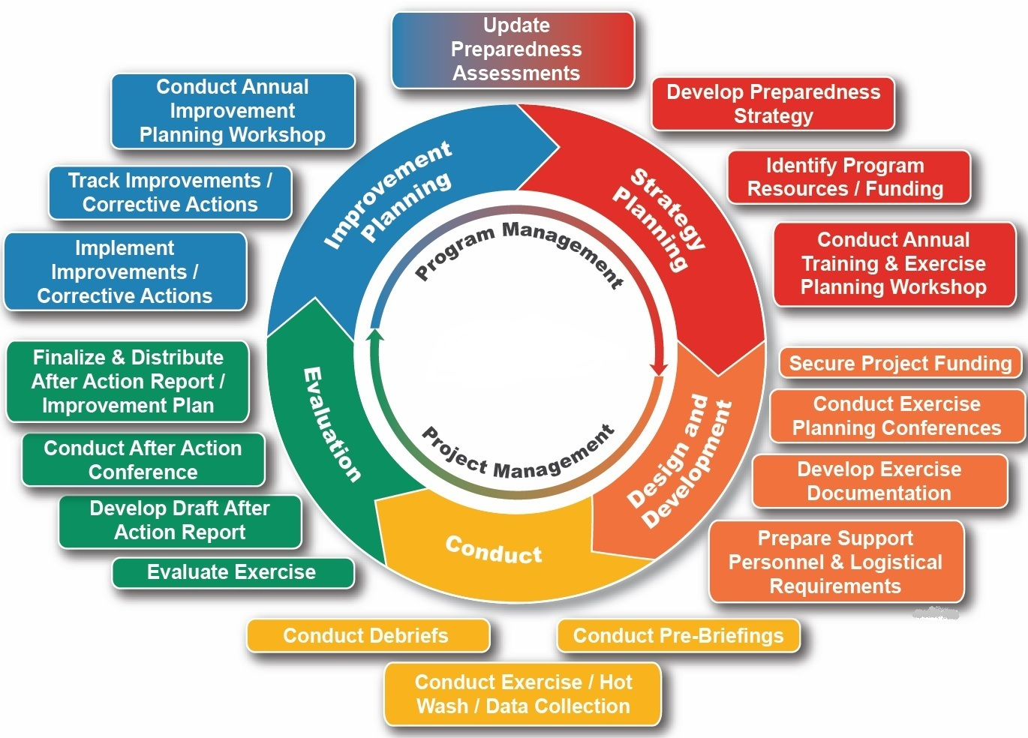

Slide 6
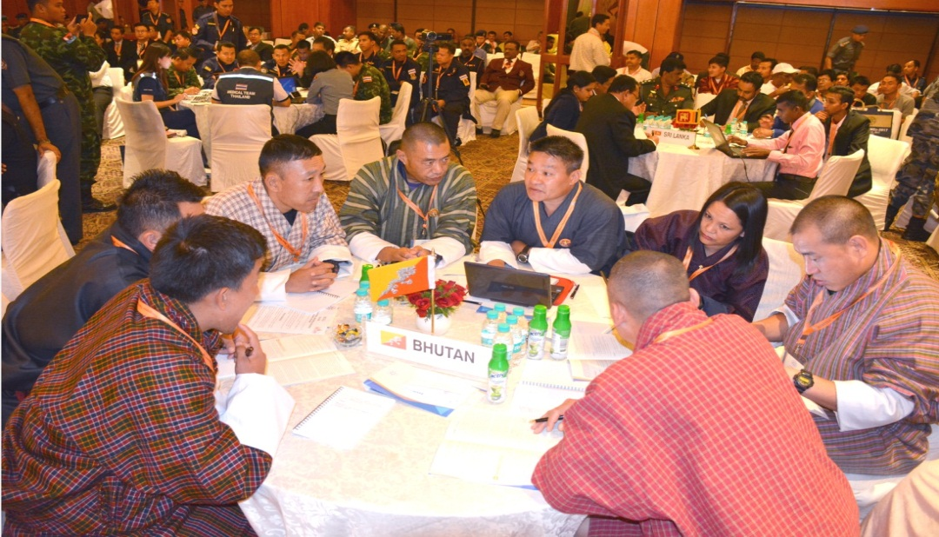
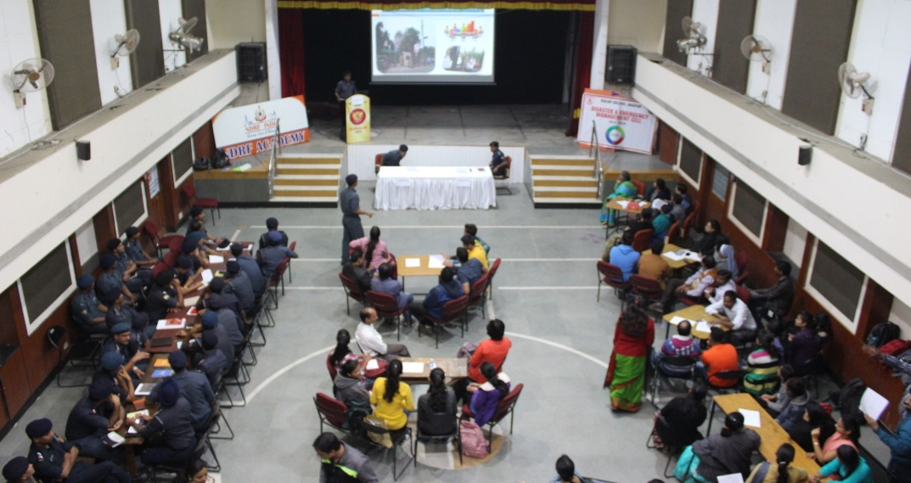
TABLE TOP EXERCISE

Slide 7
Preparedness system
Plan
Exercise &
Evaluate
Train
To integrate the plans, training programs, exercises & evaluations.
To set the training gear into motion.
Sufficient practice or opportunity to staff.

Slide 8
Key concepts
To ensure that all employees receive the training.
Refresher training on disaster preparedness
Exercise all portions of emergency management.
Use a variety of training and exercise for both discussion-based and operations-based.

Slide 9
Contd…
Conduct exercises with representatives.
Exercise with all vendors and mutual aid.
Evaluate all training and exercise for improvement of..
  Emergency management plan.
  Training.
  Exercise schedule.
Develop relationships with your local emergency management office .

Slide 10
STEPS OF PLANNING AN EXERCISE

Slide 11
Synchronize your emergency plan with training.
Distribute the plan and ensure it .
Conduct training up to standard of proficiency.
Drills validate specific training of proficiency.
Note :- If there is no existing plan? You can effectively use seminars and workshops to review it.
Step-1 Synchronize your exercise

Slide 12
Step-2 Determine which topic to use in developing an Exercise
Roles and responsibilities of key staff members.
Role of stakeholder as per IRS i.e. NDRF, SDRF etc.
The physical layout of…..
  Facility.
  Location of the nearest stair exit.
  Alternate stair exits.
  Direct route to each exit in case of building.

Slide 13
Contd….
Emergency telephone numbers and call-down procedures.
How to control or minimize rumors & prevent panic.
Evacuation priorities i.e. ambulatory, wheelchair, differently abled.
Procedures for protection of residents during evacuation.
Response procedure to a missing resident.
Power outage & generator is inoperable.

Slide 14
Responding to staff injuries during this event.
Localized fire response system.
Procedures for utility and water shut-offs.
Sudden water loss or water contamination.
Sudden flooding.
Significant structural damage.
Plan for violent resident, family member local etc.
Contd….

Slide 15
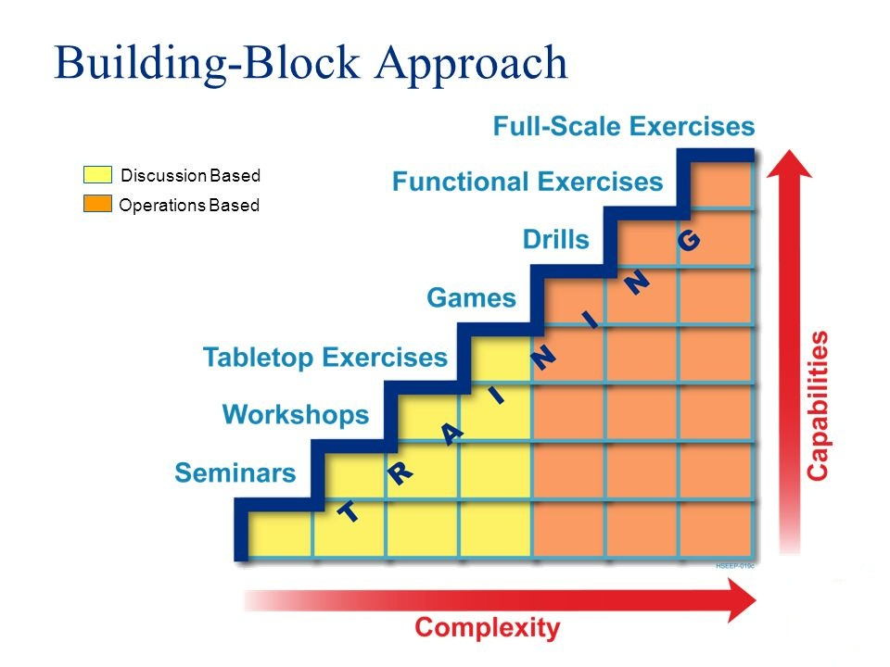
Step 3. Determine the Types of Exercise

Slide 16
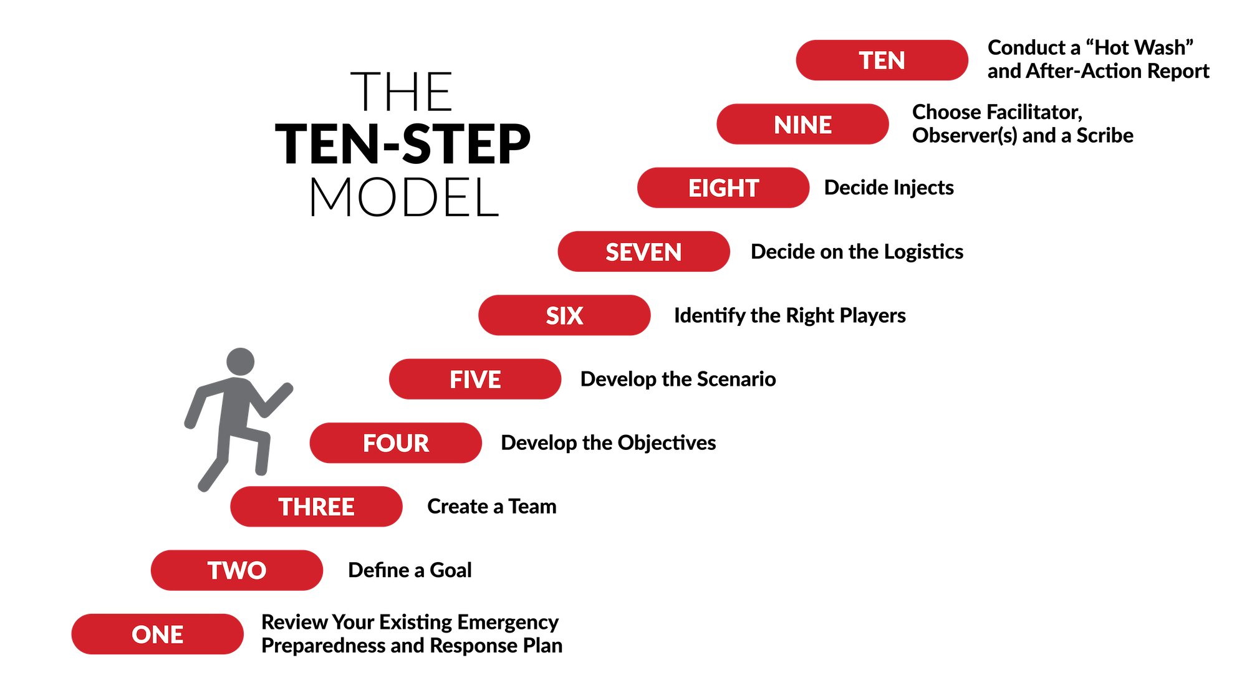

Slide 17
Step 4. Determine exercise cost
Discussion based exercise executed at low cost.
TTX have multiple objectives and scenarios.
Functional exercises may require professional support.
In house exercise required less professional support.
Existing tool is useful to avoid major expense.

Slide 18
Step 5. Set the exercise date.
Identify & organize the planning team.
Reserve a meeting space for the planning team.
Schedule planning meetings.
Identify the type, scope, objectives, and purpose of the exercise.

Slide 19
Contd….
Responsibility assignment by planning team members.
Create supporting handouts as needed.
Take care of administrative tasks.
Notify players (exercise participants).
Invite observers or external partners.

Slide 20
Step 6. Assemble the exercise planning team.
A planning team leader directs and coordinates
    All exercise planning activities.
    Responsibilities.
    Provides guidance.
    Establishes timelines.
    Monitors the development process.

Slide 21
Contd….
A SME provides ….
  Technical or functional expertise to develop the scenario.
  Serve as evaluators during the conduct of the exercise.
Responsible for compiling & developing of documentation.
Planning team member will serve ……
  A logistical function.
  Providing or arranging for the supplies, materials, facilities & services.

Slide 22

Step 7. Identify the Exercise Staffing Roles.
Safety officer
Actors
Players
Observers
Evaluators
Facilitators

Slide 23
Step 8. Identify Exercise Partners.
Law Enforcement Representatives
Hospital & Schools
Facility Supplier
Emergency Medical Services
Transportation Provider
Utility Managers
Fire and Rescue
Volunteers and FBO’s
Sister Facilities

Slide 24
Collect Performance Data
Hot wash: Hot washes may also be held with discussion-based exercises at the discretion of the exercise planning team leader.
Debrief: debriefs may be held following the hot wash or within a few days, following the exercise.

Slide 25
Did this exercise increase your awareness of event preparedness needs? How?
What can be done to improve police/security at events?
What groups are required to work together?
Who responds to the media and why?
Did this meet the criteria an emergency, disaster of crises?
HOTWASH

Slide 26
What have you learned during this tabletop exercise?
What are the emergency management preparedness strengths?
What are the weakness/gaps in the emergency management plans?
List and prioritize five short and long-term actions for follow-up.
HOTWASH

Slide 27
Evaluators should consider the following questions (When summaries the Exercise)
Were the objectives of the exercise met?
Were players knowledgeable of current plans, policies, and procedures?
Did plans, policies, and procedures support performance tasks?
Did the observations suggest that all personnel were adequately trained to complete the activities/tasks needed to demonstrate a capability?
key decisions associated with each activity

Slide 28
Contd…
Did personnel from multiple agencies or jurisdictions work together to perform tasks, activities or capabilities?
If so, are there agreements or relationships in place to support the coordination required?
Did the observations identify any resource shortcomings that could inhibit the ability to execute an activity?

Slide 29
Contd…
What should be learned from this exercise?
What strengths were identified for each activity?
Is any cross-training needed to enhance task performances?
What areas for improvement are recommended for each activity?

Slide 30
AAR are used to provide feedback.
AAR summarizes exercise events & analyzes performance of the topic’s objective tasks.
AAR includes an improvement plan outlining corrective actions needed, along with timelines for their implementation and assignment to responsible parties.
Improve the process

Slide 31
Once the recommendations, corrective actions, responsibilities, due dates are clearly identified & agreed upon in the improvement plan.
Maintaining the discipline to keep the improvement plan activities on track is the most difficult part of the process.
Failure to follow improvement plan corrective actions to completion often results in repeated lessons learned, and lack of preparedness improvement.
Track the Progress

Slide 32
This section will provide more detailed guidance for NDRF on two specific types of exercise:-
Operation-based drills
Discussion-based Tabletops

Slide 33
Steps of Conduct & Design a drill
Plan the drill
Call the drill
State the drill scenario & purpose
Conduct the drill
Conclude the drill, document of participants & activities.
Evaluate the drill and identify action needed
After the drill- next steps

Slide 34
Conducting a Table Top Exercise
Determine if participants can realistically “Talk through” their critical functions during an emergency.
Help participants become more aware of possible weaknesses and gaps in the plan.
Thoroughly acquaint participants with the contents of their facility’s plan.

Slide 35
Key roles in Table Top Exercise
Exercise observer
Exercise facilitator
Exercise players
Exercise evaluator

Slide 36
Steps of Table Top Exercise
Assess your facility’s needs.
Prioritize the needs and determine the scope of the exercise.
Write a goal (purpose statement) for the exercise.
Write specific objectives for the goal.
Select or create an emergency scenario.

Slide 37
Identify exercise participants.
Determine date/time/place.
Invite players (participants) and any external partners if appropriate.
Prepare materials.
Conduct the exercise.

Slide 38
Step 11: Evaluate the exercise.
What went well?
What didn’t go so well, and what might be the root causes of any concerns?
What were the surprises, if any?
Were the exercise goals and objectives met? If not, why not?
Are there action items for follow-up in an improvement plan?

Slide 39
RULES OF THE EXERCISE
There are no right or wrong answers. All ideas are welcome.
Let there be artificiality in the exercise.
Lets maintain a stress free environment. No fault finding exercise.
Your response should be based on the information provided in the scenario
We are looking for creative yet realistic ideas for our improvement.
Respond as per your present capacity
Do not limit your thinking…

Slide 40
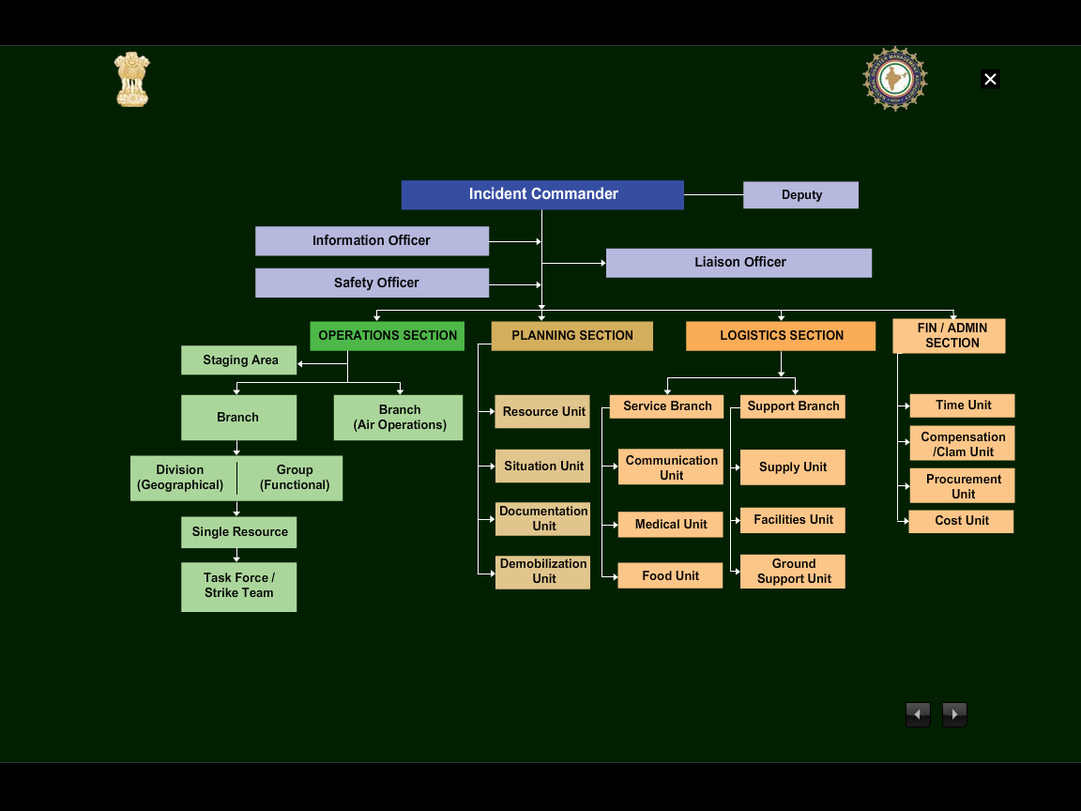




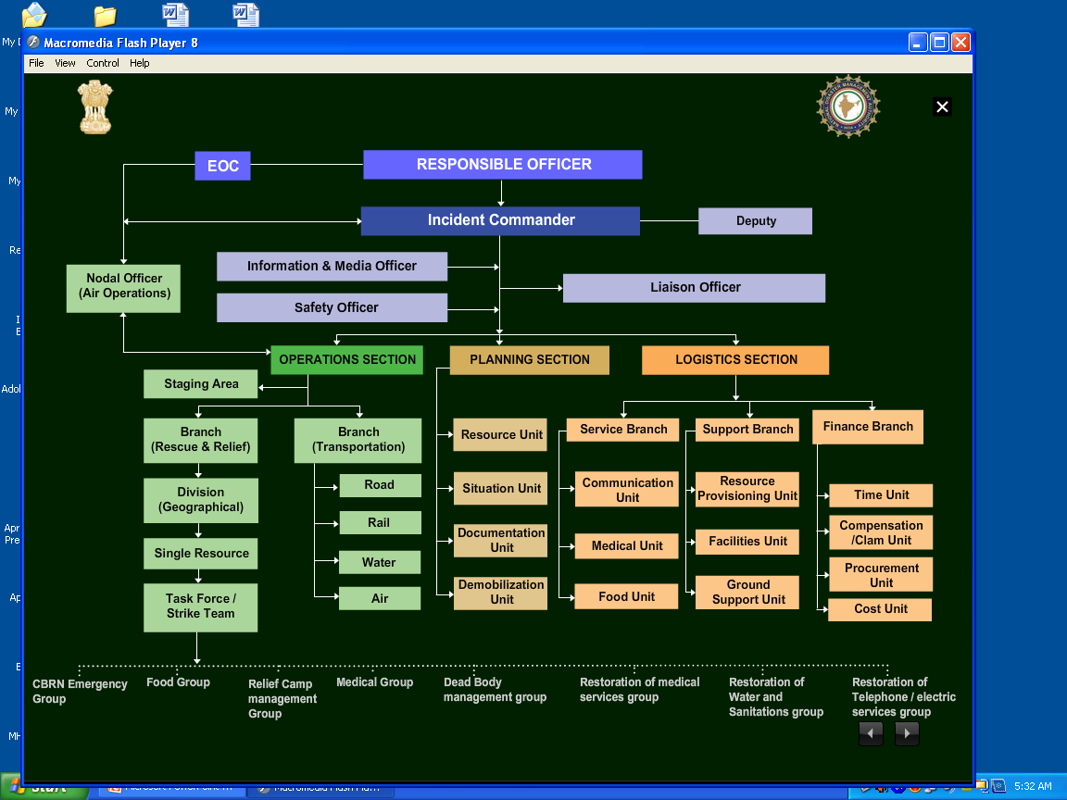



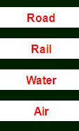

INCIDENT RESPONSE SYSTEM

Slide 41
Now you will be able to:-
Preparing of Scenario.
Briefing before, after and during of exercise,
Roles and responsibilities of stakeholders in disaster management set up in district.
Conduct of table top exercise on designed exercise.
Review

Slide 42
Any Question?

Slide 43


Evaluation
TXE means?
Ans;- Tabletop Exercise

Slide 44


THANK YOU

