Slide 1
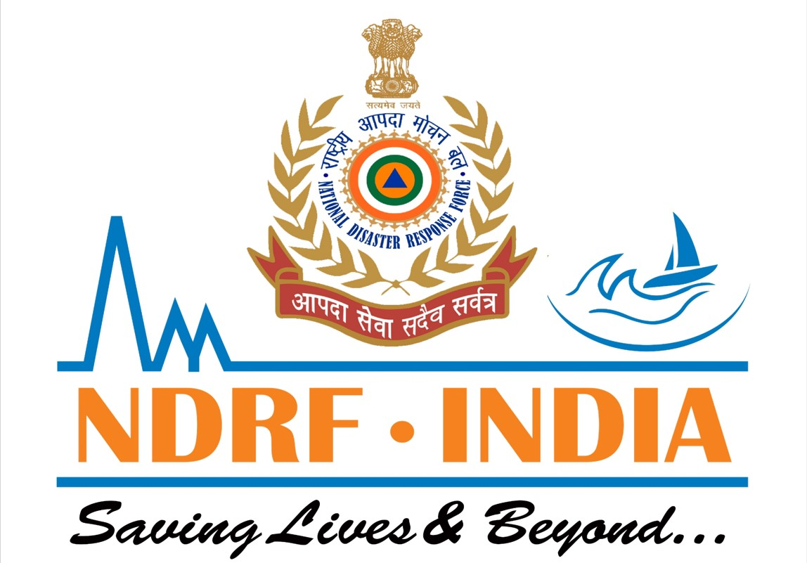



INTRODUCTION TO FIRE
SPREAD DYNAMICS
Presented By:- Sachin Chauhan,2IC
PEER | CSSR | INDIA
PPT 2 -

Slide 2
OBJECTIVES
  Introduction to fire spread dynamics
  Heat transfer mechanisms
  Stages of fire development
  Advanced concepts
Upon completing
of this lesson,
you will be able to :-

Slide 3
INTRODUCTION TO FIRE SPREAD DYNAMICS
Fire spread dynamics refers to the study of how fires ignite, grow, and propagate over time. It involves understanding the interplay of various factors that influence fire behavior, including chemistry, material science, fire science, mechanical engineering, fluid mechanics, and heat transfer.

Slide 4
Understanding fire spread dynamics is crucial for several reasons:-
Fire Safety Engineering: It helps in designing safer buildings, materials, and systems to prevent or mitigate fire incidents.
Risk Assessment: Enables accurate assessment of fire risks in various environments, including urban areas and wildlands.
Fire Prevention and Suppression: Provides insights into developing effective strategies for preventing and controlling fires, and improving firefighting techniques.
Understanding Wildfire Behavior: Helps to understand the behavior of large-scale wildfires, particularly in areas like wildland-urban interfaces.
INTRODUCTION TO FIRE SPREAD DYNAMICS

Slide 5

Several key concepts form the foundation of fire spread dynamics:-
      Fire triangle/tetrahedron.
      Heat transfer mechanisms
      Stages of fire development
      Flame spread
      Smoke
KEY CONCEPTS

Slide 6
Beyond the fundamentals, fire spread dynamics delve into more complex aspects, particularly in the context of large-scale wildfires:
Fuel Preheating Mechanisms: Different heat transfer mechanisms may contribute to fuel preheating depending on the fire environment.
Flame Geometry Transformation: Wind and terrain can significantly modify the flame's characteristics, including its shape and angle, which in turn affect the rate of fire spread.
ADVANCED CONCEPTS

Slide 7
3. Fire line Interaction and Merging: When multiple fire lines burn near each other, they can interact, potentially merging and accelerating fire spread, especially at higher slopes.
4. Transitions to Intense Burning Behaviors: Surface fires can transition into more intense behaviors like crown fires or fire whirls, driven by factors like fuel, wind, and topography interactions.
ADVANCED CONCEPTS

Slide 8
  Introduction to fire spread dynamics
  Heat transfer mechanisms
  Stages of fire development
  Advanced concepts
REVIEW

Slide 9

ANY QUESTION ?

Slide 10
1.What are the key concepts form the foundation of fire spread dynamics ?
Ans-There are 05 key concepts form the foundation of fire spread dynamics, are as under-
      1. Fire triangle/tetrahedron.
      2. Heat transfer mechanisms
      3. Stages of fire development
      4. Flame spread
      5. Smoke
EVALUATION

Slide 11

THANK YOU

