Slide 1




EVACUATION SAR
Presented by:- Amit Kumar, AC
PEER | CSSR | INDIA
PPT 2 -

Slide 2



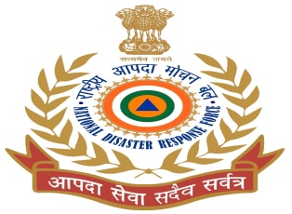
OBJECTIVES
Introduction
Understand the correct techniques to be applied on the casualty
Execute the correct method of carrying the casualty
Demonstrate the necessary safety measures taken to prevent injury to the rescuers
1
2
Upon completing of this lesson, you will be able to :-
3
4

Slide 3




INTRODUCTION
Non-Risky Situation
Package casualties wherever possible.
Evacuate casualties with stretchers
Ensure comfort or minimize the suffering of the casualties
Emergency or Risky Situation
No stretchers or time to construct improvised stretchers.
The casualty must be removed quickly due to potential dangers.
Do not attempt to rescue if your own life is in danger

Slide 4

FACTORS INFLUENCING THE METHODS USED
Methods employed will depend on a combination of the following factors:-
Type and severity of the injuries
Casualty's status
-conscious
- unconscious.
Weight of the casualty
Availability of Rescuers.
e. Distance and Route

Slide 5


GENERALS RULES
Search should commence at the point of the greatest survival rate.
In multi-storey buildings, search should start from the top and work your way down
Common places where casualties are found:-
Near doors
Near windows
At staircases
In the restrooms

Slide 6


Rescue Drag and Carry Techniques
Required to evacuate a sick or injured person from an emergency scene to a location of safety.
Causalities carried carefully and correctly handled, otherwise their injuries may become more serious or possibly fatal.
Situation permitting, evacuation of a causality should be organized and un-hurried.
Each movement should be performed as deliberately and gently as possible.
Manual carries are tiring for the rescuer and involve the risk of increasing the severity of the casualty's injury.
Choose the evacuation techniques that will be least harmful, both to rescuer and the victim.

Slide 7

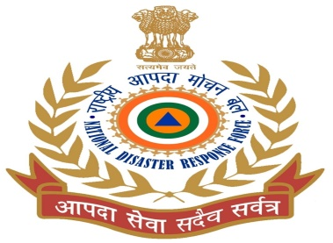
SAFETY PRECAUTIONS
Always work in pairs
Ensure the proper placement of your feet for the selected techniques - to prevent falling.
The correct method of lifting and gripping must be followed.
Put on safety gears
Bring along a torch
Ensure that the method selected does not suffocate or cause further injury to the casualty.
Do not drop the casualty.
Squat down to Lift casualty instead of bending body down

Slide 8


Ground Level Rescue/Evacuation

Slide 9


One Rescuer Evacuation Techniques

Slide 10


One Rescuer Methods
Ankle Pull
Shoulder Pull
Blanket Drag
Cradle Method (One person Arm Carry)
Fireman Lift (Firefighters carry)
Fore Method
Backward Drag
Human Crutch
Pack-Strap Carry (Piggy Back Carry)
Tied Hands Crawl

Slide 11


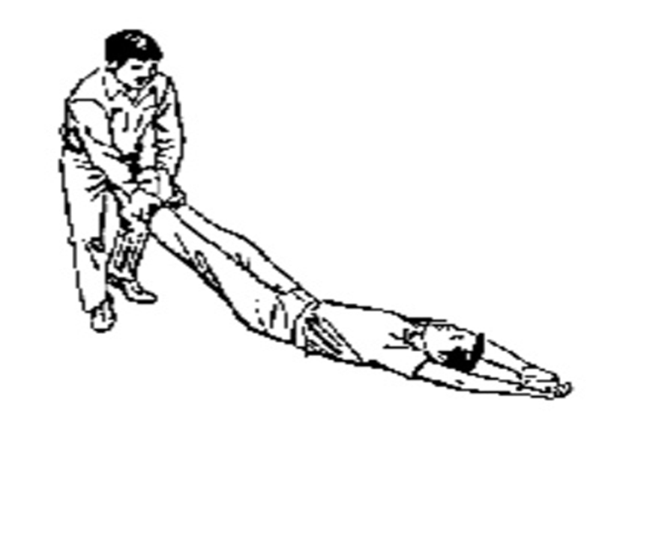
Ankle Pull
The ankle pull is the fastest method for moving a victim a short distance over a smooth surface.
This is not a preferred method of patient movement.
Grasp the victim by both ankles or pant cuffs.
Pull with your legs, not your back.
Keep your back as straight as possible.
Try to keep the pull as straight and in-line as possible.
Keep aware that the head is unsupported and may bounce over bumps imperfections. and surface

Slide 12
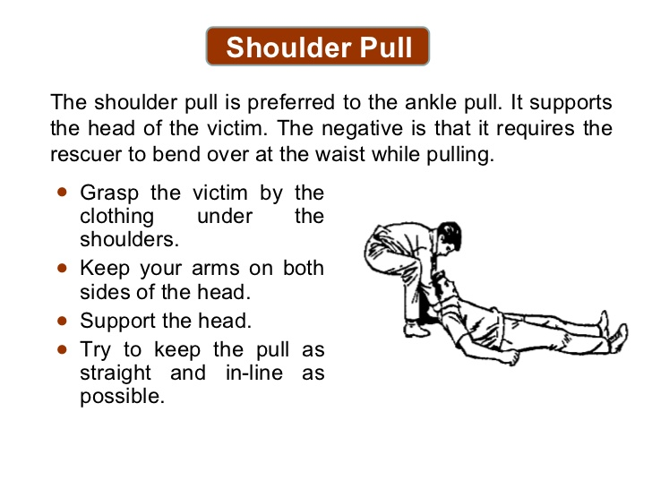

Slide 13
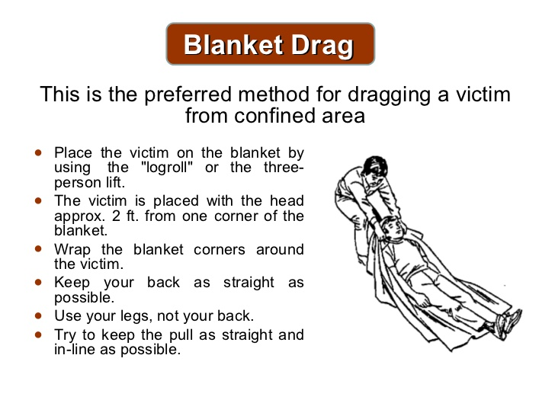

Slide 14

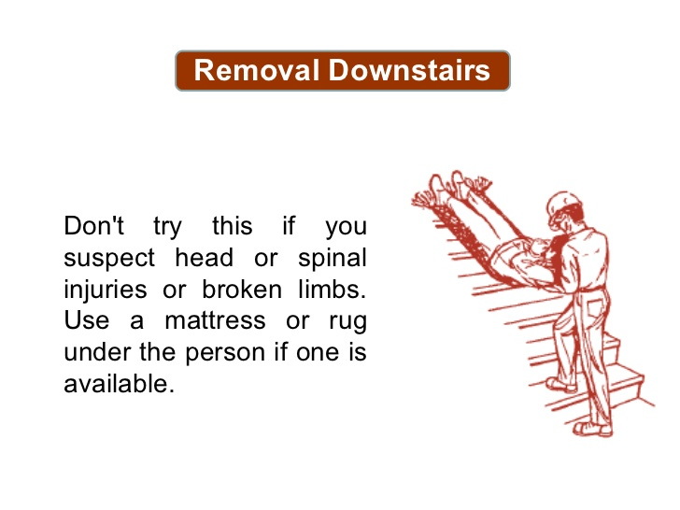

Slide 15
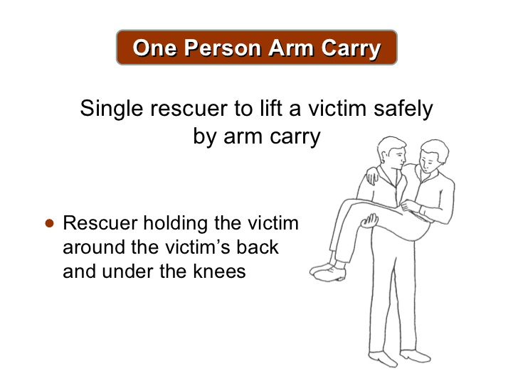
One Person Lift (Cradle Method)
This only works with a child or a very light person.

Slide 16


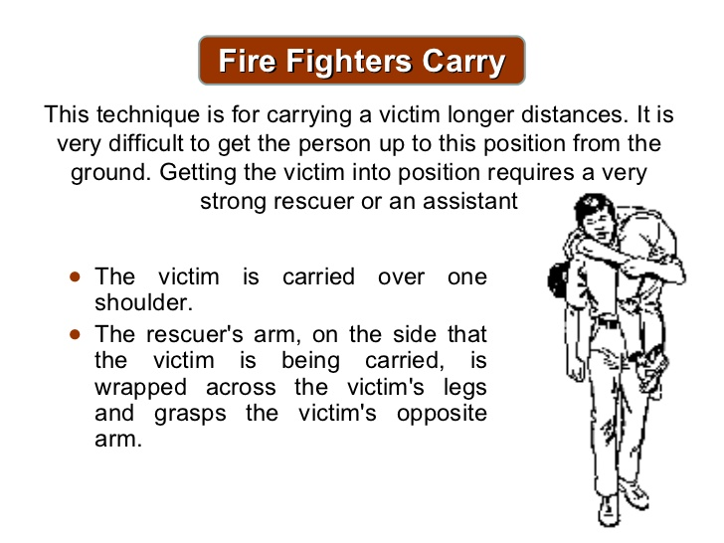
Fireman Lift
This technique is for carrying a victim longer distances. It is very difficult to get the person up to this position from the ground. Getting the victim into position requires a very strong rescuer or an assistant.
The victim is carried over one shoulder.
The rescuer's arm, on the side that the victim is being carried, is wrapped across the victim's legs and grasps the victim's opposite arm.

Slide 17
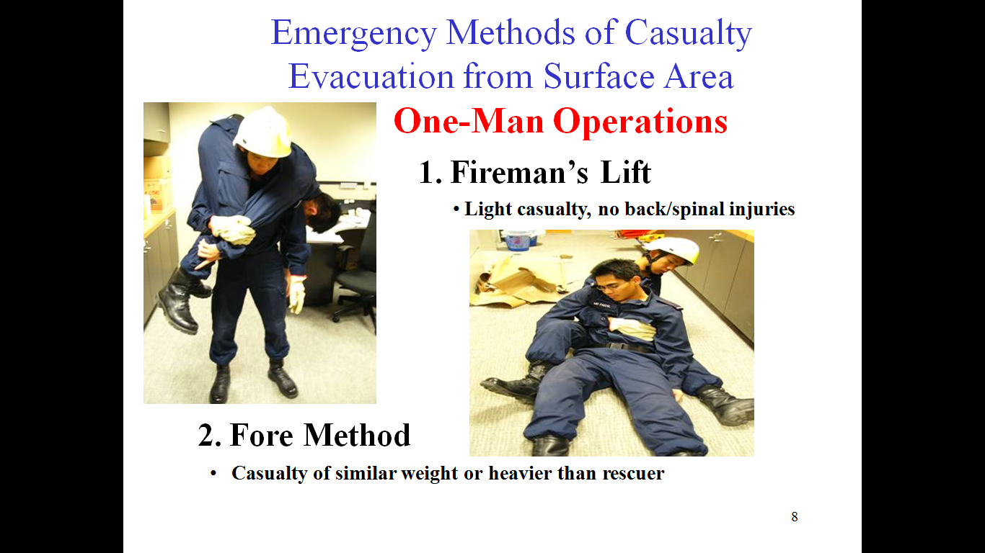

Slide 18
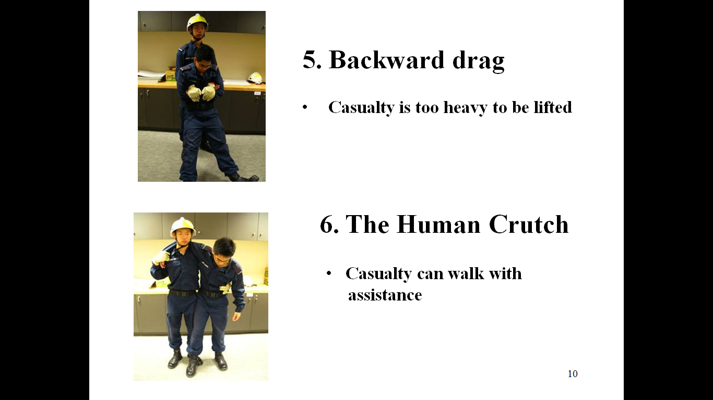

Slide 19

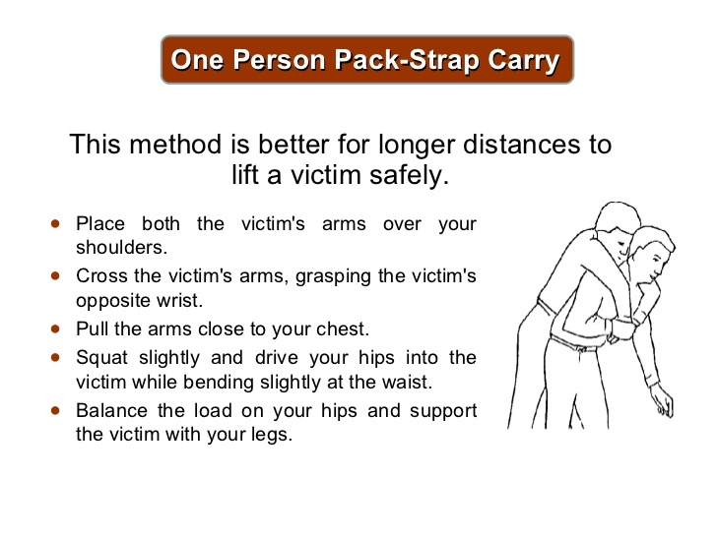
Pack Strap Carry (Piggy Back carry)

Slide 20


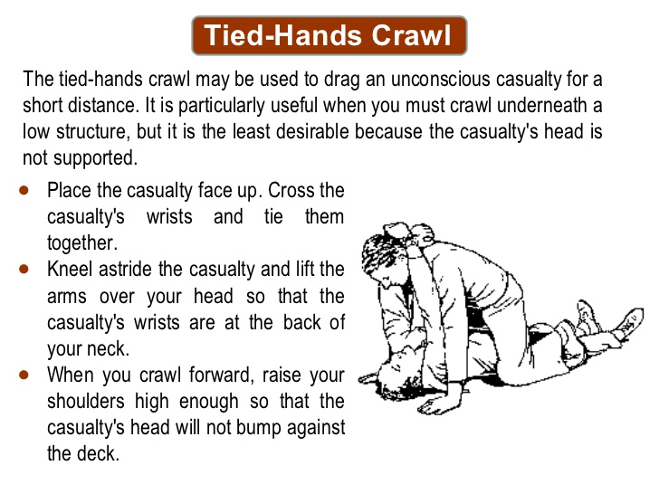
The tied-hands crawl may be used to drag an unconscious casualty for a short distance. It is particularly useful when you must crawl underneath a low structure, but it is the least desirable because the casualty's head is not supported.
Place the casualty face up. Cross the casualty's wrists and tie them together.
Kneel astride the casualty and lift the arms over your head so that the casualty's wrists are at the back of your neck.
When you crawl forward, raise your shoulders high enough so that the casualty's head will not bump against the deck.
Tied-Hands Craw

Slide 21
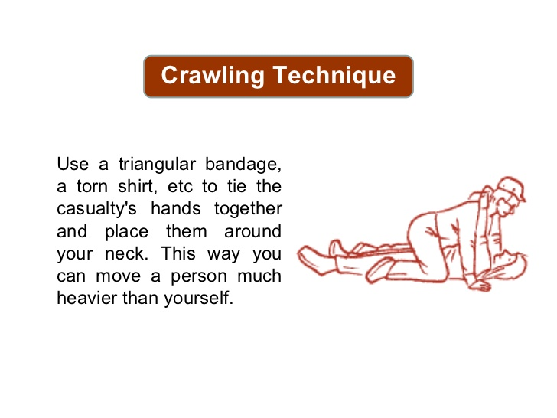
Crawling techniques
Use a triangular bandage, a torn shirt, etc to tie the casualty’s hands together and place them around your neck this ways you can move a person much heavier than yourself.

Slide 22


Two Rescuer Evacuation Techniques

Slide 23
Two Rescuer Methods
Two Rescuer Human Crutch
Two Handed Seat
Three Handed Seat
Four Handed Seat
The Fore and Aft Method
Chair Carry

Slide 24
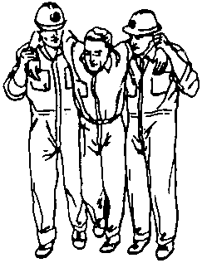
Two Rescuer Human Crutch
Similar to the one rescuer human crutch, except that the casualty is supported on both sides.
The arms of the rescuers cross over on the casualty's back and grasp the clothing on the opposite sides of his body.

Slide 25
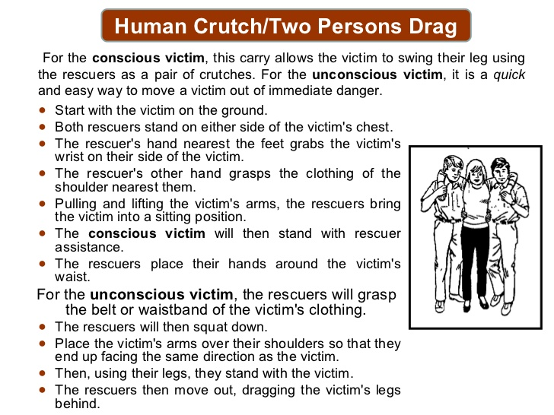
Two Rescuer Human Crutch

Slide 26


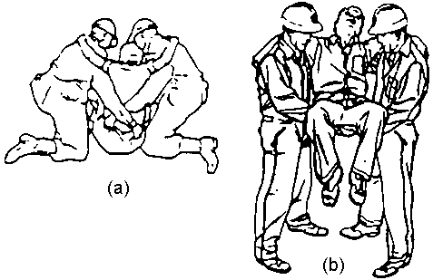
Two Handed Seat
Rescuers kneel on either side of the casualty, get him into a sitting position, place one arm under his knees and link up with the hand to wrist grip. Their free arms are then crossed over the casualty's back, where they get a firm grip on his clothing.
The leader should give the normal orders for lifting and lowering.

Slide 27
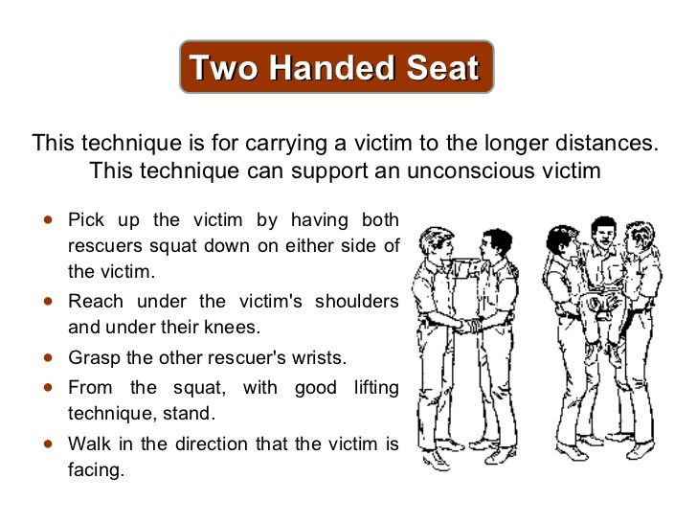


Slide 28

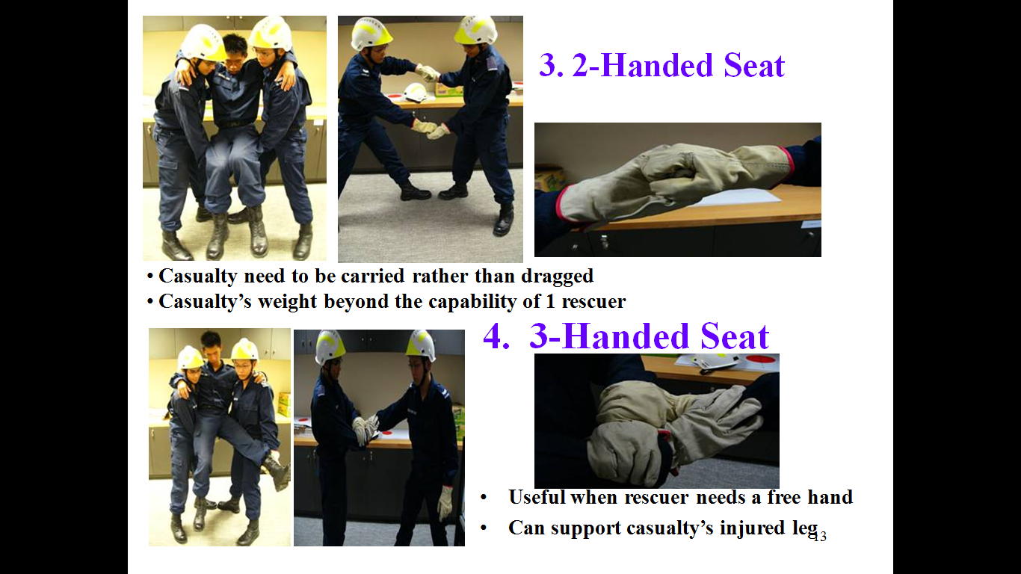

Slide 29

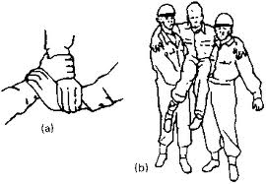
Three Hand Seat Method
This method gives the casualty good support and is reasonably comfortable for the rescuers. It has the added advantage that the two rescuer team has a spare hand for steadying.
One rescuer grasps his left wrist with his right hand and the second rescuer places his hand and wrist as shown in Figure. This forms a seat. If the casualty is capable of standing for a short period he can be loaded by placing the seat under his buttocks, but if not, the rescuers' hands must be placed under the casualty's knees first and then joined up.

Slide 30
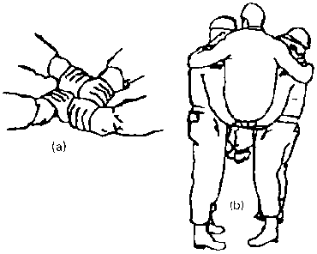
Four Hand Seat Method
This is a method where each rescuer grasps their left wrist and the hands are joined up as in Figure.
This provides a comfortable seat for the casualty and places a minimum strain on the rescuers. However, as can be seen in Figure the casualty must be sufficiently conscious to hold on.

Slide 31
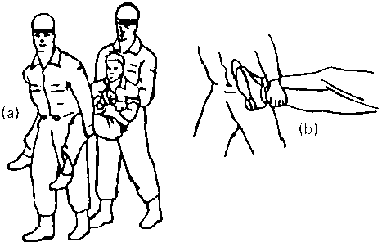
The Fore and Aft Method
This is perhaps the most suitable way in which two rescuers can handle an unconscious casualty.
The casualty’s wrists are tied together. The first rescuer stoops at the rear of the casualty. Reaching under the casualty's arms, the first rescuer grips the casualty's wrists. The second rescuer stoops between the casualty's legs grasping them underneath the knees. The standard lift orders are given and the casualty is lifted to the carrying position.

Slide 32
The Fore and Aft Method
Should the casualty have a leg injury, the effects of this can be minimized by the front rescuer crossing the casualty's legs over, then carrying them to one side.
The advantage of this method is that the rescuer supporting the casualty's feet has a free hand with which to open doors, clear debris, etc.

Slide 33
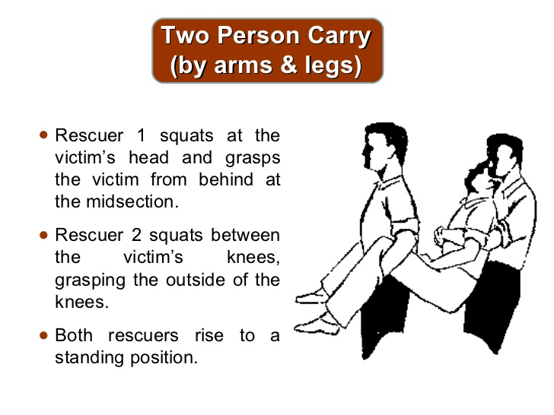
The Fore and Aft Method

Slide 34
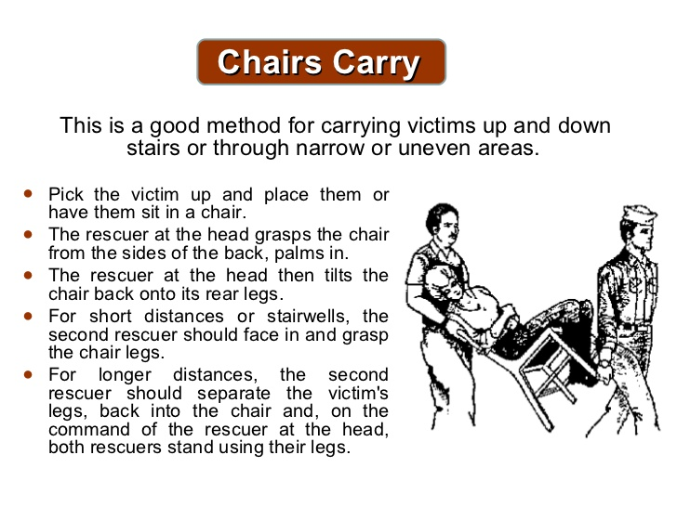

Slide 35

Chair Carry
The chair used should be a sturdy one.
Don't use aluminum beach chairs or folding chairs.
Chairs with wheels can be used to roll the victim, but should not be used for a carry.

Slide 36
Three or More Rescuers Evacuation Techniques

Slide 37


Three or more Rescuer Methods
Hammock Carry
Three Person carry (Three person Stretcher Carry)

Slide 38
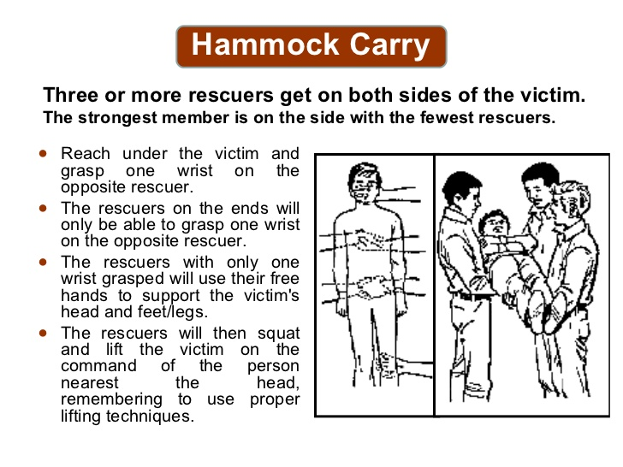

Slide 39


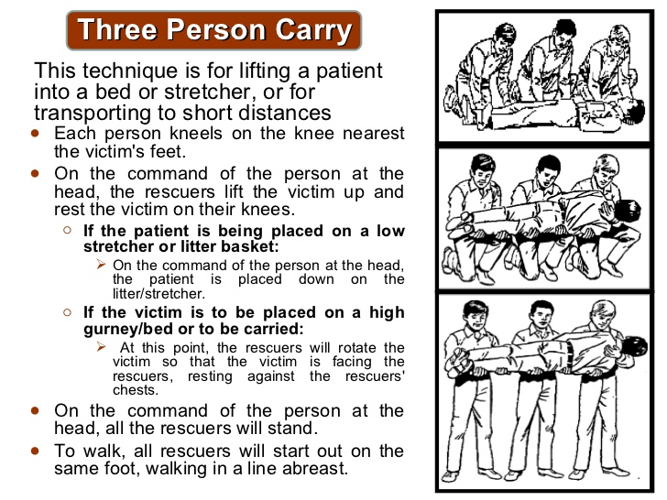

Slide 40
Emergency Stretchers

Slide 41
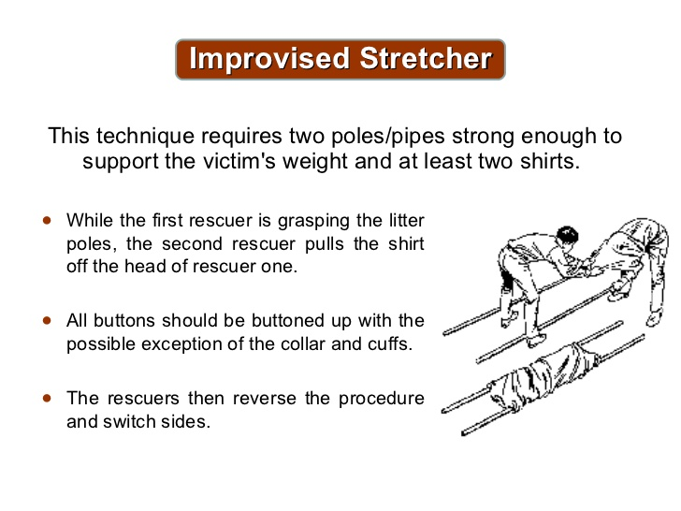



Slide 42
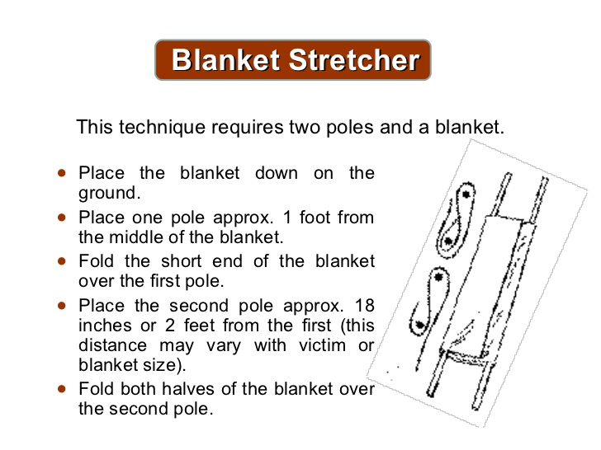

Slide 43

REVIEW
Now you will be able to know :-
Introduction
Understand the correct techniques to be applied on the casualty
Execute the correct method of carrying the casualty
Demonstrate the necessary safety measures taken to prevent injury to the rescuers

Slide 44
Any Question.

Slide 45


Evaluation
How many types of methods in the fire Rescue?
Ans :- 02

Slide 46


THANK YOU

